Slide 1
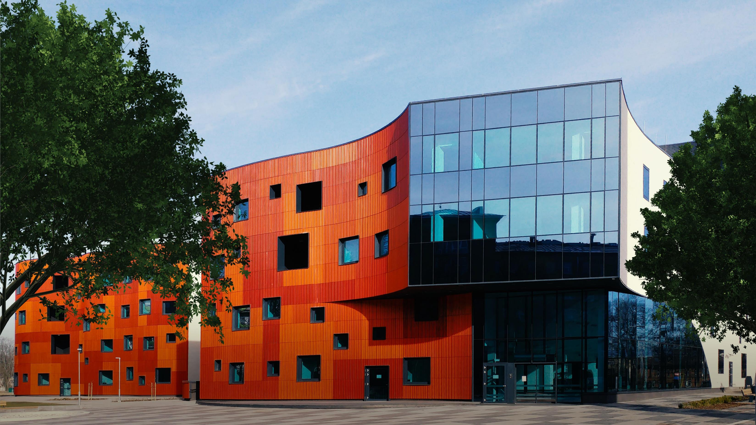
HEALTH
TOURISM IN LATVIA

Slide 2
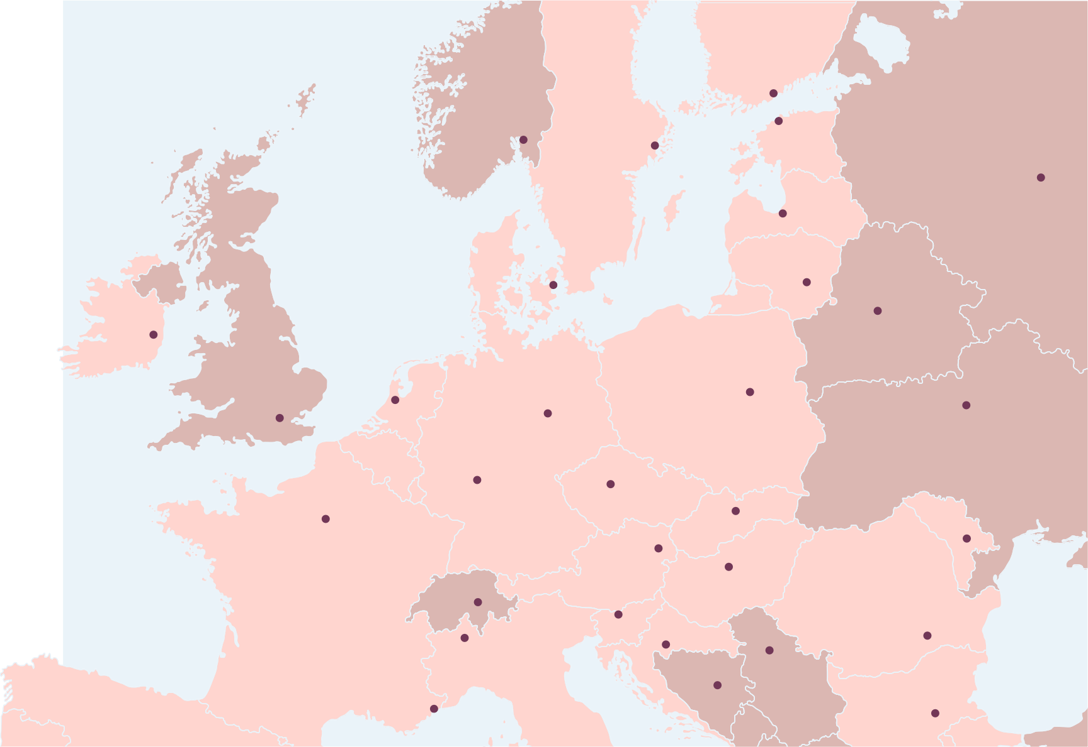
Helsinki
Accessibility of Latvia
Stockholm
Tallinn
Oslo
3h flight
2h flight
1,5h flight
Riga
Copenhagen
Vilnius
Dublin
Europe
Less than 3 hours away from the majority of European capitals
London
Berlin
Warsaw
Amsterdam
Frankfurt
Prague
Bratislava
Paris
Vienna
Chisinau
Budapest
Bern
Ljubljana
Zagreb
Bucharest
Milan
Belgrade Sarajevo
Monaco
Sofia

Slide 3










Riga - home of airBaltic
Closest destinations from Riga International Airport
The capital Riga is only 9km away while the resort city Jurmala is in 15km distance
Air traffic hub for Baltics
More than 100 direct flights
Baltic Sea
airBaltic codeshare partners:
Jurmala
15km
Riga International Airport
Riga City Center
9km

Slide 4
The top reasons why you should choose Latvia for medical treatment
Latvia’s health clinics and hospitals can offer patients quality diagnostic and healthcare services, combining the experience of doctors with the latest technologies and high standards

Slide 5
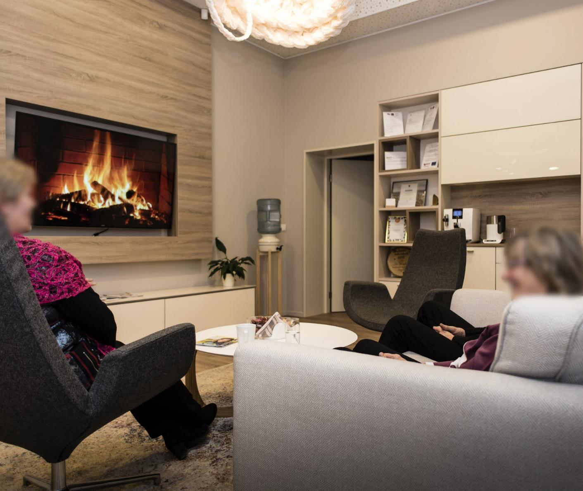
Quality
and personal care
The healthcare available in Latvia corresponds to the highest level offered by the world’s leading clinics.
The very best opportunity for each patient

Slide 6
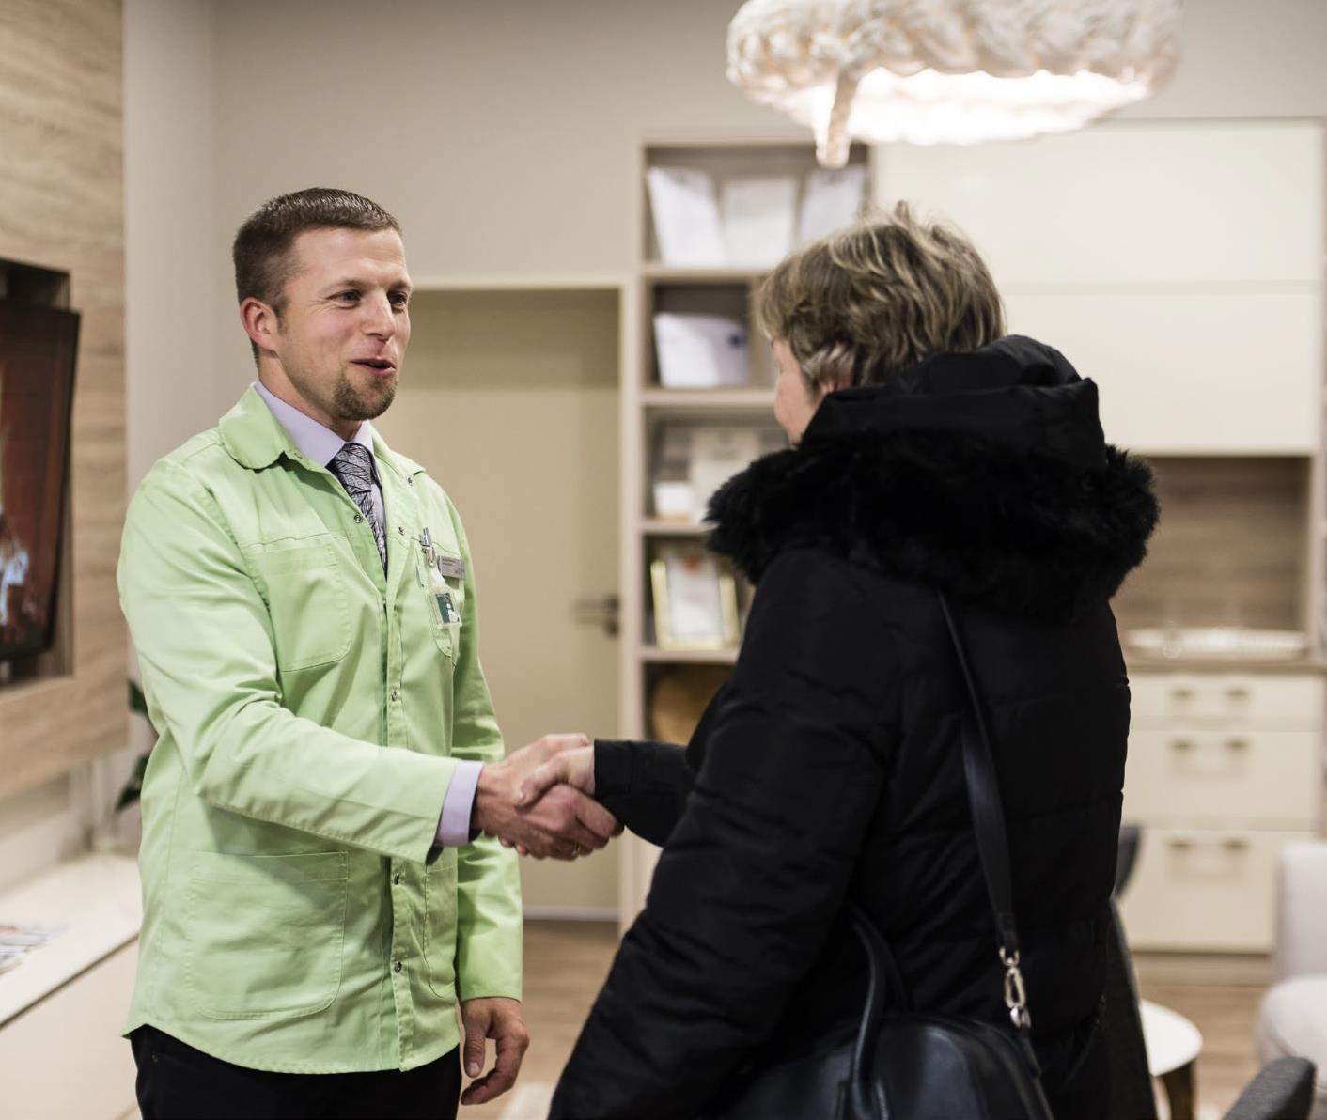
Availability
The date of consultations and operations can usually be arranged within the next two weeks, sometimes earlier. Examinations are available with no waiting lists in accordance with a carefully planned schedule.
Our doctors are ready to meet patients on weekends, if arranged

Slide 7
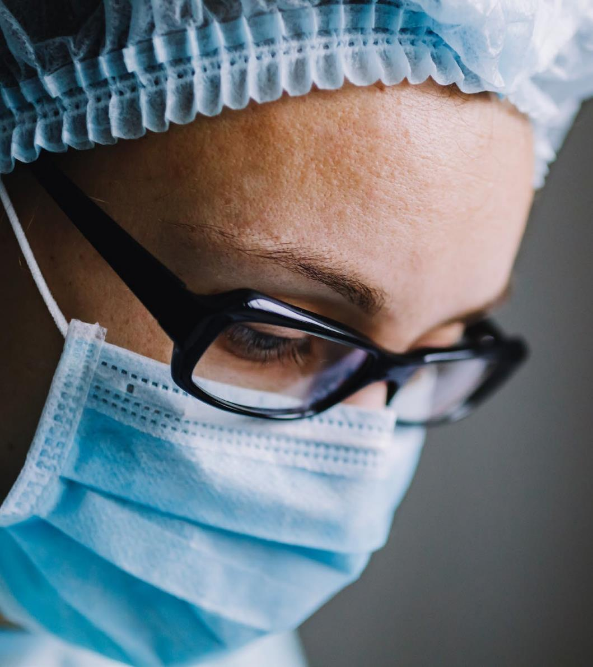
Professional knowledge
The education of Latvia’s specialists corresponds to the highest international standards and the country’s top medical practitioners regularly continue their further education, thus mastering the latest healthcare practices.
Expertise, as well as the newest treatment methods

Slide 8
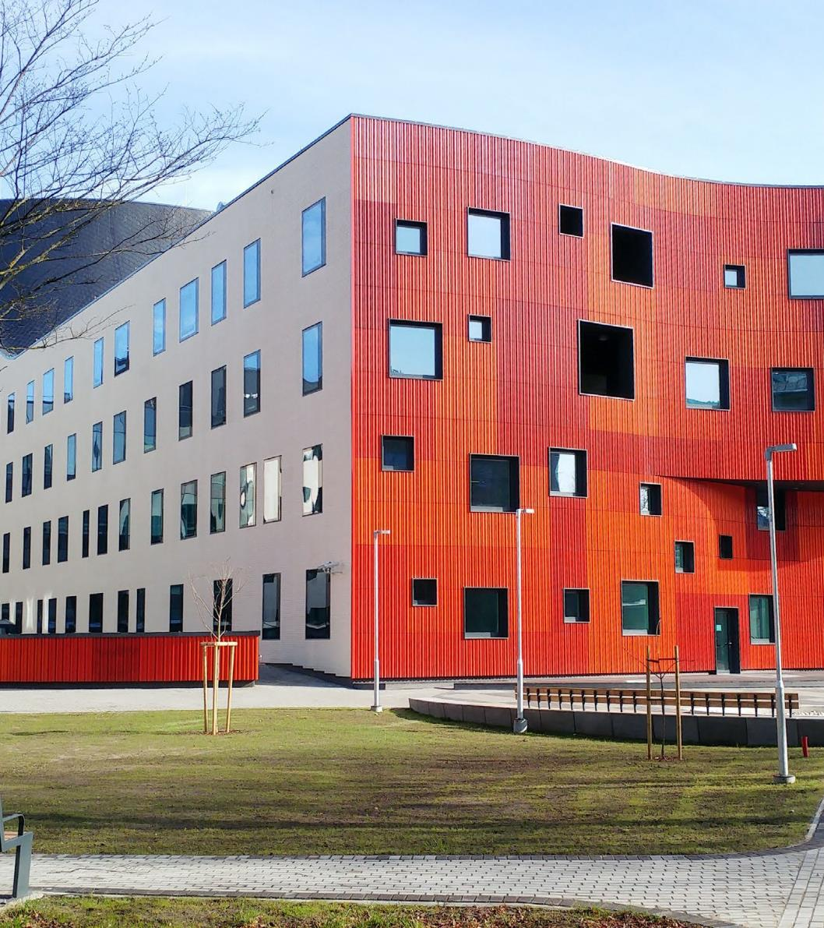
Safety and EU quality standards
The infrastructure, environment and work organisation at Latvia’s clinics correspond to Europe’s best patient care standards. The country’s state-of-the-art healthcare institutions conduct sterilised procedures according to the highest EU quality standards. These clinics have received ISO quality certificates.
International quality standards

Slide 9
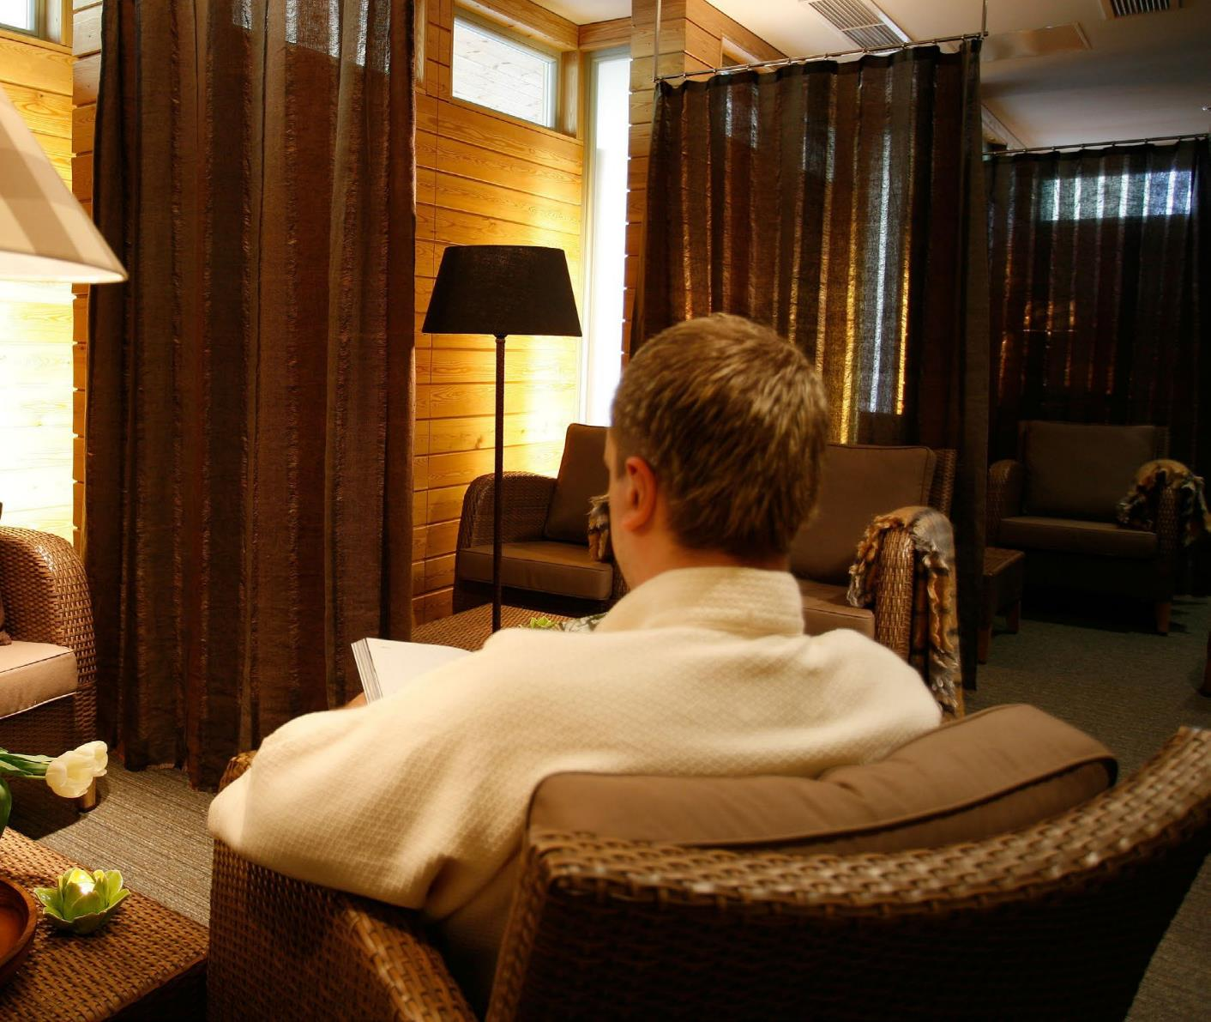
Privacy
Professional ethics and patient safety are the cornerstones of our professionalism. We guarantee absolute confidentiality, meeting EU requirements in relation to personal data protection.
We guarantee absolute confidentiality

Slide 10
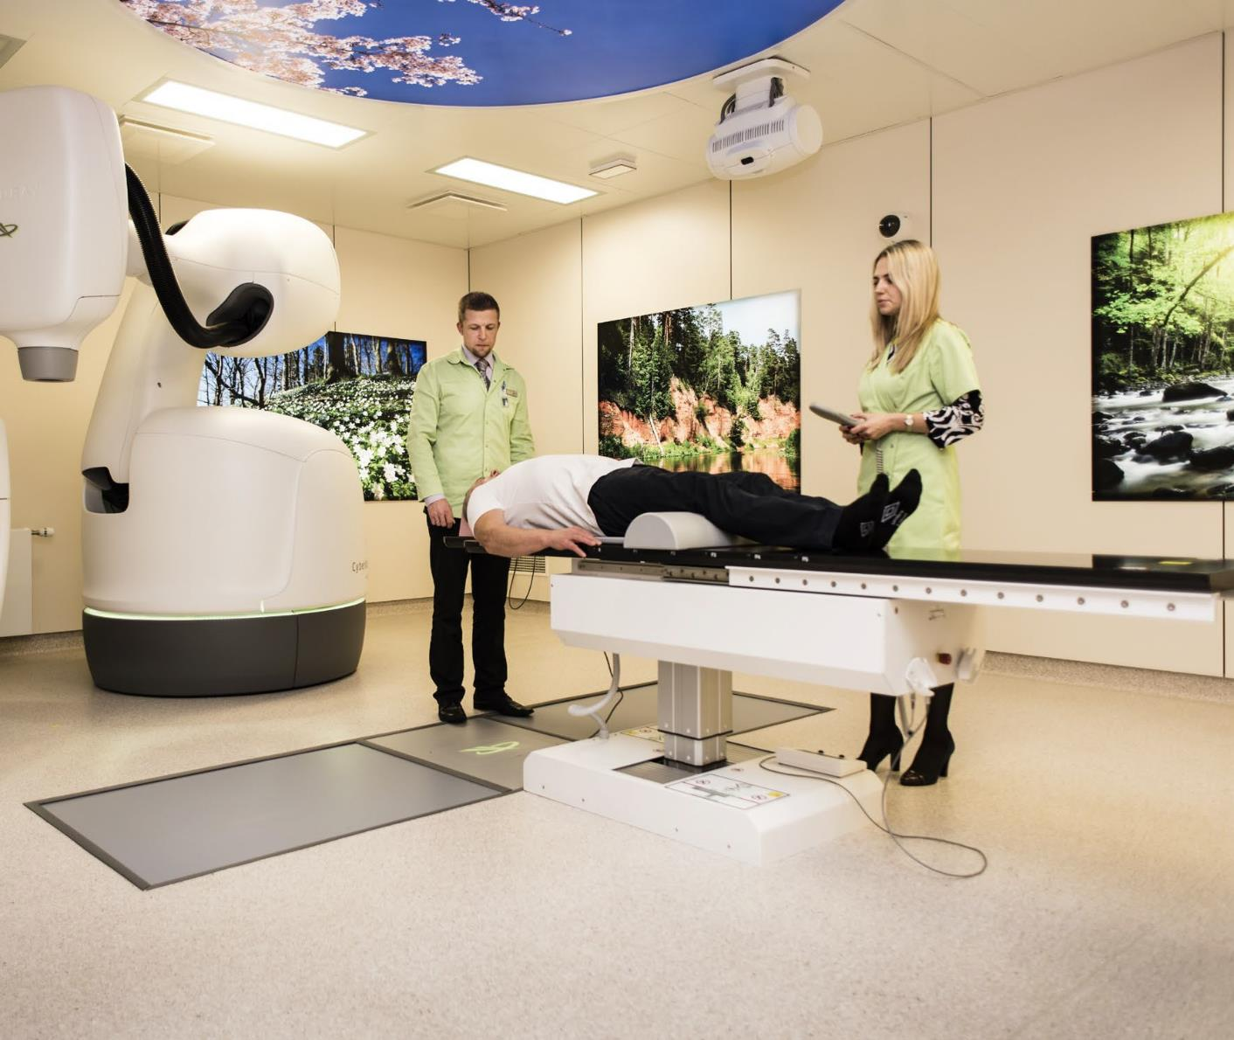
Technology
Latvia’s clinics are continually introducing cutting edge technologies that are widely acclaimed within the international medical community. Latvia’s clinics offer innovative treatment methods, which guarantee the most effective results possible.
Cutting edge technologies

Slide 11

No language barriers
Latvia’s specialists communicate fluently in several foreign languages including English, Russian, French and German.
Latvian specialists are vastly experienced
in working with
foreign patients

Slide 12
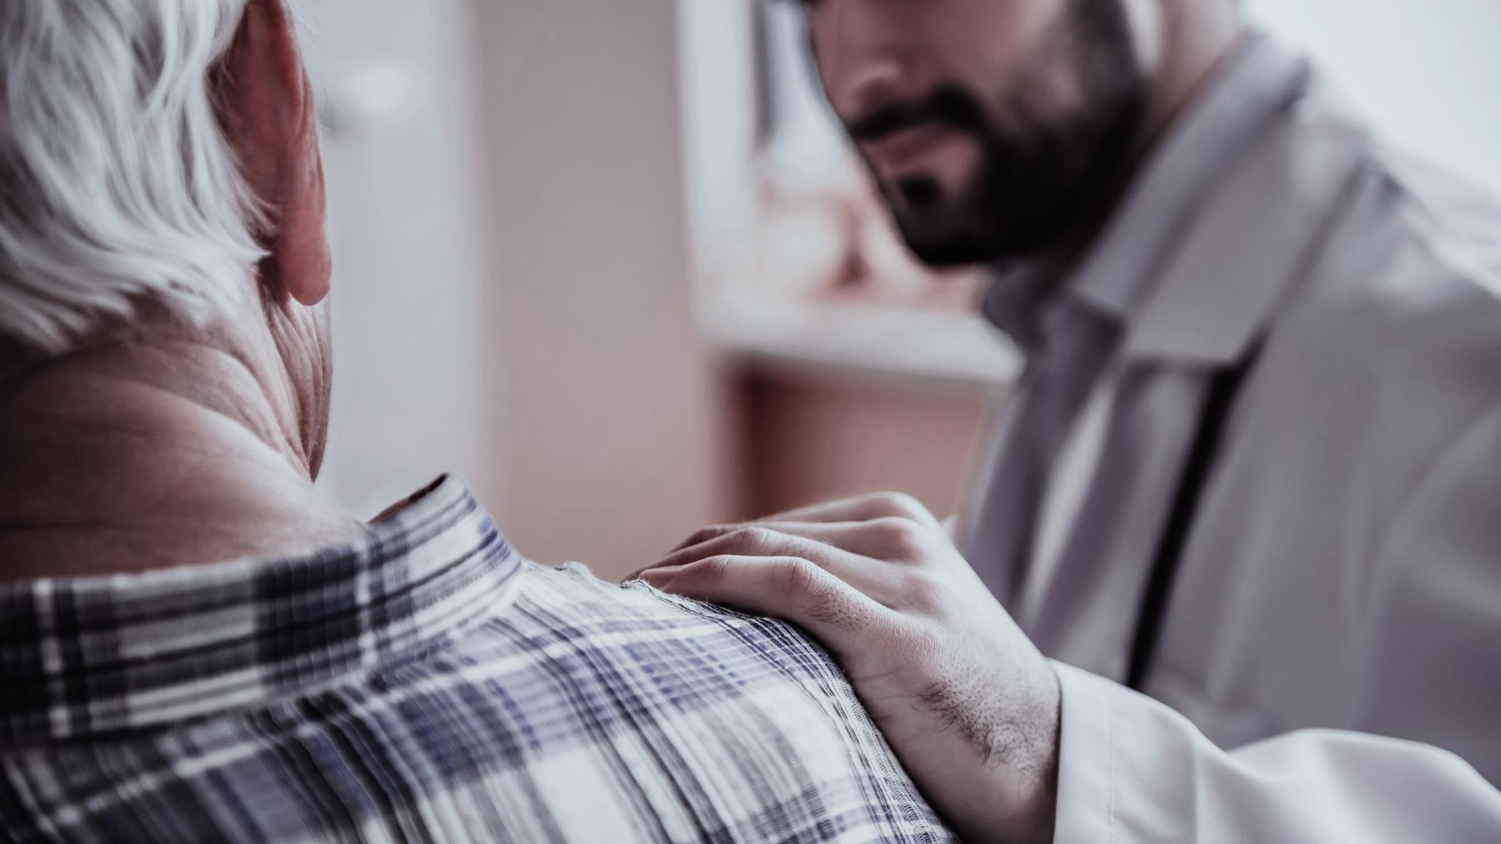
TREATMENTS

Slide 13
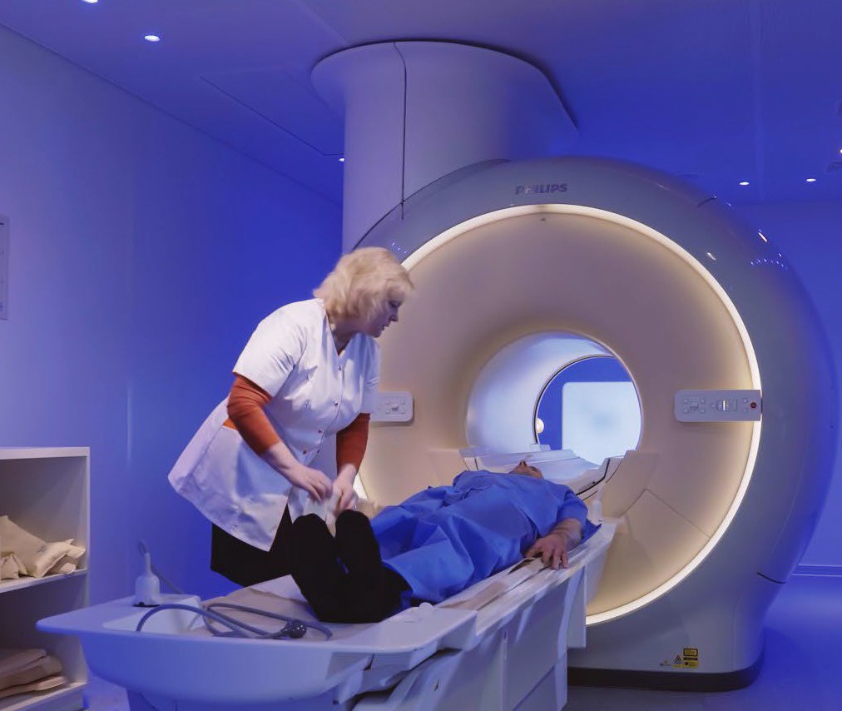

Diagnostics
Latvia’s clinics offer medical imaging, endoscopies, functional and invasive diagnostics, tests and check-up packages. Some screening programmes consisting of two to four procedures can be completed within just a few hours. Patients receive European quality at
affordable rates.
https://healthtravellatvia.lv/en/service/diagnostics/

Slide 14
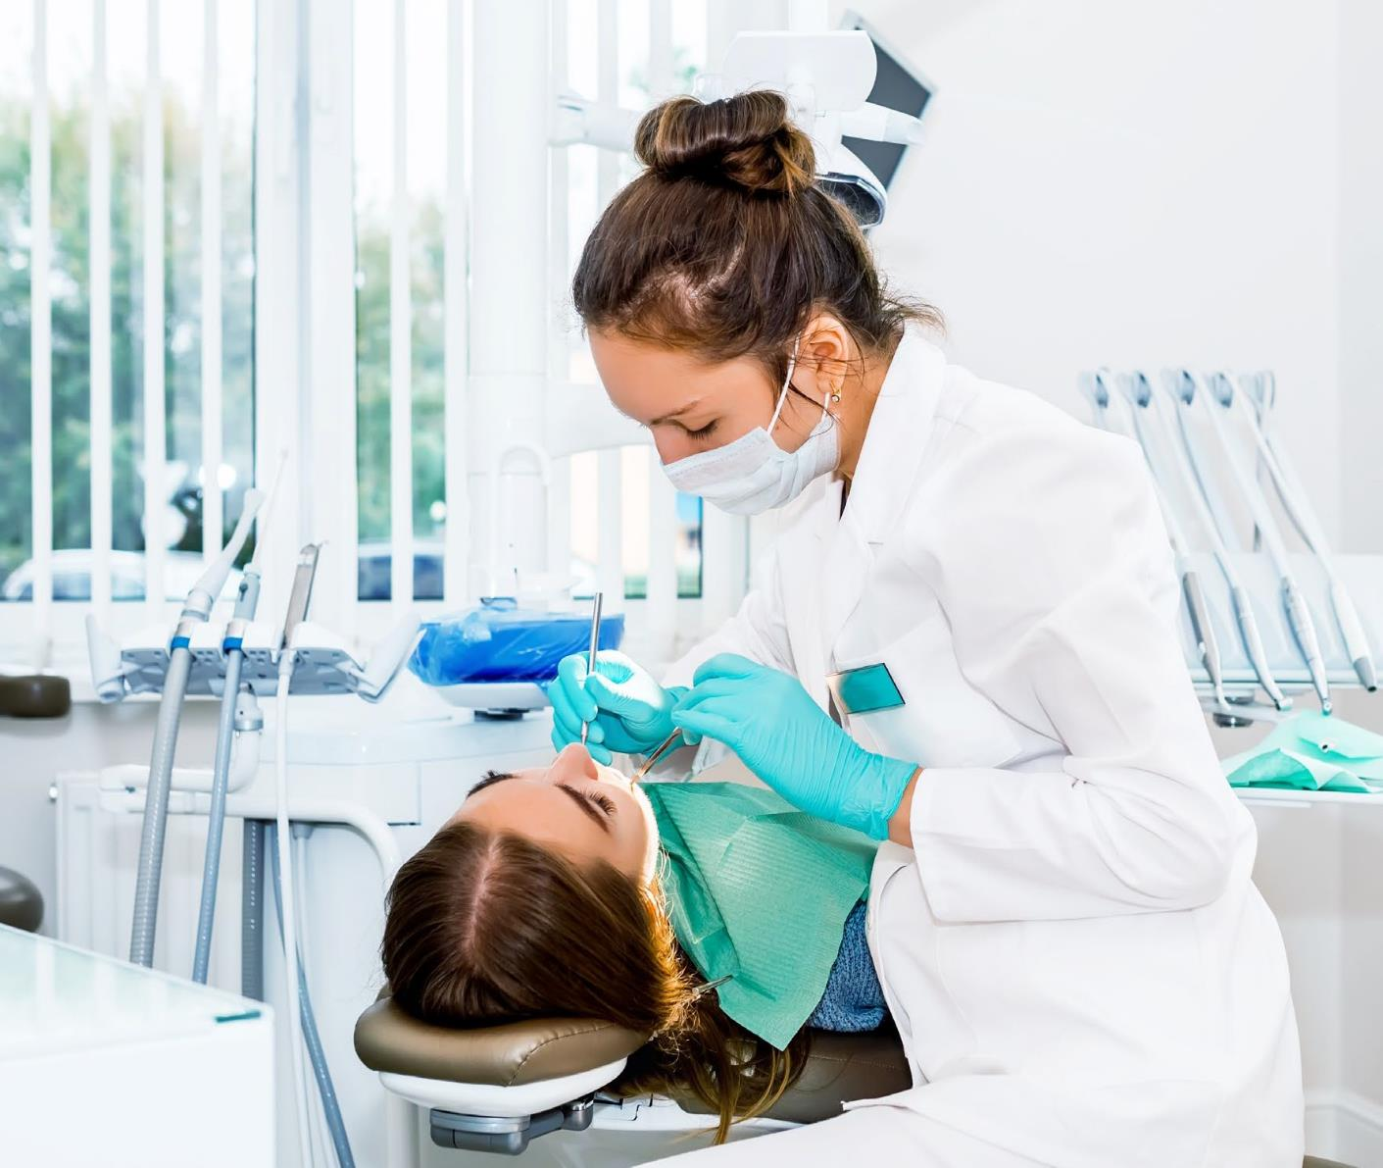

Dentistry
Visits to a hygienist, dentist, surgeon, implantologist and prosthetologist can be arranged within a short time of one another. The highly qualified specialists have interned at German, Swiss and American clinics and regularly participate in international congresses, conferences and seminars to enhance their knowledge.
https://healthtravellatvia.lv/en/service/dentistry/

Slide 15
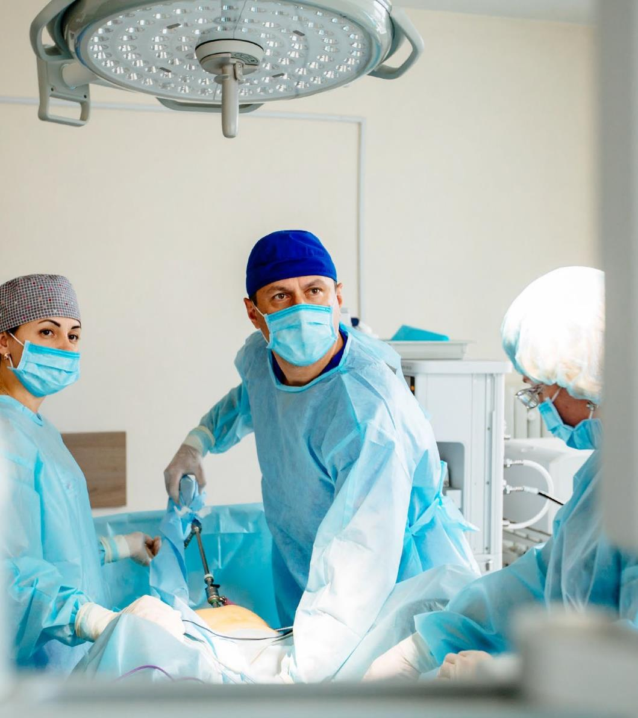

IVF and fertility
Latvia’s clinics have a success rate of well over 50%. In patients up to 30 years of age, fertilisation is successful in over 70% of cases, which is one of the best results in Europe. Latvia is home to the only reproductive genetics laboratory in Northern Europe where tests can be conducted at the embryonic stage, allowing to identify genetic illnesses.
https://healthtravellatvia.lv/en/service/ivf_fertility/

Slide 16
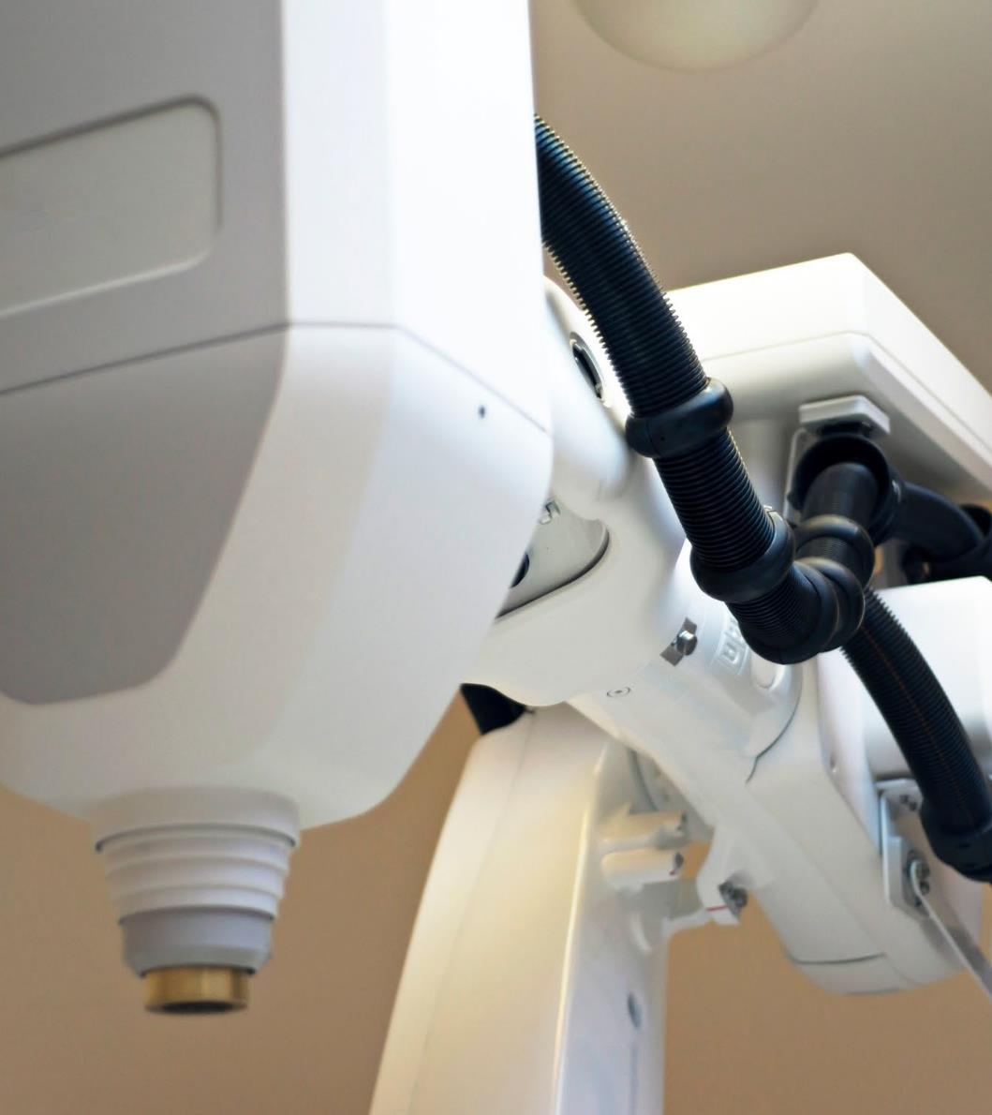

Oncology
Latvia has over 70 years of experience in the research and treatment of oncological diseases, which ensures specialists are very thoroughly trained. Thanks to their level of expertise, access to modern equipment and methods, Latvian oncology specialists are some of the best in Europe.
https://healthtravellatvia.lv/en/service/cancer/

Slide 17
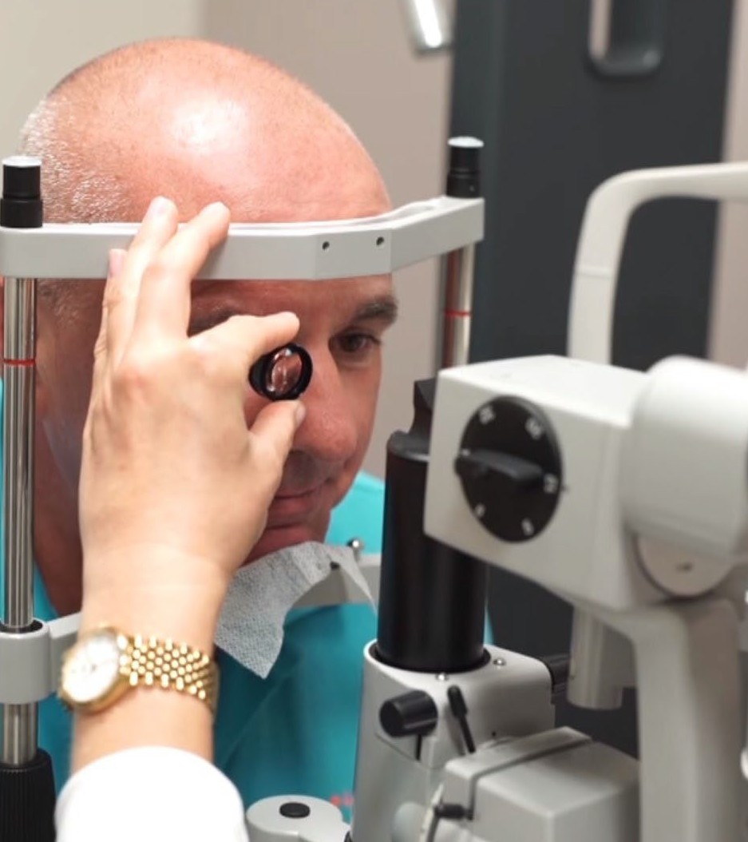

Ophthalmology
The state-of-the-art equipment in Latvia’s clinics and experienced staff comply with European and American quality standards. Latvia’s ophthalmologists regularly attend international training and experience exchange programmes in the USA, the UK, Austria, India, Germany, Denmark, Sweden and other countries to be able to apply the most progressive treatments.
https://healthtravellatvia.lv/en/service/vision/

Slide 18
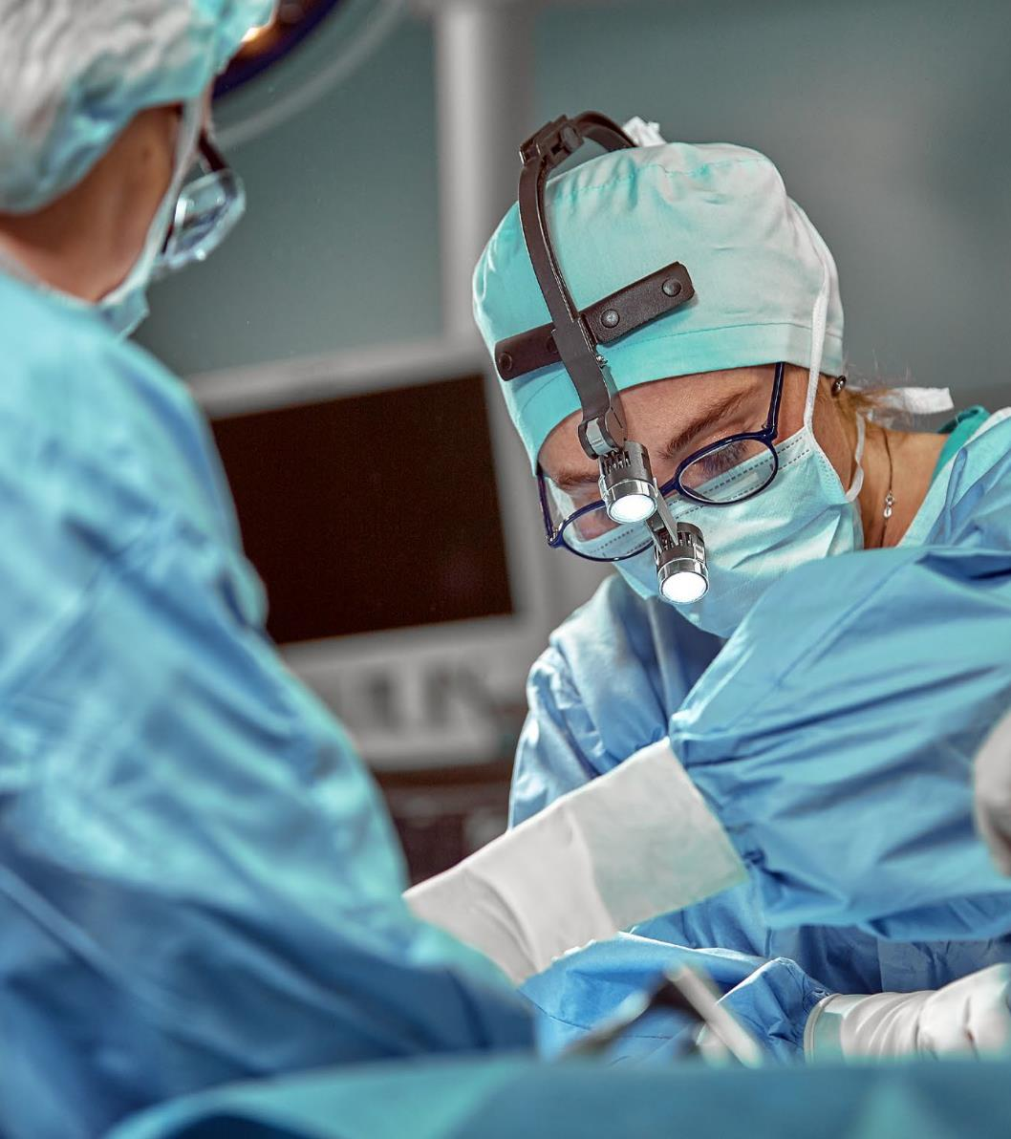

Reconstructive surgery
Latvia’s leading plastic surgeons are internationally acclaimed and their reconstructive work has been showcased at global congresses. They give lectures abroad and belong to leading industry associations including the International Confederation for Plastic Reconstructive and Aesthetic Surgery (IPRAS), the American Society for Aesthetic Plastic Surgery (ASAPS) and European Society for Laser Aesthetic Surgery (ESLAS).
https://healthtravellatvia.lv/en/service/reconstructive-surgery/

Slide 19
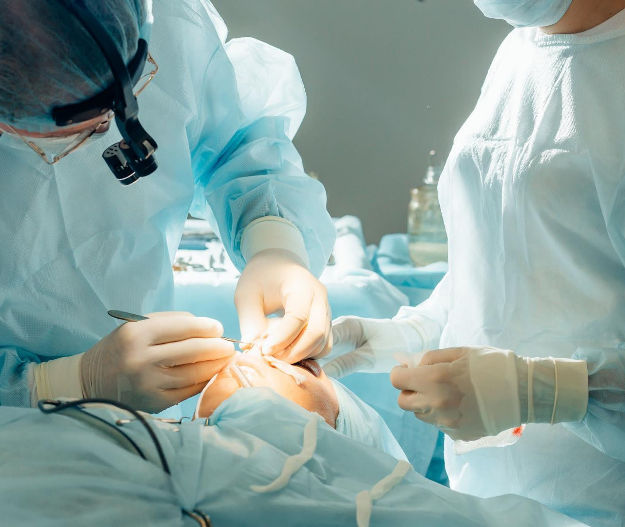

Plastic surgery
Latvia’s surgeons have attained their education and internships at the best Western medical universities and clinics.
Personal responsibility and uncompromising standards of excellence. Clinics provide unique operating and recovery conditions that guarantee maximum aesthetic outcome and absolute confidentiality.
https://healthtravellatvia.lv/en/service/plastic-surgery/

Slide 20
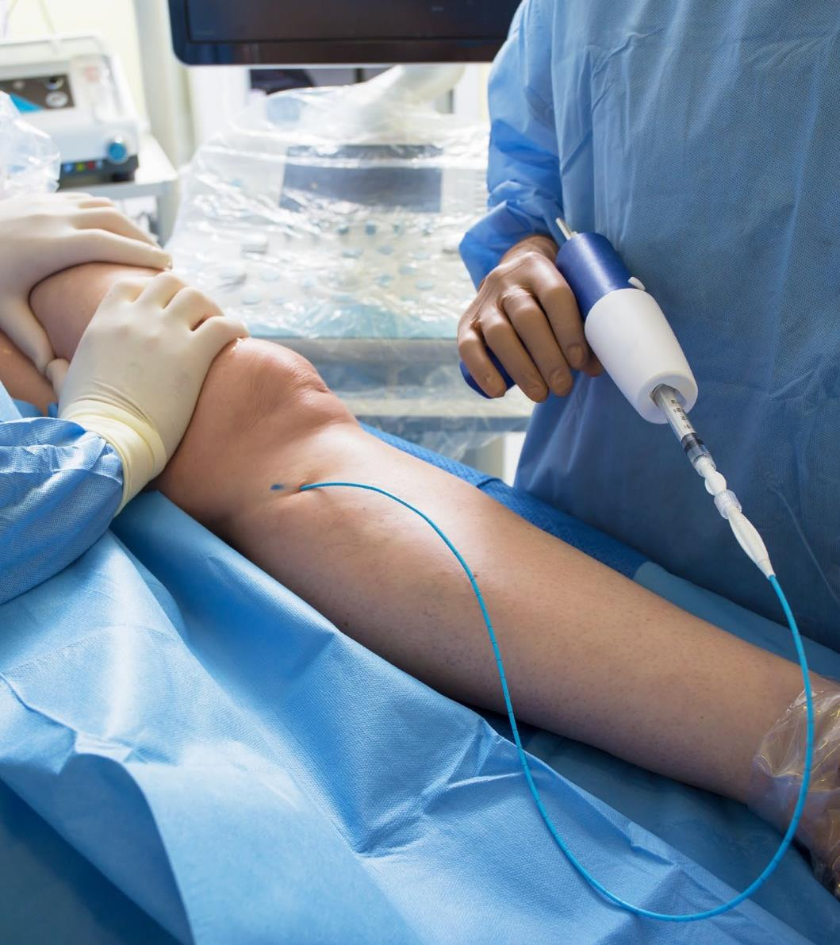

Phlebology and proctology
In Latvia we are offering worldwide- recognised treatment using all the modern methods that are currently in use around the world along with combinations of these methods to achieve the best results. Clinics are equipped with
state-of-the-art equipment.
https://healthtravellatvia.lv/en/service/vein-treatment/

Slide 21
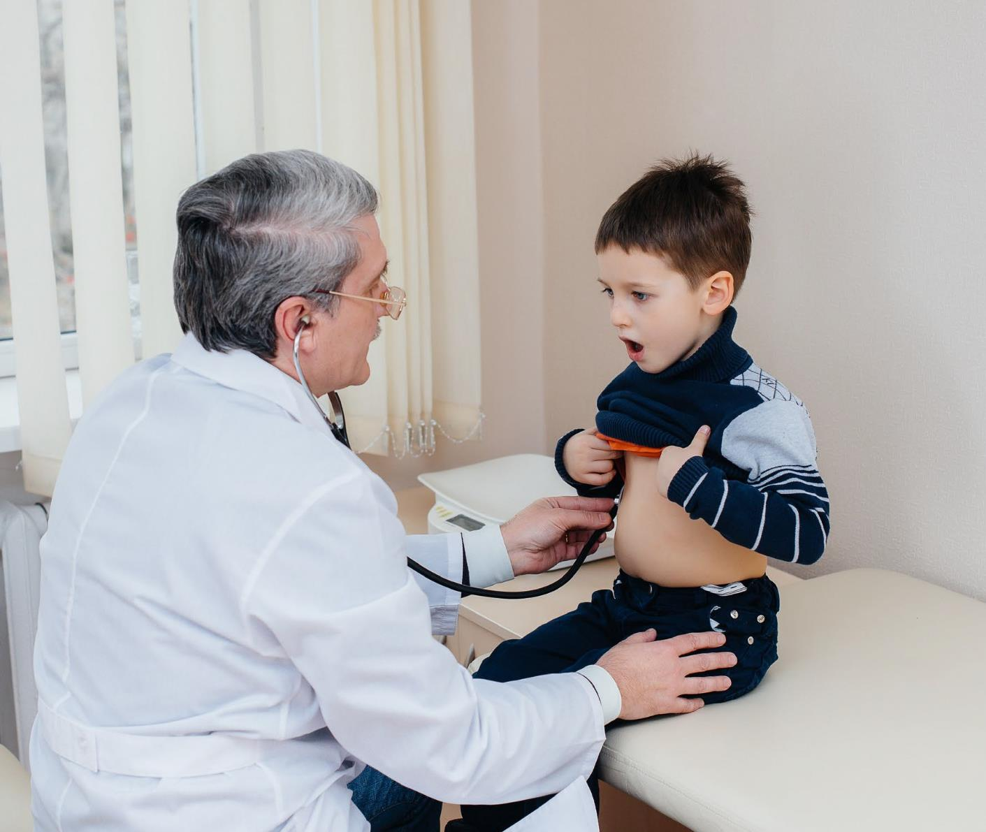

Paediatrics
Most doctors working with childrens consider their work to be not just a service, but a mission.
Doctors are educated and do internships abroad and in some sectors, such as cardio surgery, conduct complex world-class operations, in collaboration with foreign doctors.
https://healthtravellatvia.lv/en/service/pediatrics/

Slide 22
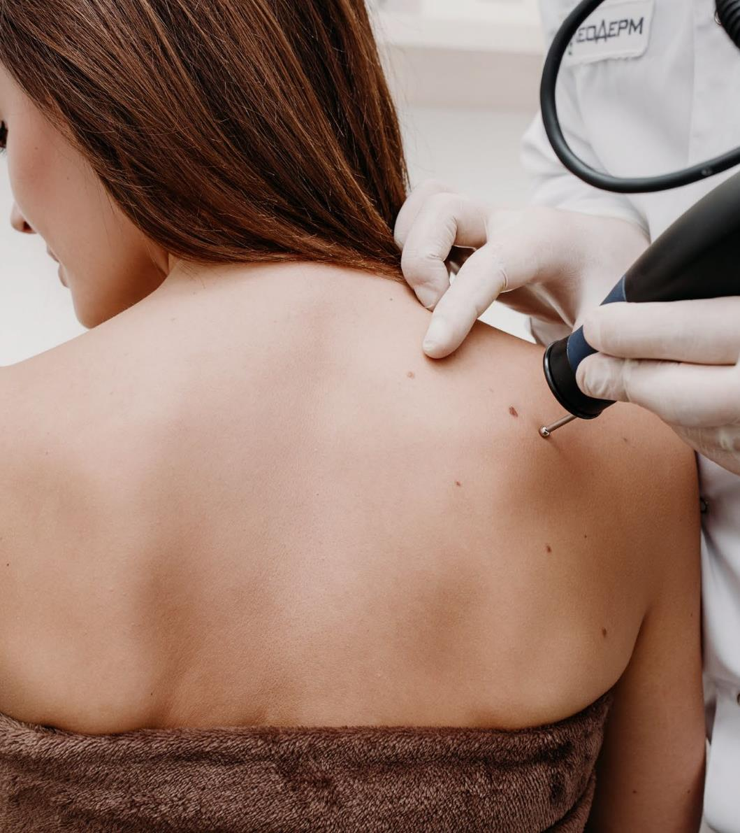

Dermatology
Latvia’s dermatologists are experienced professionals with an international education and focus on development. Many are members of key industry associations in Latvia and Europe. Dermatologists can help treat acute and chronic skin diseases, skin growths, fungal skin and nail infections, acne and dermatitis, septic and viral skin conditions such as furunculosis and herpes, scabies, pediculosis, demodicosis, skin psoriasis and more.
https://healthtravellatvia.lv/en/service/dermatology/

Slide 23
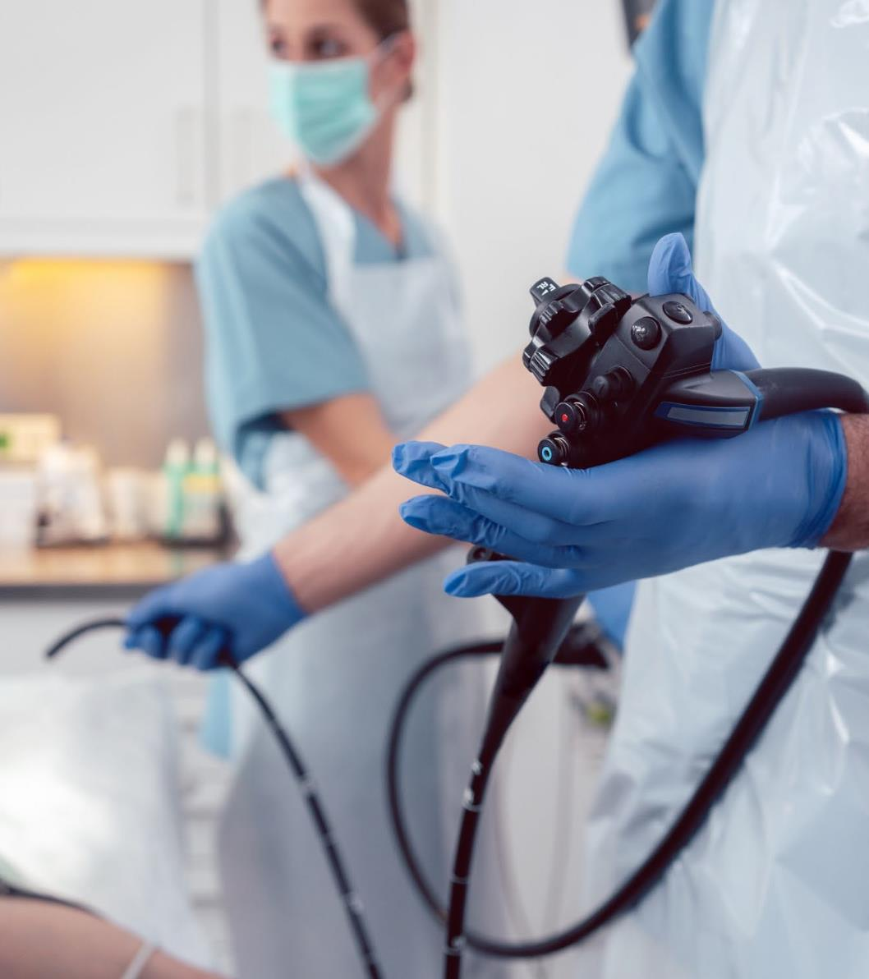

Gastroenterology
Advanced diagnostic equipment and technologies significantly reduce examination times and improve precision. The variety of treatment options available helps doctors find the right course of action for each individual patient. Latvia’s gastroenterologists can help get to the root cause of digestive problems, reflux disease, stomach aches, vomiting, irregular and painful bowel movements, and unexplained weight loss.
https://healthtravellatvia.lv/en/service/gastroenterology/

Slide 24
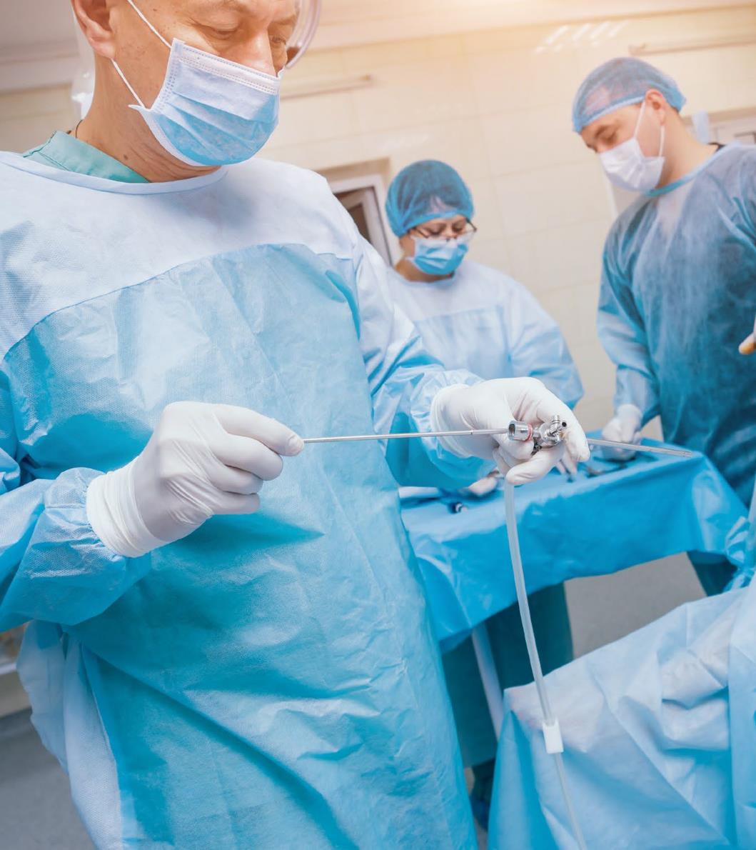

Orthopaedics
Latvia’s doctors are highly sought after by professional athletes, including ice hockey and basketball players, as well as ballet dancers.
Doctors have practiced at several American and European clinics and are members of the European Society of Sports traumatology, Knee surgery and Arthroscopy (ESSKA), International Society of Arthroscopy, Knee Surgery and Orthopedic Sports Medicine (ISAKOS) and other associations.
https://healthtravellatvia.lv/en/service/orthopedic/

Slide 25
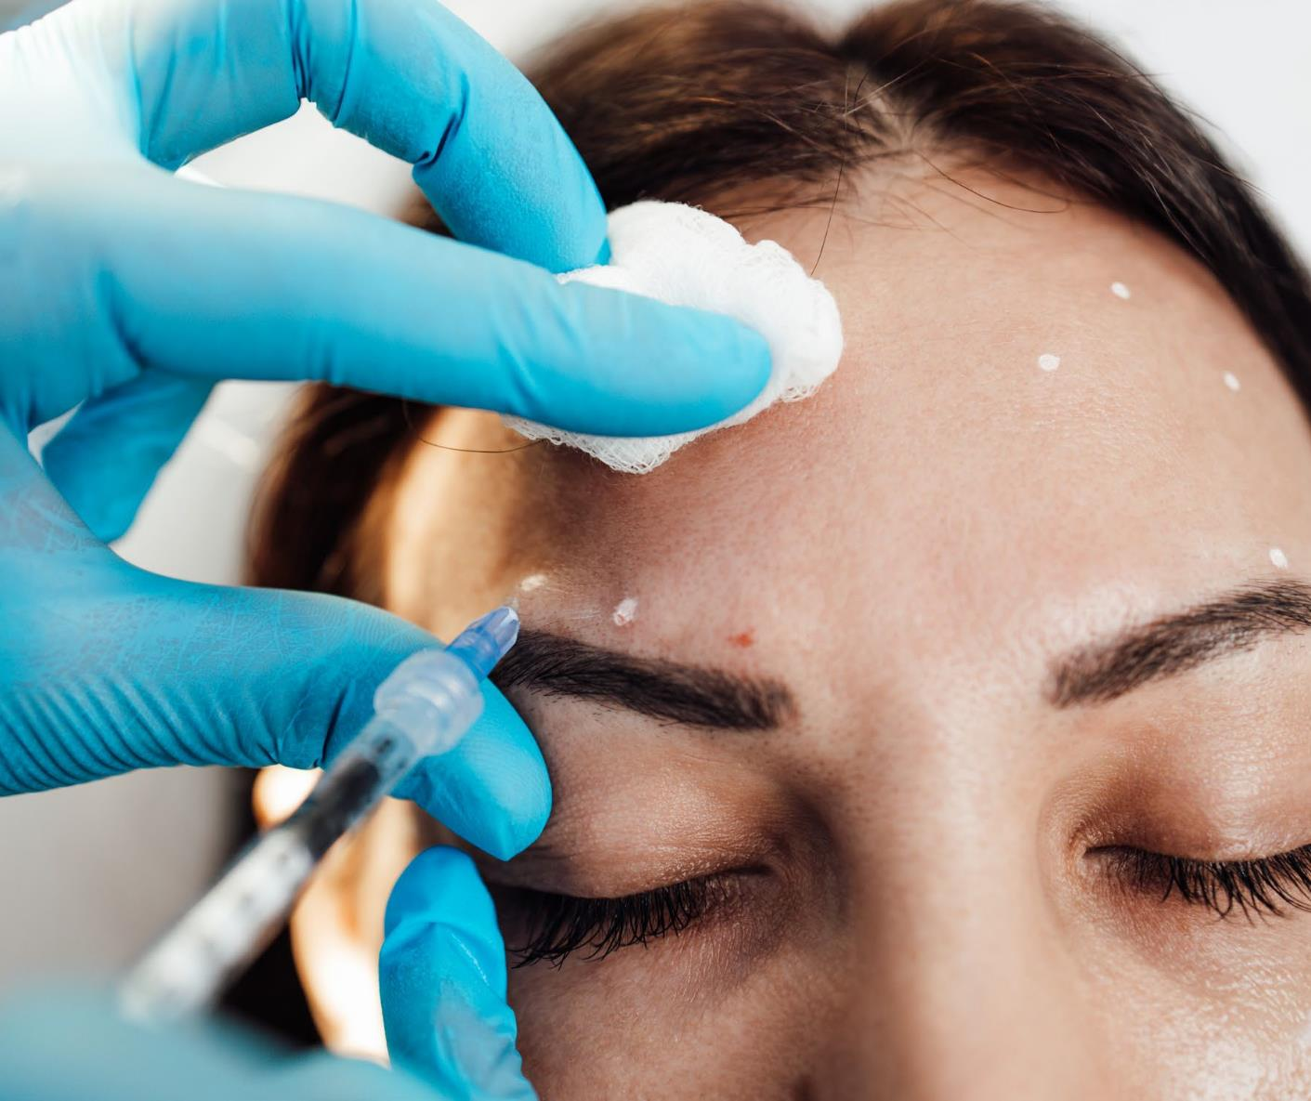

Aesthetic medicine
Aesthetic medicine is available at short notice and at competitive rates. Latvia’s clinics are equipped with world class equipment to help resolve numerous skin conditions and carry out unique skin rejuvenation procedures.
Less invasive methods are becoming more common as technology advances.
https://healthtravellatvia.lv/en/service/aesthetic_medicine/

Slide 26
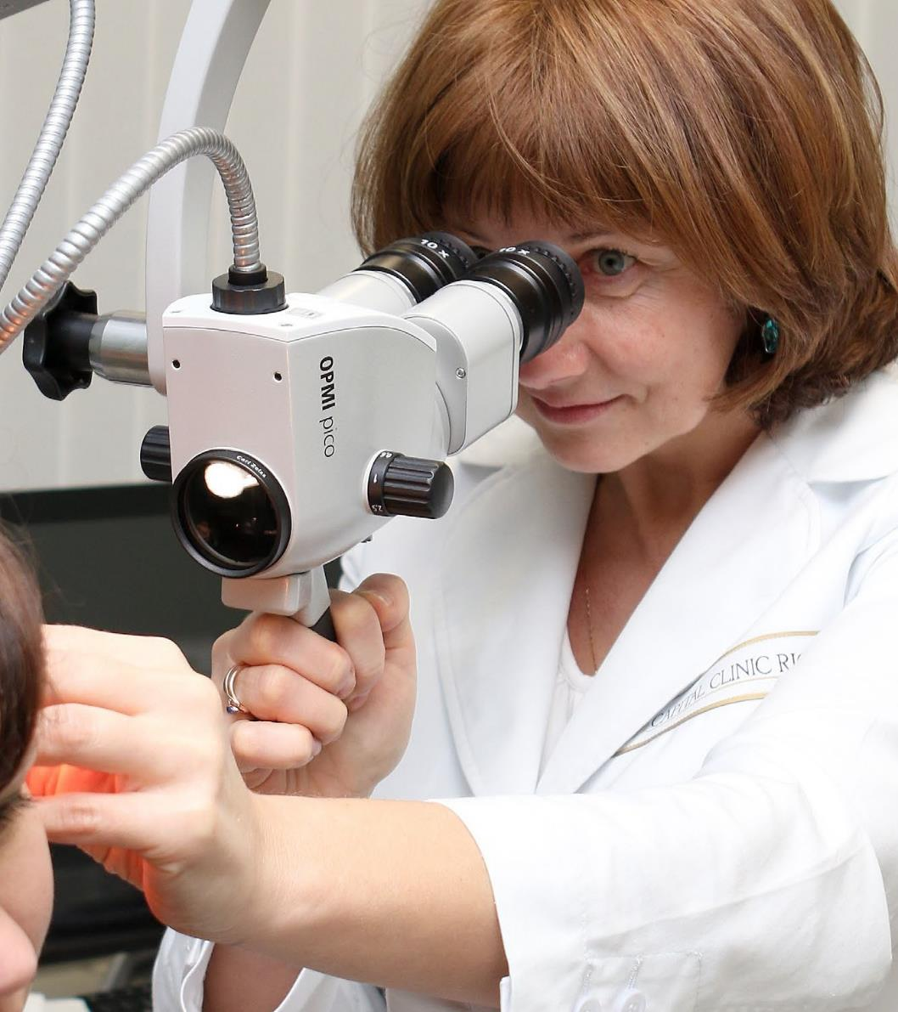

Otorhinolaryngology
Since ear, nose and throat conditions are often connected with other illnesses, patients may also be seen by otoneurologists, allergologists, gastroenterologists, audiologists, children’s neurologists, paediatricians, children’s infectologists and hearing aid technicians to determine the best course of action.
Contemporary technology and methods can lessen patients’ discomfort.
https://healthtravellatvia.lv/en/service/otorhinolaryngology/

Slide 27
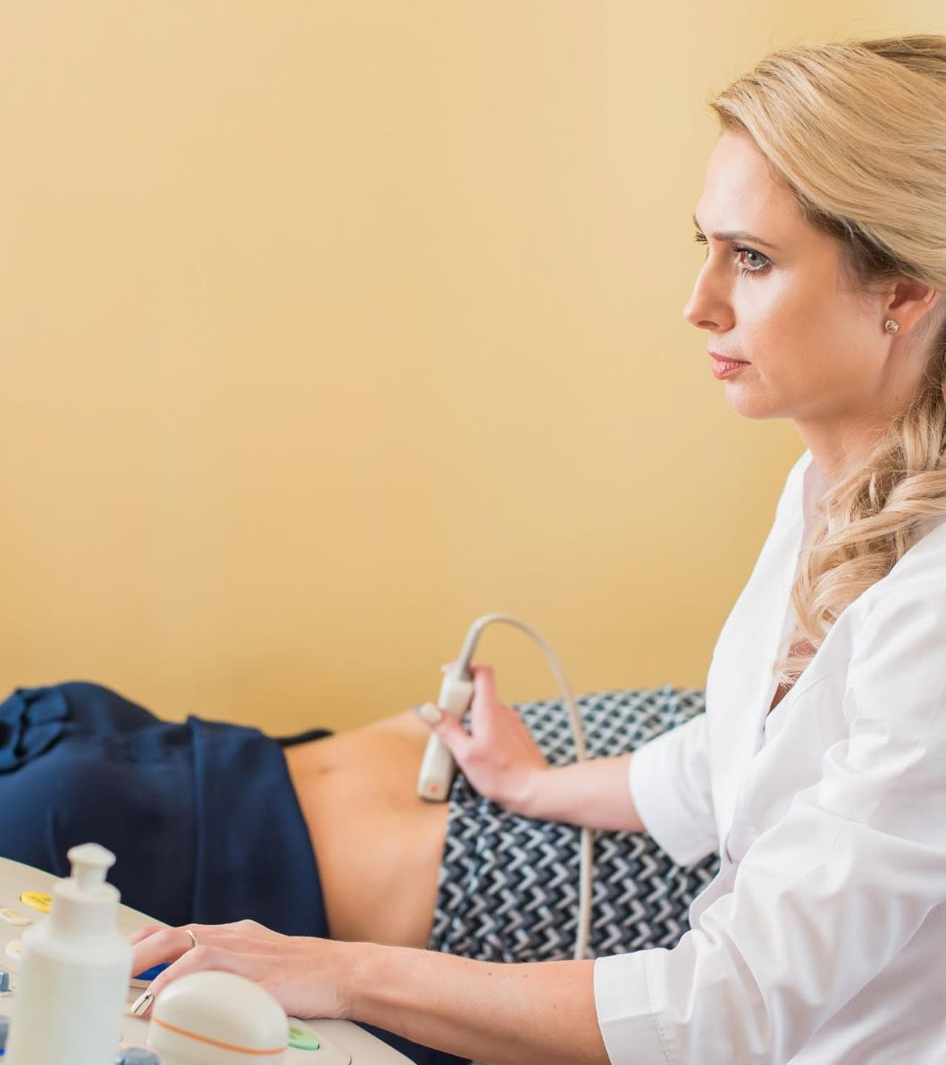

Gynaecology and urology
Doctors use the latest approaches and equipment to carry out accurate diagnostic procedures and surgery. Doctors have gained international experience at Europe’s leading university hospitals in France, the UK, Italy and elsewhere. Both doctors and clinics are members of major international associations of gynaecologists and obstetricians such as the ISUOG and ISPD.
https://healthtravellatvia.lv/en/service/gynaecology-and-urology/

Slide 28
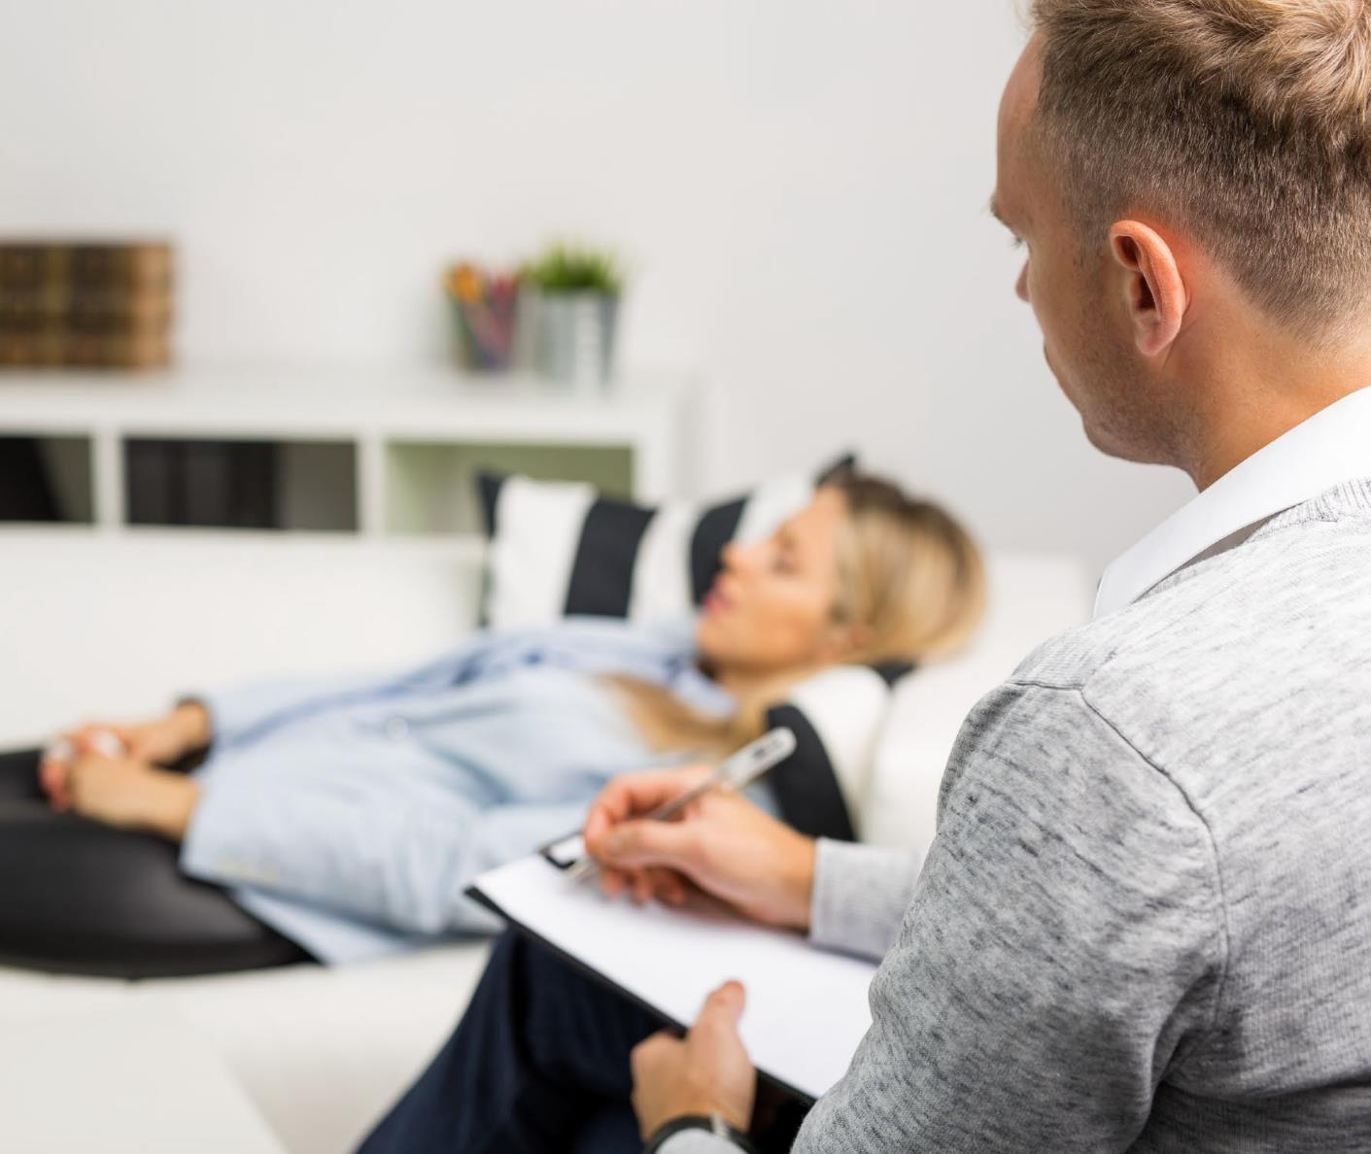

Psychiatry
A group of specialists including psychiatrists, psychotherapists, narcologists, physiotherapists and art therapists apply the latest research-based methodology to produce personalised treatment plans to improve patients’ physical and emotional wellbeing.
https://healthtravellatvia.lv/en/service/psychiatry/

Slide 29
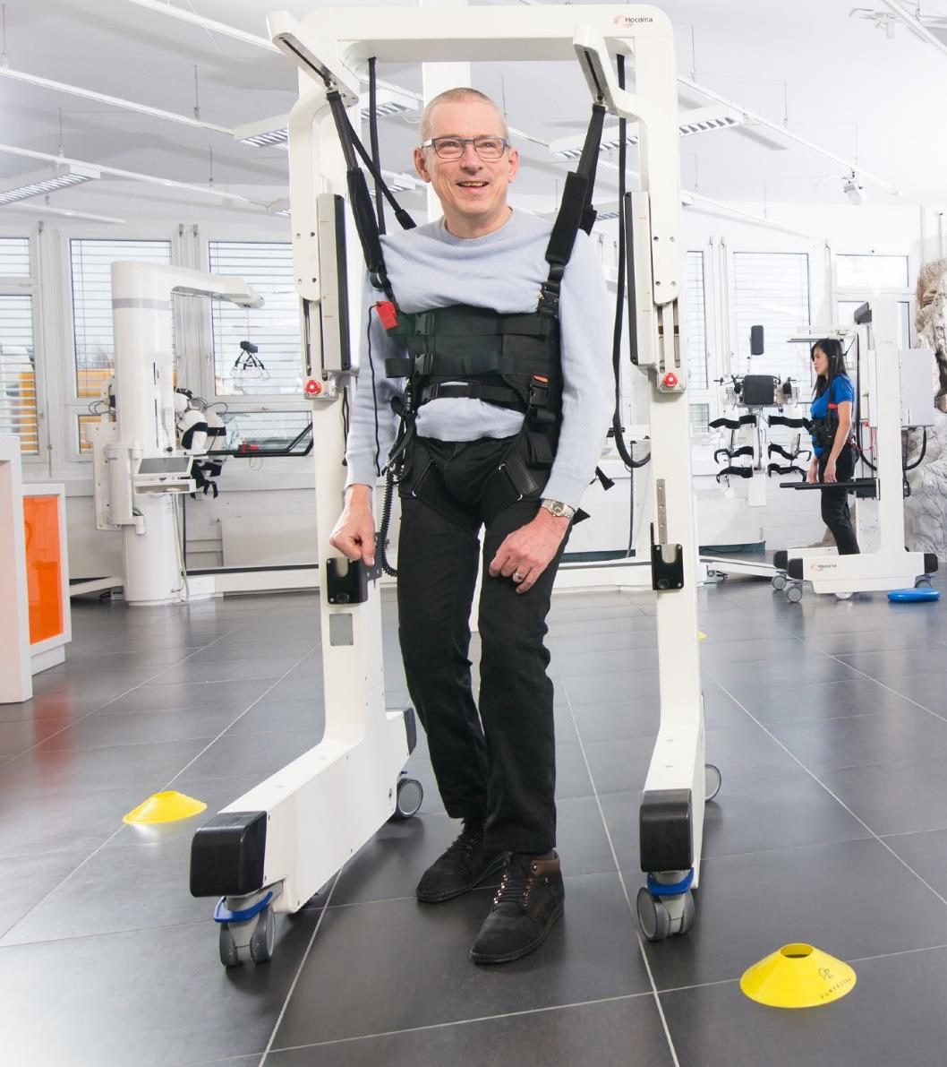

Medical rehabilitation
Patients receive treatments to encourage recovery after operations, injuries or periods of illness, as well as tackle chronic illness and boost the immune system as a preventative measure. The centres’ psychotherapeutic approach also enhances patients’ emotional wellbeing.
https://healthtravellatvia.lv/en/service/rehabilitation/

Slide 30
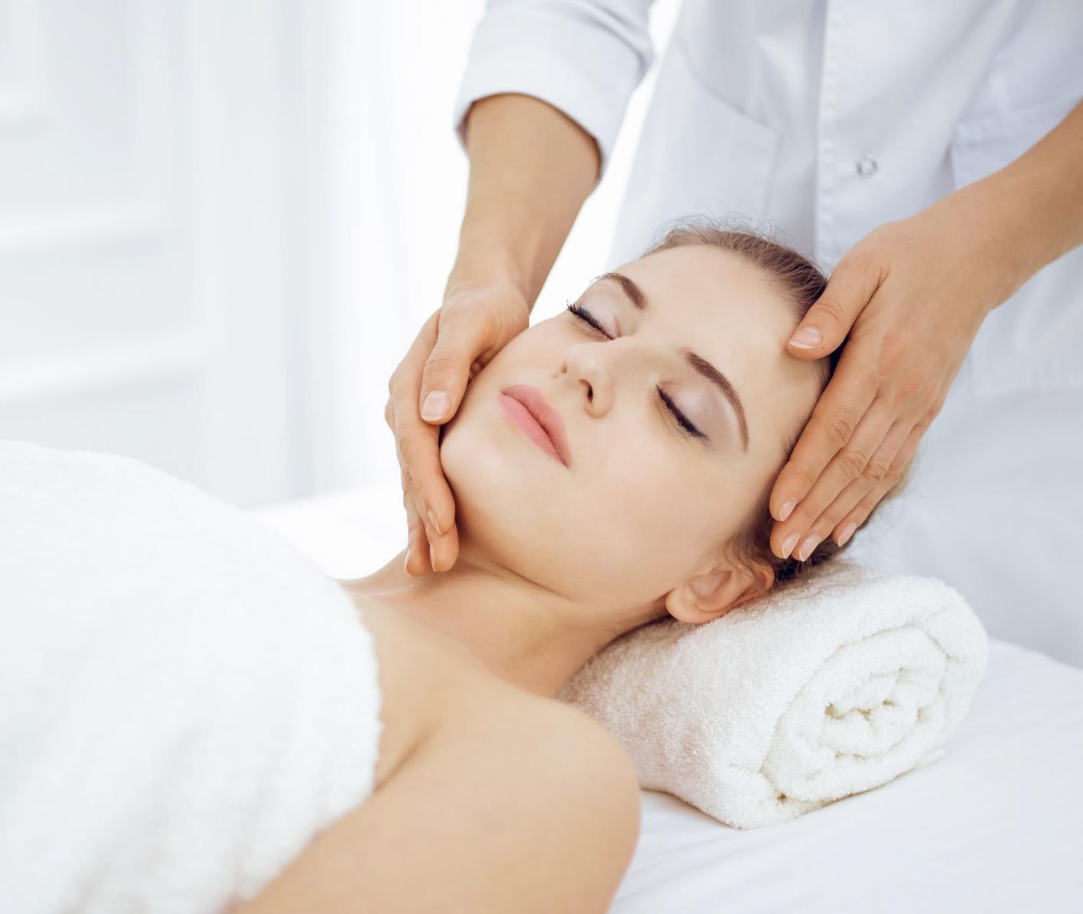

Spa & wellness
The services of Latvia’s clinics are being increasingly appreciated by foreign clients receiving high-class treatment corresponding to international standards for low prices. The range of services includes a full care package.
https://healthtravellatvia.lv/en/service/spa/

Slide 31
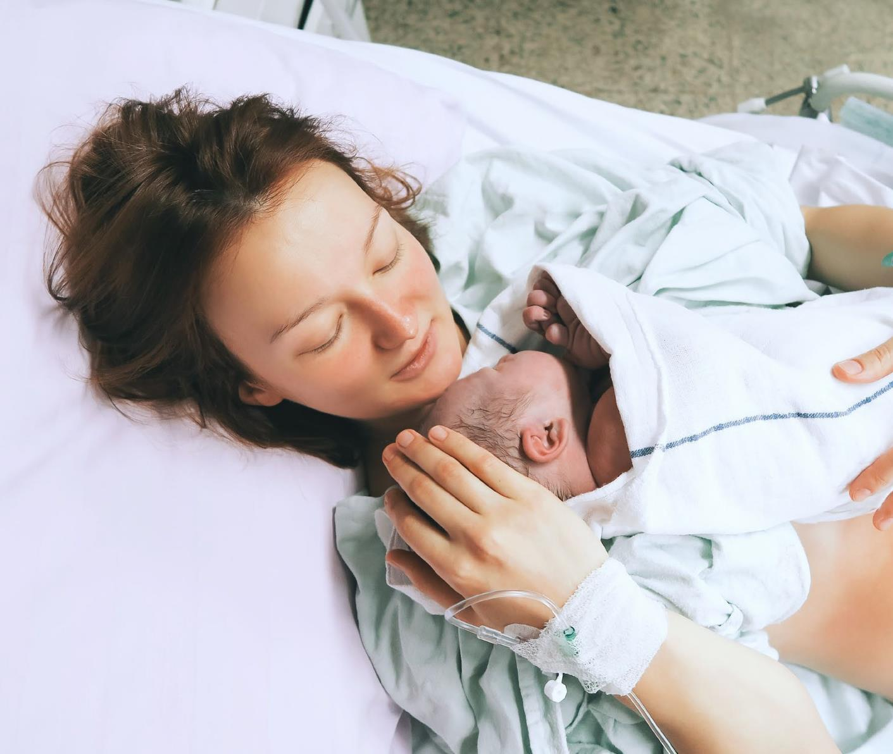

Childbirth
Latvia’s clinics are high level medical institutions which provide quality obstetrics services to latvian residents, but also to a significant number of foreign patients. Patients arrive here to receive medical care from countries including norway, sweden, the united kingdom, ireland, russia and other countries.
https://healthtravellatvia.lv/en/service/childbirth/

Slide 32
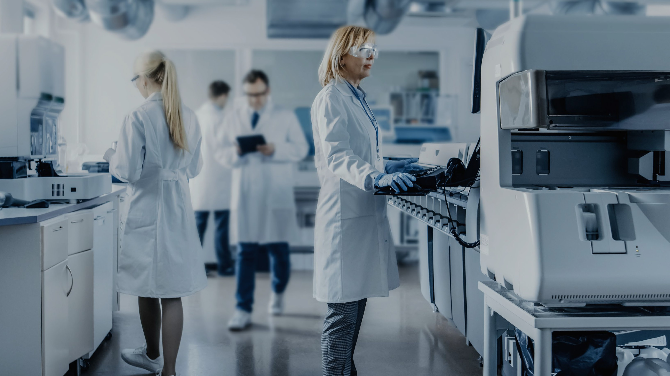
ADVANCED
MEDICAL PRODUCTS

Slide 33
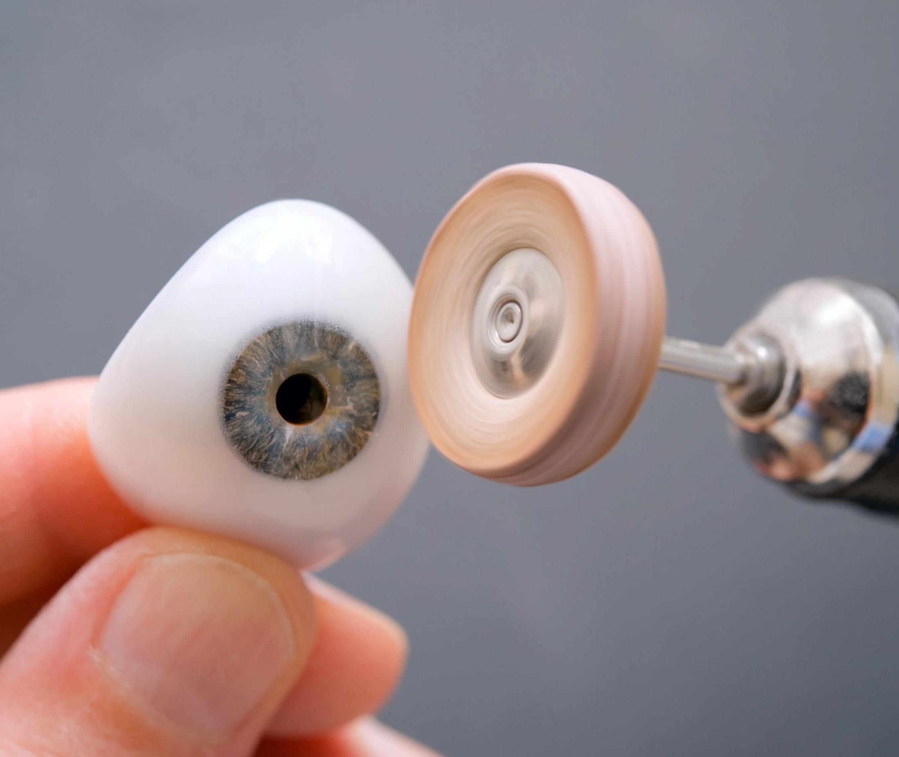
Eye prosthesis
Product:
eye prostheses made from various
materials to fill in the eye cavity.
Indications:
for people who have lost one or both
eyes due to an accident or illness, as well as in cases when the pupil of the eye has become blind, has contracted or become dull.

Slide 34
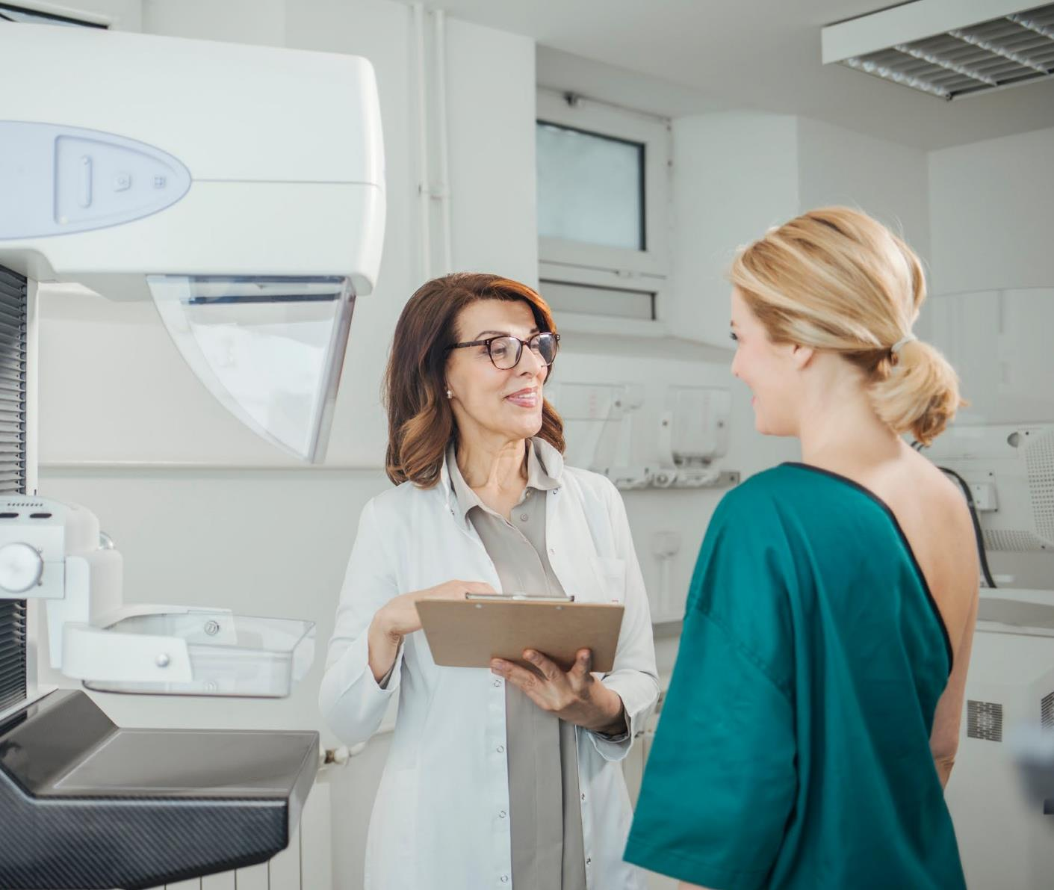
Oncolytic virotherapy
Service:
virotheraphy virus.
Indications:
for oncological patients, a particularly
valuable method for treating tumours that do not respond to radiotherapy or chemotherapy, e.G. Melanomas.

Slide 35
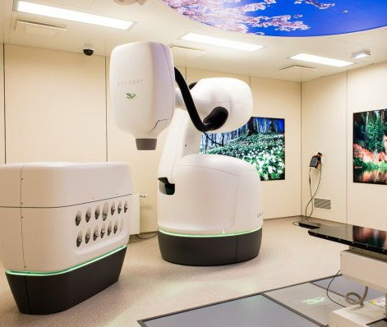
Cyberknife® m6
Service:
radiotherapy robot cyberknife® m6.
Indications:
patients with cancer, benign tumours
and other illnesses that can be treated using radiosurgery or radiotherapy.

Slide 36
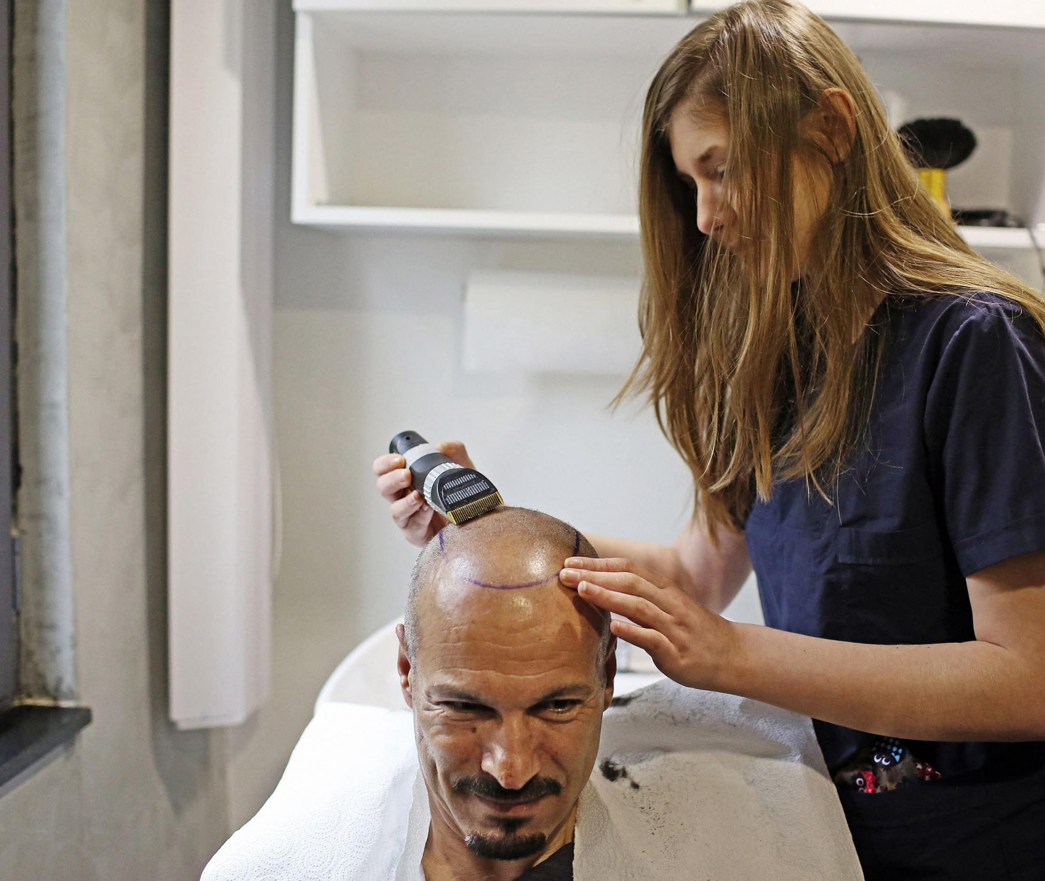
Tricopigmen- tation
Service:
tricopigmentation procedure HIM.
Indications:
hair loss in men; brief or complete loss of
hair in men and women due to illness, to increase hair thickness after a hair transplant; scar camouflage; and to create density in the beard and moustache area.

Slide 37
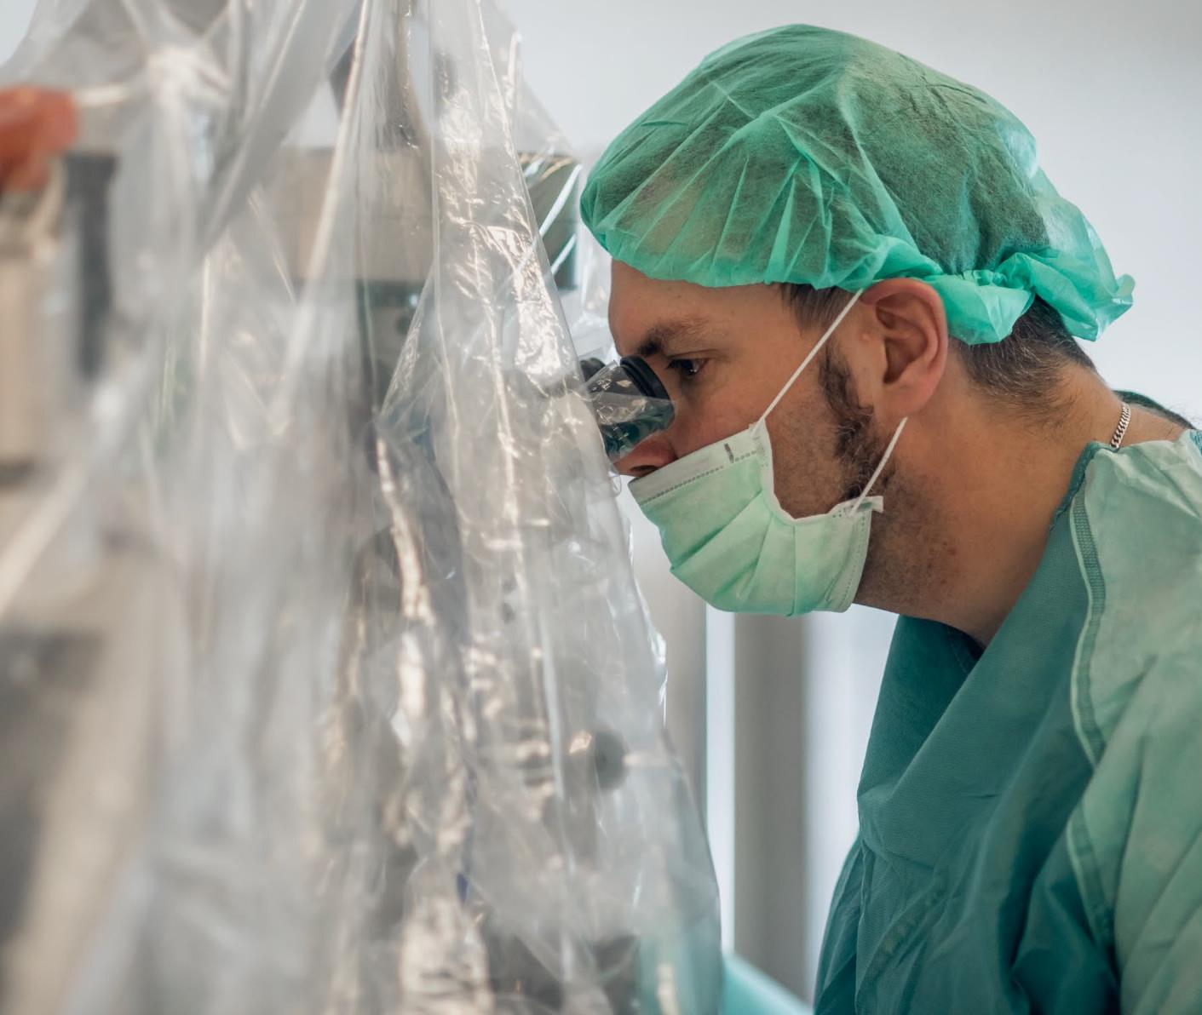
Andrology centre
Service:
microsurgical spermatozoid extraction
or removal (m-tese – microsurgical testicular sperm extraction).
Indications:
men whose sperm does not contain
spermatozoa. Useful for a patient, who has undergone a standard biopsy in which spermatozoa were not found, or in the event that before any spermatozoid search procedure, the doctor suspects that the chances of finding them are negligible.

Slide 38
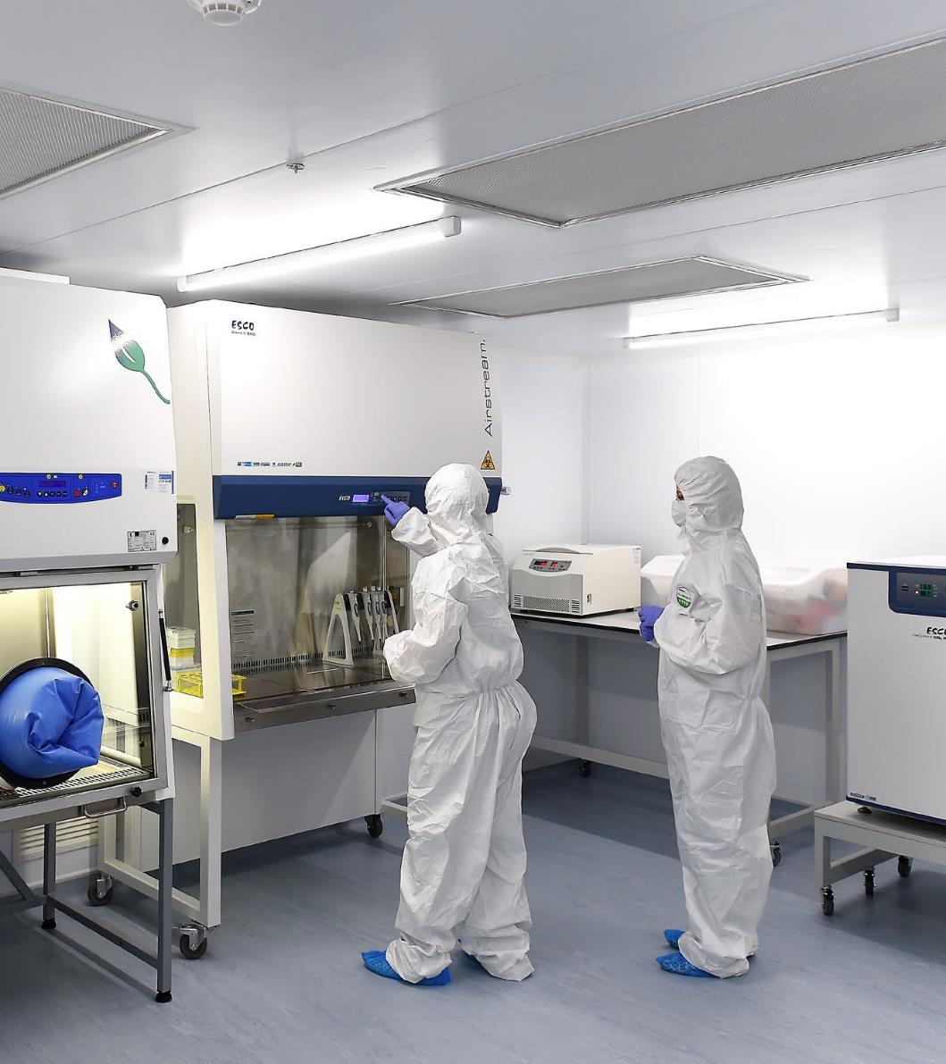
Genetic analyses
Service:
doctor-geneticist’s consultations, genetic diagnostics and dna tests.
Indications:
couples in situations in which there have been cases in the family or relatives’ families of children being born with mental and/or physical retardation, parents diagnosed with genetic diseases or chromosomal anomalies, cases involving one or more spontaneous abortions or structural foetal anomalies discovered during the course of pregnancy.

Slide 39
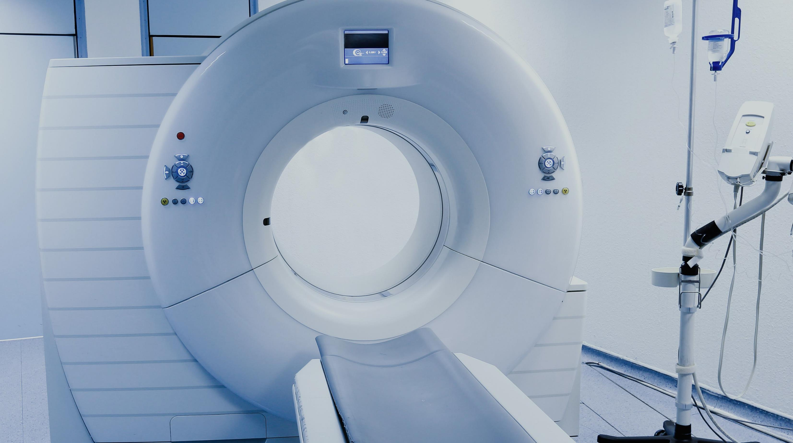
TECHNOLOGIES

Slide 40
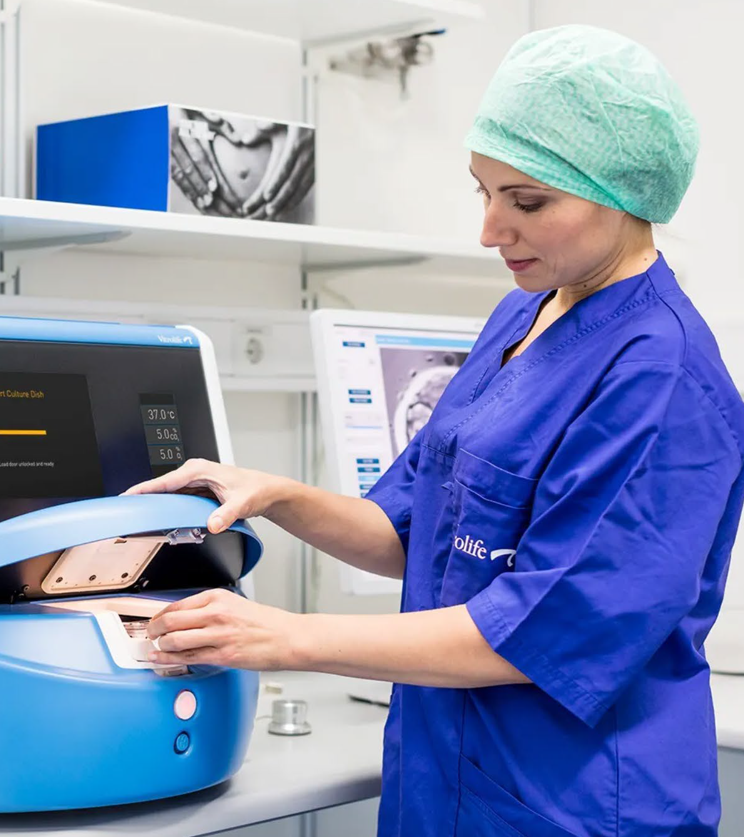

The New Word in the Treatment of Infertility
EmbryoScope
iVF Riga offers a new method of cultivation of embryos in the unique incubator EmbryoScope, which provides continuous monitoring of the embryo development and recording it on video.
Indications for infertility treatment using EmbryoScope:
For patients with failed implantation in previous IVF cycles;
For patients with poor egg or semen quality;
For patients over 35 years old;
For patients after missed abortions
www.ivfriga.eu

Slide 41
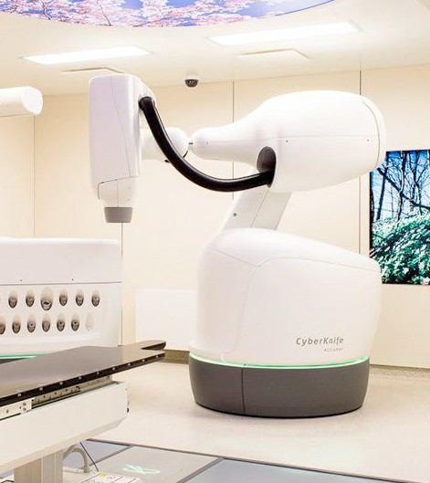

Radiosurgery with M6
An effective and noninvasive treatment method for primary, recurrent and oligometastatic cancer
Therapy with the robotic radiosurgery CyberKnife M6 is:
innovative approach of treatment contrary to the traditional paradigm – surgery,
conventional radiotherapy or hormonal therapy (ADT);
very precise, fast, effective and safe;
do not affect daily life.
The main goals of the therapy are:
to find tumour lesions in patient’s body and inactivate them;
to prolong symptom-free and overall survival;
to preserve the existing quality of life.
https://cyberknife-sigulda.com/en/

Slide 42
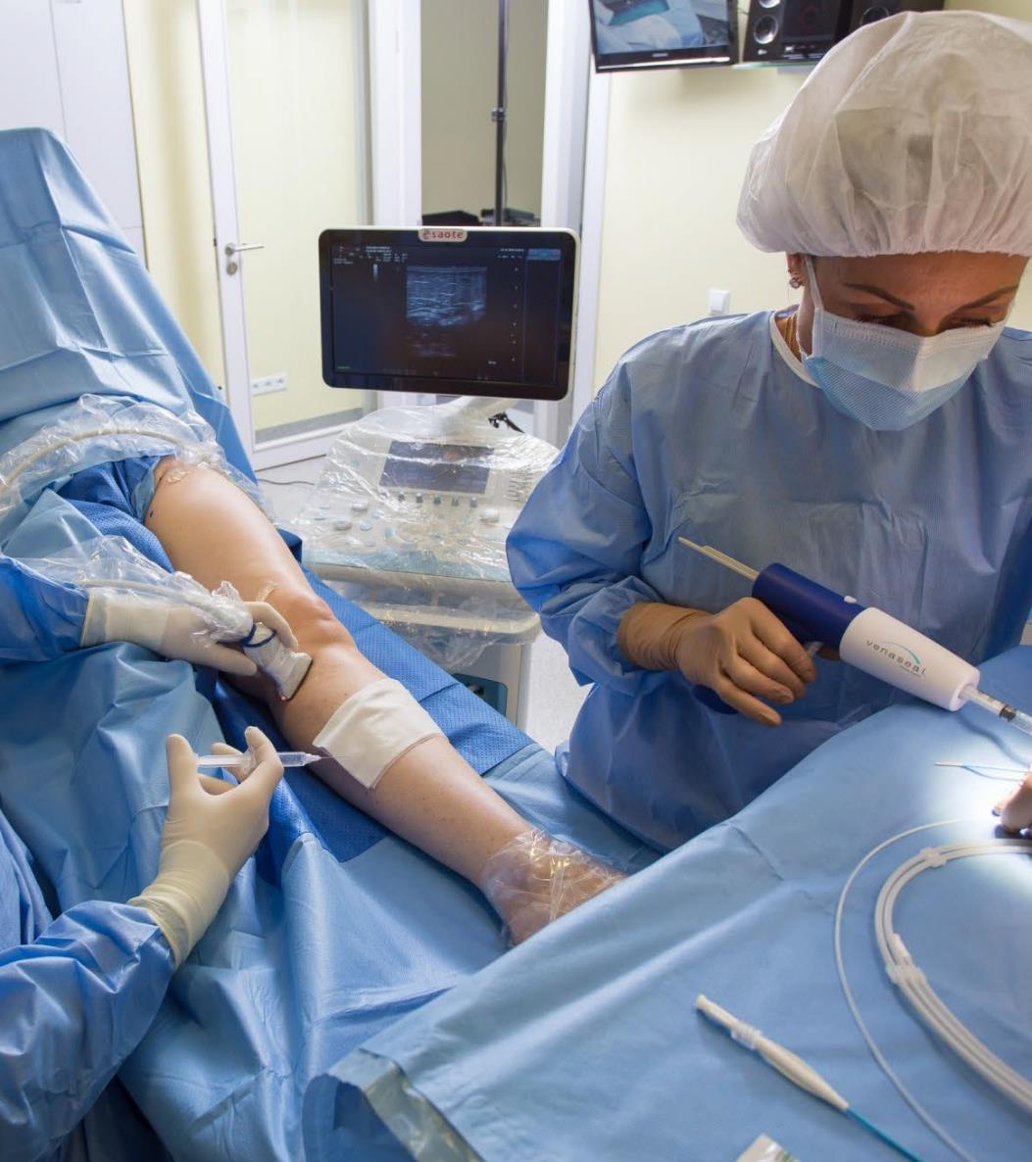

Vein closure using bioglue - (VenaSeal™ Closure System)
This is the newest, the most advanced and the safest endovenous surgery technique. A vein is glued up from the inside using special bioglue.
VenaSeal™ Closure System as a treatment method was introduced to the world only in 2012, and Latvia is the fifth country in the world to use it.
https://venas.lv/en/treatment/vein_surgery/surgery_using_venaseal_closure_system/

Slide 43
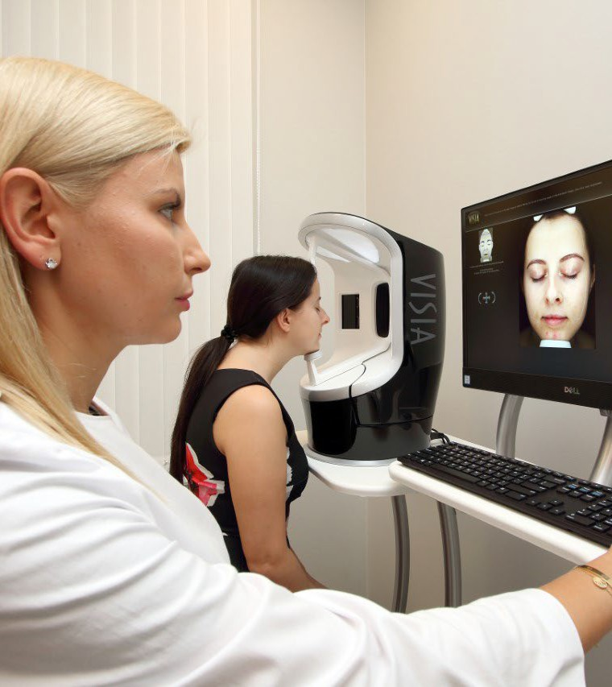

Facial skin diagnostics using VISIA®
The new VISIA® skin condition analysis system of the seventh generation provides currently the most accurate and fastest professional facial analysis.
VISIA® system analyses the following factors:
pigment spots,
wrinkles,
differences in the skin tone,
pores,
damage caused by the sun (hyperpigmentation, lentigo),
pigmentation of the upper layer of the skin,
condition of the facial blood vessels (couperosis, rosacea),
presence of porphyrin bacteria.
https://vc4.lv/en/jaunumi/jaunums-sejas-adas-diagnostika-ar-visia/

Slide 44
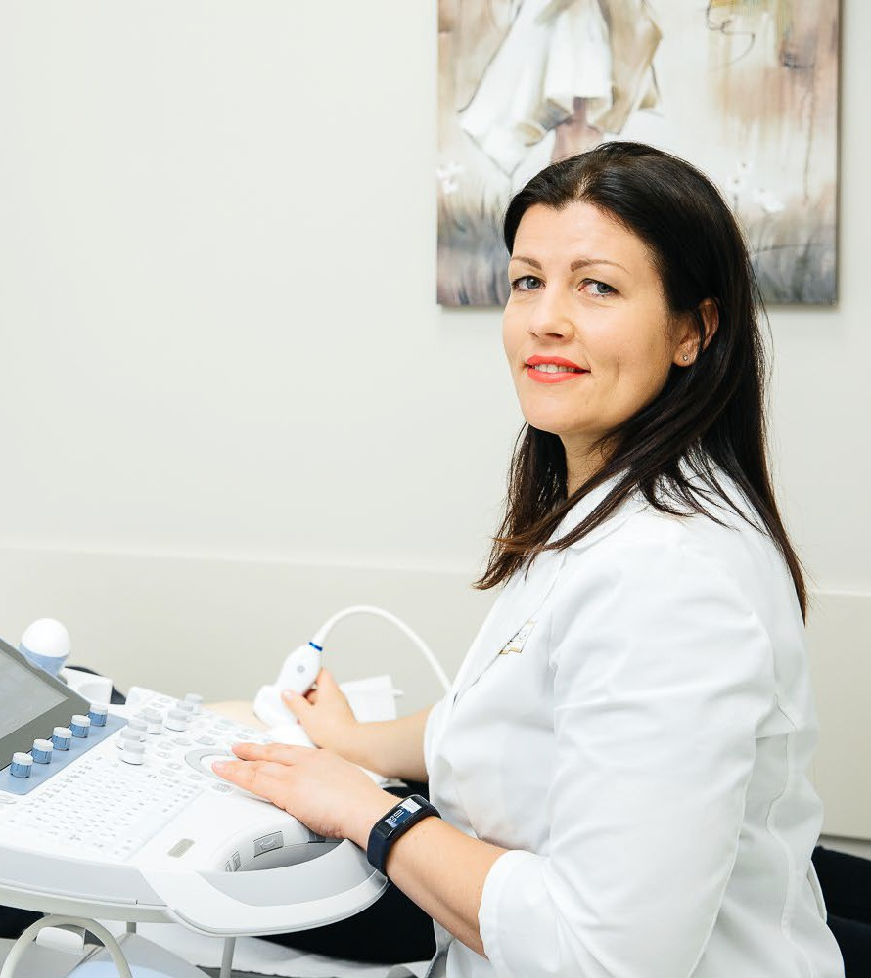

GE Voluson E10 for particularly complicated cases
Ultrasound machine Voluson E10 for gynaecologists and obstetricians
It is a highly valued expert class ultrasound machine used in gynaecology, reproductive medicine and perinatal diagnostics all over the world. Innovations in image quality, use of applications, and analysis of image quality ensure excellent performance of this equipment and precision in diagnostics. Along with standard examinations, this machine can also perform important additional examinations in gynaecology and obstetrics.
https://vc4.lv/en/jaunumi/ge-voluson-e10-visa-pasaule-augstu-novertets-ekspertklases-ultrasonografs/

Slide 45
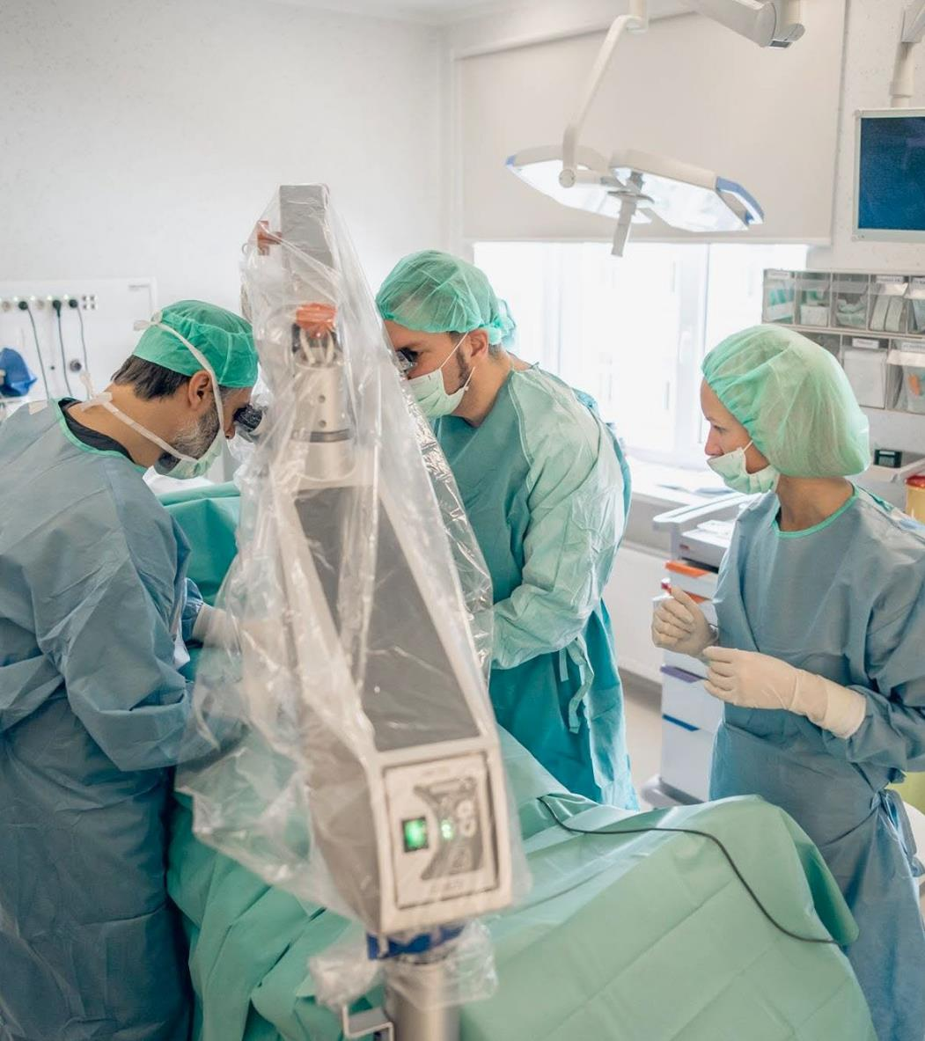

Center of Andrology
Patients can receive consultations about men’s fertility issues, erectile problems, and STDs.
Experts perform ultrasound and dopplerography examinations of men’s genitals (including prostate, testicles and penis) and urinary tract, as well as minimally-invasive urological surgeries, surgical treatment of men’s infertility – TESE, PESA, micro TESE, MESA, recanalization of the ejaculatory duct after vasectomy, and
vaso-epididymal anastomosis. The surgical treatment of male infertility uses the latest generation SOM62 surgery microscope SOM62 - German-quality
https://www.egv.lv/en/men

Slide 46
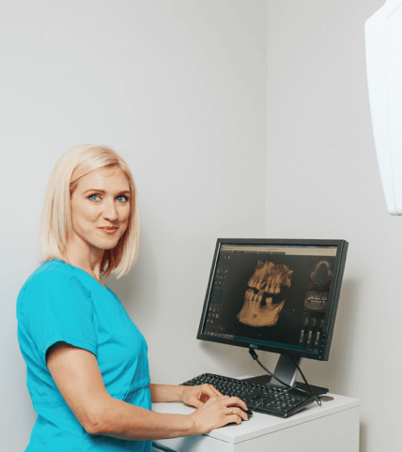
Dentistry,
The digital X-ray device «Carestream CS 8100 3D»
The digital X-ray device «Carestream CS 8100 3D» From traditional panoramic exams to endodontics, implant planning and oral surgery applications, the CS 8100 3D is capable of far more than the average 3D unit. It allows to view areas of interest from every angle with
one-to-one accuracy.

Slide 47
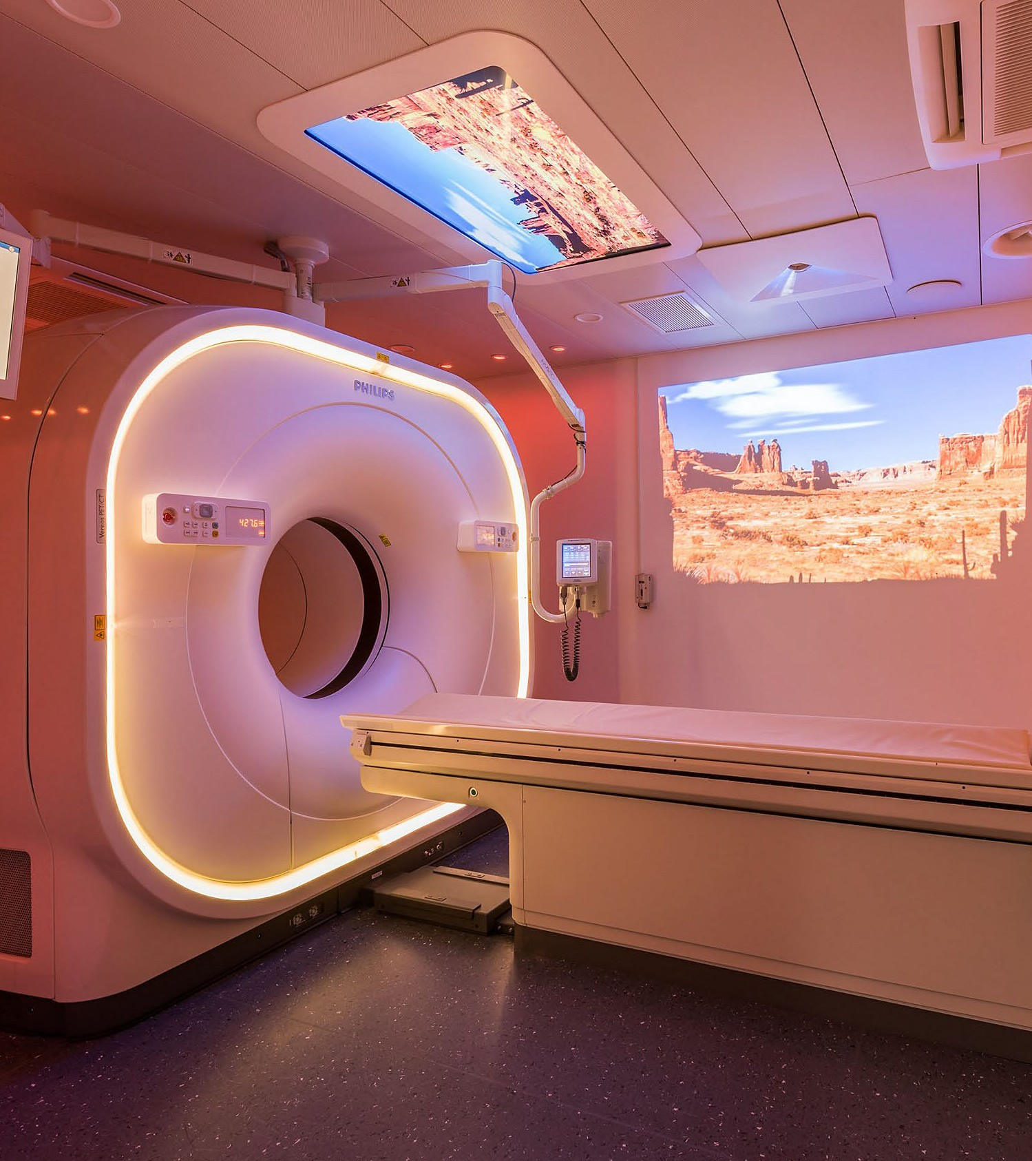

Philips Vereos PET/CT digital imaging system
The new imaging system, the only one of its kind in Central and Eastern Europe, enables medical specialists to perform high-quality examinations in patients with oncologic, haematologic disorders, certain neurological, cardiologic disorders as well as other disorders in improved ways.
The digital PET/CT imaging system represents one of the most advanced medical imaging systems in the world, enabling a detailed examination of patients with oncologic disorders in a combination of PET (positron - emission tomography) and CT (computer tomography) imaging techniques. ‘A PET/CT examination is one of the most precise methods in cancer diagnostics, merging PET and CT images into a single scan and thus enabling a quick and precise appraisal of the spread of the morbid process.
https://arsmed.lv/en/2018/12/pet-ct-examinations/

Slide 48
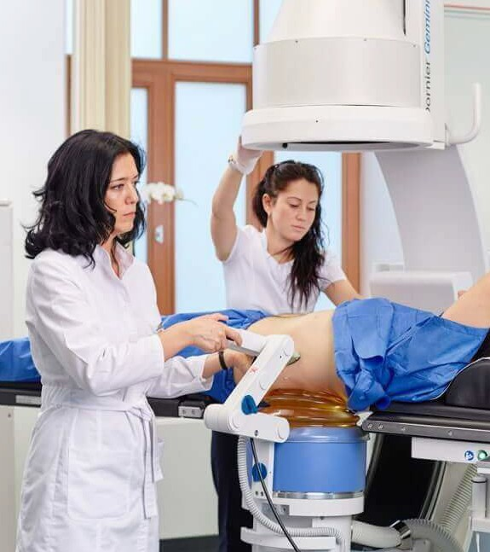

Extracorporeal Shockwave Lithotripsy
Equipment for kidney stone fragmentation (distance lithotripsy). It has started using the latest generation Premium class lithotripsy equipment Gemini from the leading German urological equipment manufacturer Dornier MedTech.
Advantages of Gemini Dornier MedTech:
performs most accurate and effective kidney stone fragmentation procedures in an outpatient setting;
patients are free to go home after the procedure;
the procedure is adjustable for children;
kidney stone fragmentation is also suitable for larger patients – up to 200 kg;
extensive image documentation and comparison options that allow the results of previous lithotripsy procedures to be evaluated.
https://arsmed.lv/en/ars-diagnostikas-klinika/lithotripsy/

Slide 49
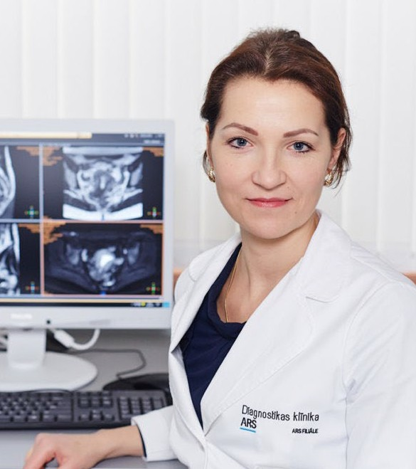

Unique 3t Mri Exams In Gynaecology And Urology
It is assumed in the world, including Europe and North America, that a 1.5T MRI system is completely suffcient to perform these exams.
However, where it is possible to use both systems and to compare the image quality, one must admit that images obtained in a 3T MRI scan have a much higher resolution which facilitates diagnostics greatly.
An MRI scan is completely harmless for health because no ionising radiation is used. Tissue resolution is very good, therefore administration of an intravenous contrast agent is required in rare cases only.
https://arsmed.lv/en/2017/02/unique-3t-mri-exams-gynaecology-urology/

Slide 50
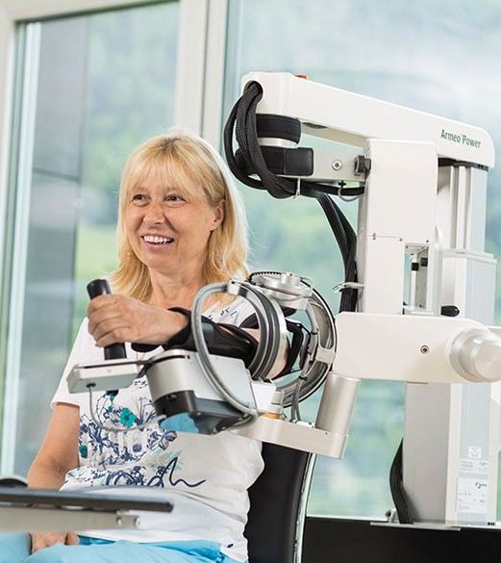

Armeo Arm Rehabilitation System
This robotic process is used as a rehabilitation method with which to exercise arms after injuries and diseases. The therapy requires a high degree of engagement on the part of the patient; the exercises are performed repeatedly and independently. The device is suitable for both adults and children and is easily adaptable for individual patients. The device can be used by patients suffering from various types of neurological ailments (post-stroke, Parkinson’s disease, multiple sclerosis, geriatric patients, etc.).
https://healthtravellatvia.lv/en/service/rehabilitation/#4

Slide 51
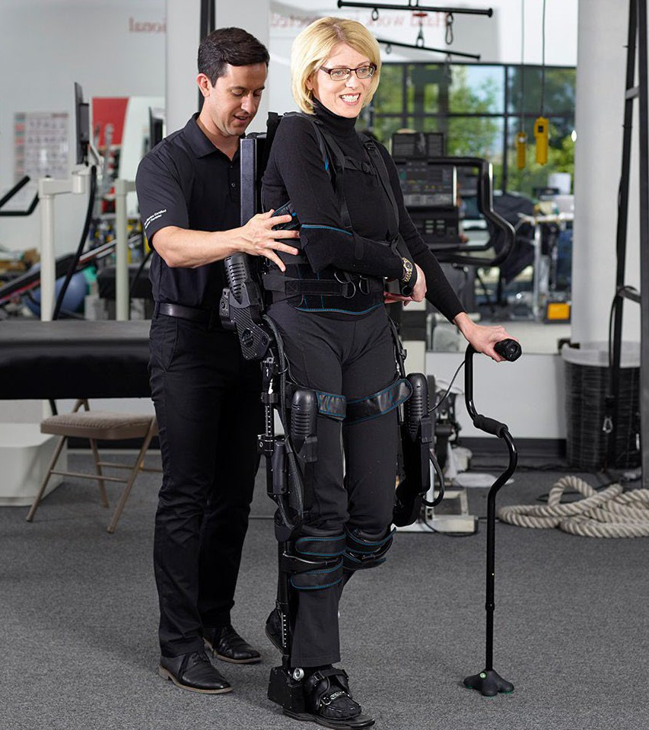

Eksogt Walking Robot
This unique robotic device helps patients with spinal cord damage to move vertically and to train their legs. The support of the robot allows the patient to move his muscles and stretch his legs. The device makes it easier for the patient to undergo initial mobility training, which is intended to help the patient get around better.
The device makes training sessions smarter, because the robot records data, as a result of which it is subsequently possible to analyse how much the patient has moved and how much work has been done by the device. The EksoGT rehabilitation device is used to aid the recovery of patients after spinal cord injuries, multiple sclerosis patients, as well as other patients with mobility problems caused by paralysis. The robot can only be operated with the help of specialists.
https://healthtravellatvia.lv/en/service/rehabilitation/#4

Slide 52
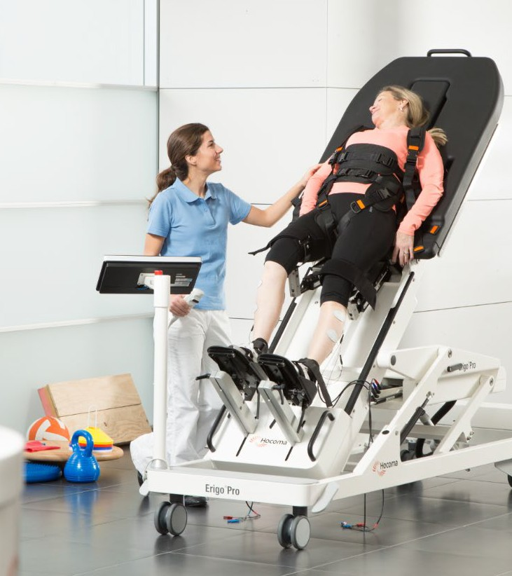

Erigo Verticalization Device
Suitable for patients recovering from serious injuries and diseases. Technology simulates active leg movements, which makes it possible to ensure early muscular mobilization. Robotic movements enable patients who have been bedridden for a long time to gradually learn to walk again. The device can also be used by patients who are completely paralysed.
https://healthtravellatvia.lv/en/service/rehabilitation/#4

Slide 53
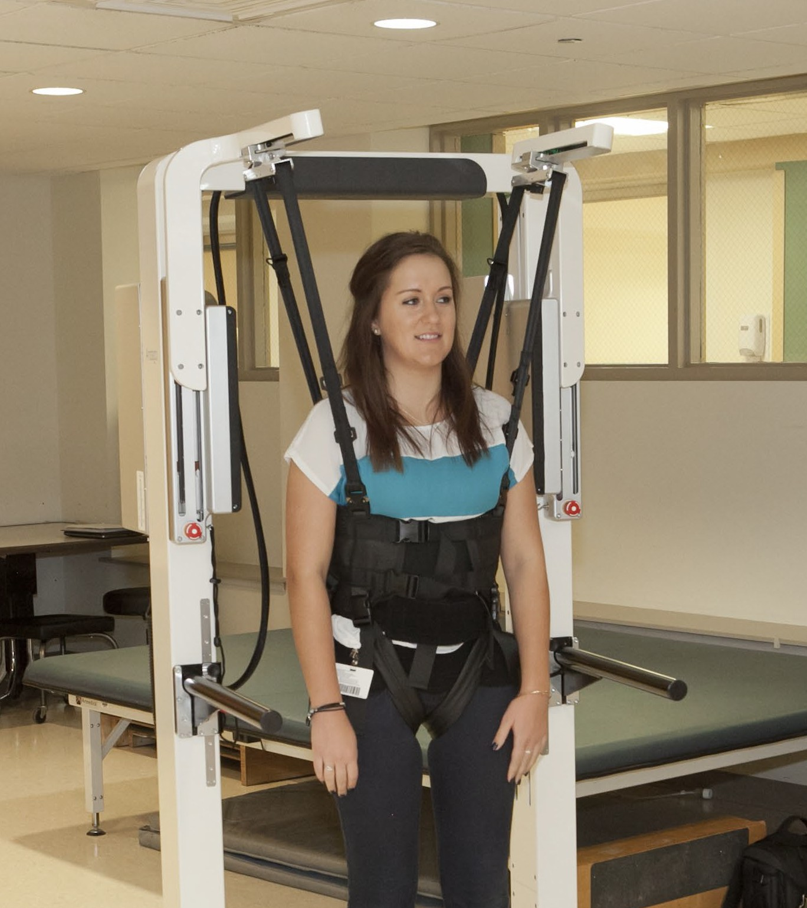

Andago Robotics
Andago is a robotic device that provides safety during gait training. It is a robot that provides stability while walking, at the same time preserving the quality of the patient’s quality, and liberating the patient from the fear of falling.
Andago is one of the safest robotic devices, which is intended for intensive gait and balance training, and is particularly recommended for use by patients after a stroke or with a gait deficit caused by various neurological, orthopaedic or cardiovascular illnesses.
https://healthtravellatvia.lv/en/service/rehabilitation/#4

Slide 54


Mirerehab Virtual Reality
Mirarehab is used in rehabilitation for children, orthopaedic, psychiatric, geriatric and neurological patients. With a virtual reality device it is possible to improve active and passive mobility, active stability, movement coordination, balance, weight transfer, stereotypical gait, muscular strength, mood, motivation and cognitive abilities.
Virtual reality boosts the desire of patients to become more involved in the rehabilitation process. Mirarehab therapy is administered by a certified therapist, who assesses the patient and his abilities to perform the therapy offered by the software, prepares an individual plan and monitors each therapy session.
https://healthtravellatvia.lv/en/service/rehabilitation/#4

Slide 55


Ocular Prosthetics
The latest technologies and modern instruments ensure fast production of prosthesis and outstanding durability; depending on the selected material, ocular prosthesis can be made in Valters' Prosthetic Laboratory within 1-3 days.
Each prosthesis is unique handwork; it proves the craftsmanship of the specialist and can be compared with an inimitable work of art.
http://www.vpl.lv/eng/ocular_prosthetics

Slide 56


Medical education in Latvia
Riga Stradins University (RSU)
Rīga Stradiņš University (RSU) is a public university located in the city of Riga, Latvia and Faculty of Medicine is highly valued in Latvia and worldwide. It has been the academic destination of international students for almost 30 years.
RSU has enrolled 1,611 international students from more than 40 countries: Austria, Azerbaijan, Canada, China, Finland, France, Germany, Italy, Israel, India, Ireland, Norway, Poland, Portugal, Russia, Spain, Sri Lanka, Sweden, Switzerland, United Kingdom, the Netherlands, Turkey, etc. The majority of the international students represent Germany, Sweden and Norway.
https://www.rsu.lv/en/international-student-department

Slide 57

STARTUPS IN
MEDICINE IN LATVIA

Slide 58


Anatomy next
3D human atlas which boosts learning among the medical students.
www.anatomynext.com/

Slide 59


Castprint
CastPrint® is 3D printed casts for various types of fracture injuries. 3D printed casts
are a lightweight, ventilated and waterproof. Casts made from biodegradable plastic which is environmentally friendly material.
Anti-allergenic and safe for skin contact.
https://www.castprint.co/

Slide 60


Cheeks-up
Interactive face motion digital game to empower children with speech and face disabilities.
https://cheeksup.com/

Slide 61


Dorothy
Dorothy AR is the first assitstant for people with memory problems. It reminds them about daily
tasks, guides around the house using Augmented Reality and keeps them connected
with their caregiver.
https://dorothy.app/

Slide 62


Vigo
Vigo is the first software based stroke rehabilitation therapy using years of research in stroke treatment, psychotherapy, and neuroscience.
https://vigo.health/

Slide 63


Medcub
DERMA
Wide
Inovative company that provide radiology services via internet to hospitals and doctors.
Mobile Skin Screening Device Intended for people to follow their own skin condition.
A device that comes with the phone and comes with applications for both the patient and the professionals.
Software for digital customization of orthoses and prosthesis.
https://www.medcub.com/
https://wide.tech/

Slide 64
More about Latvian Heath tourism cluster
Latvian Health tourism cluster, Email: info@healthtravellatvia.lv, Phone: +371 29 214 868
www.healthtravellatvia.lv/en

Slide 65

HEALTH
TOURISM IN LATVIA
Investment and Development Agency of Latvia
Tourism department
tourism@liaa.gov.lv

