Slide 1
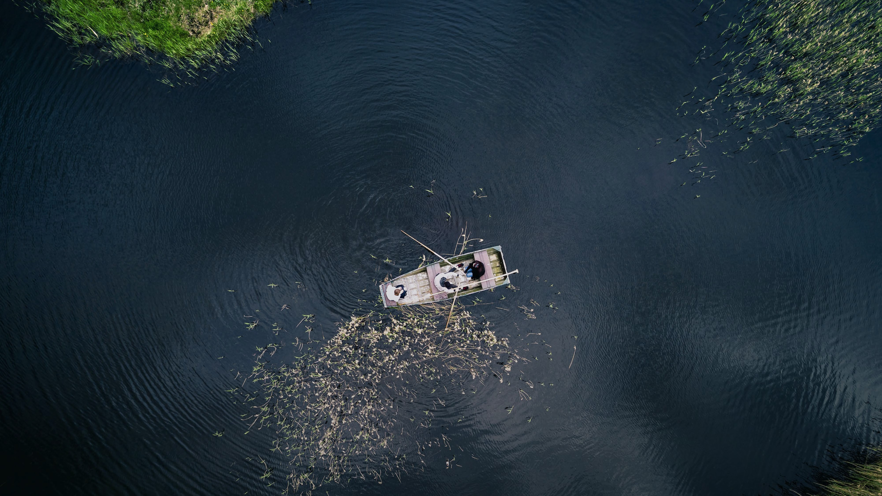











TRAVEL
Investment and Development Agency of Latvia
Tourism department
tourism@liaa.gov.lv
Magnetic Latvia Travel
LatviaTravel
LatviaTravel
tourism@liaa.gov.lv
latvia.travel

Slide 2
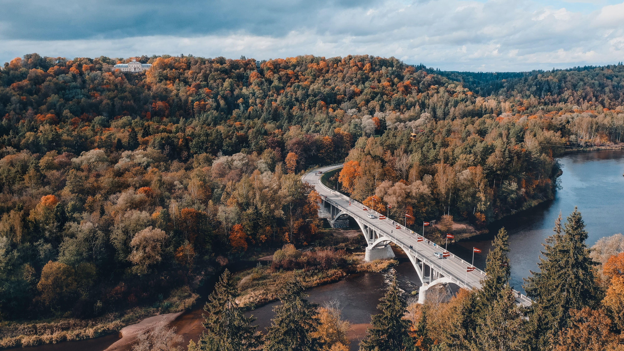
Key information about Latvia
Capital: Riga
Currency: EUR
Schengen Area: member since 2007
European Union: member since 2004
Population: 1.9 million
Area: 64,589 km2
Density: 30/km2

Slide 3

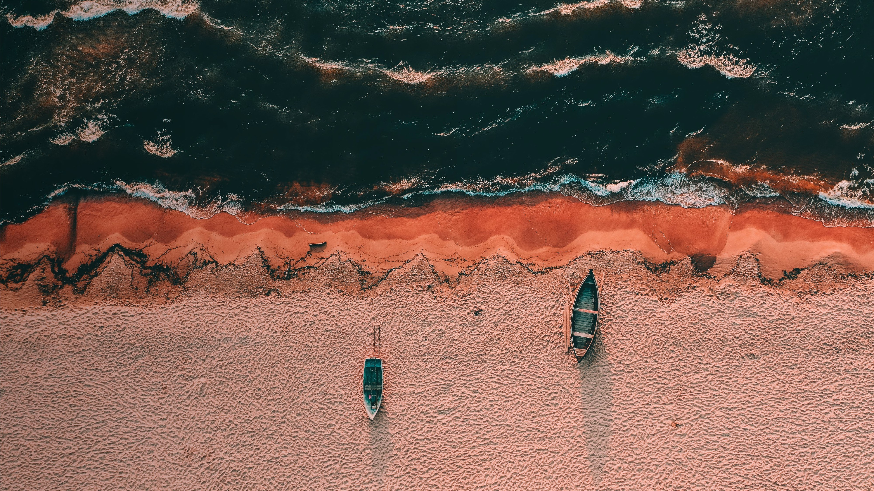
A small part of what makes Latvia special
With over 500 km of coastline, Latvia has plenty of white sand beaches
With over 800 Art Nouveau buildings, Riga
is one of the world’s greatest galleries of this style
Latvia has around 12,000 rivers and 3,000 small lakes – perfect if you like boating or fishing
Little known fact: Ventas Rumba in Kuldiga is the widest waterfall in Europe
Over half of Latvia's territory is covered by forest, making it one of Europe’s greenest countries

Slide 4

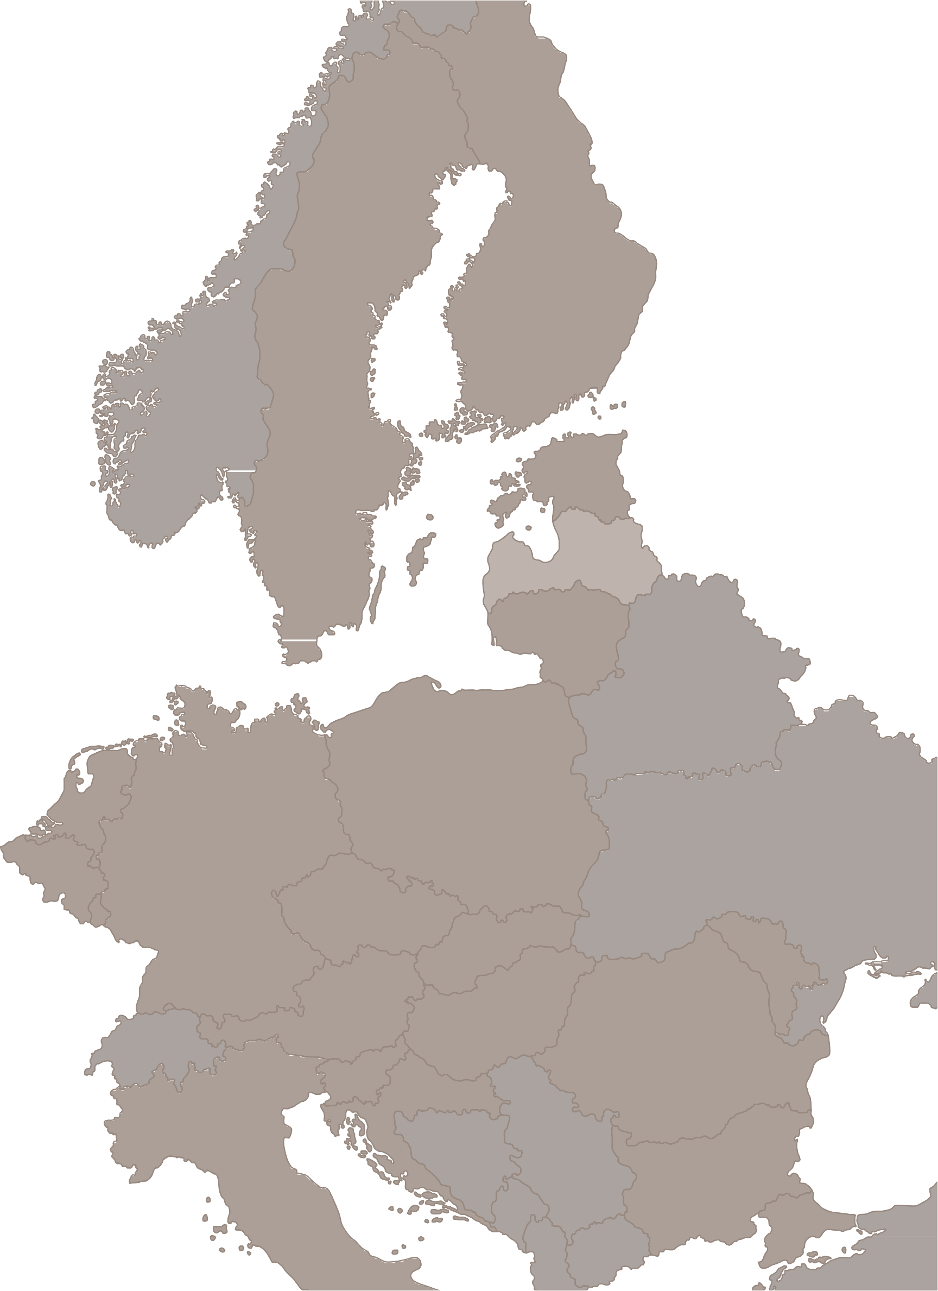
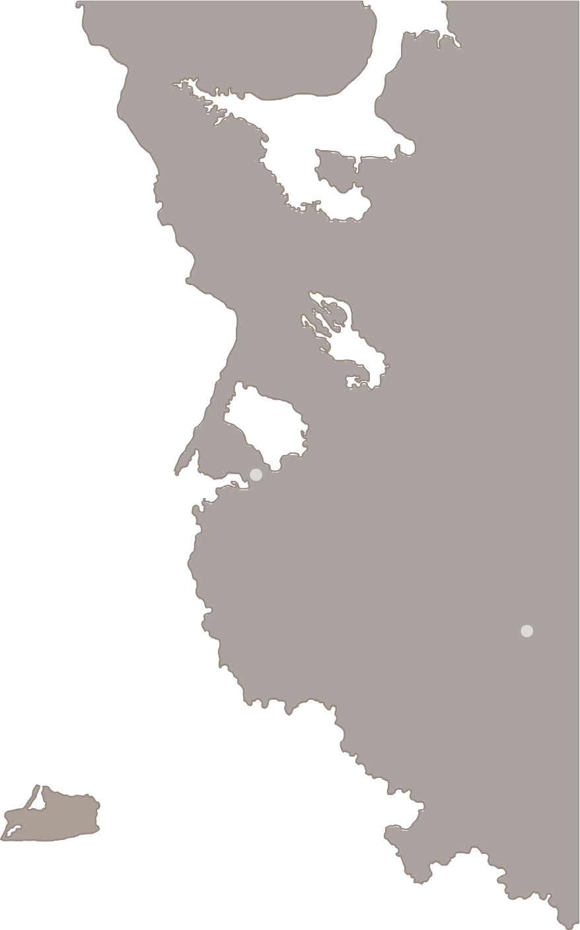

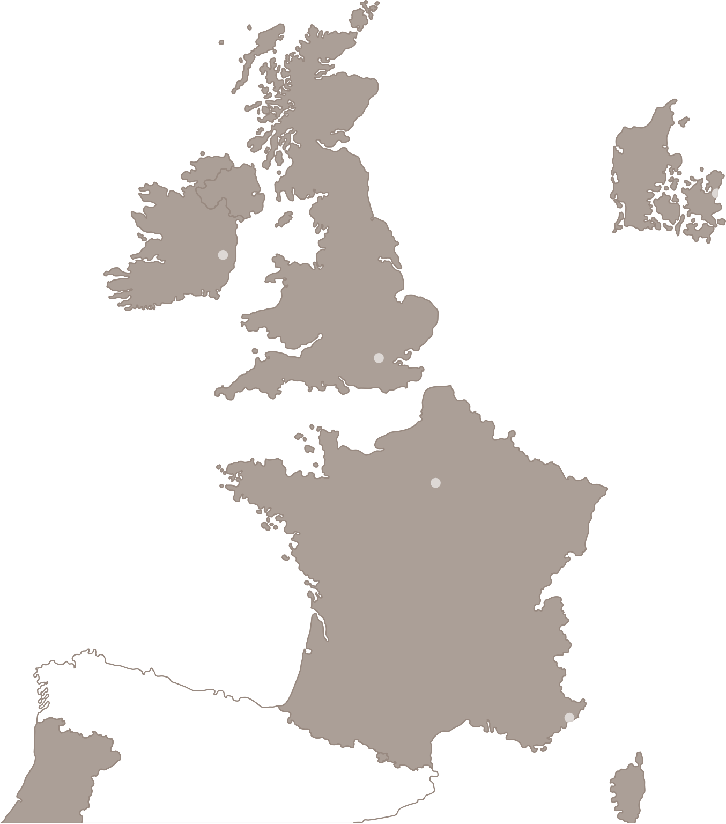








Riga - home
Latvia in Europe
of
Helsinki
St.Petersburg
Less than 3 hours away from the majority of European
Oslo
Stockholm
Tallinn
Air traffic hub of the Baltics
capitals
Moscow
More than 100 direct flights
3h flight
2h flight
1,5h flight
Riga
Copenhagen
Vilnius
Minsk
Dublin
airBaltic Codeshare partners:
London
Berlin
Kiev
Amsterdam
Warsaw
Frankfurt
Prague
Bratislava
Paris
Vienna
Chisinau
Bern
Budapest
Ljubljana
Zagreb
Bucharest
Milan
Belgrade
Monaco
Sarajevo
Sofia
Rome
Podgorica
Skopje
Madrid

Slide 5
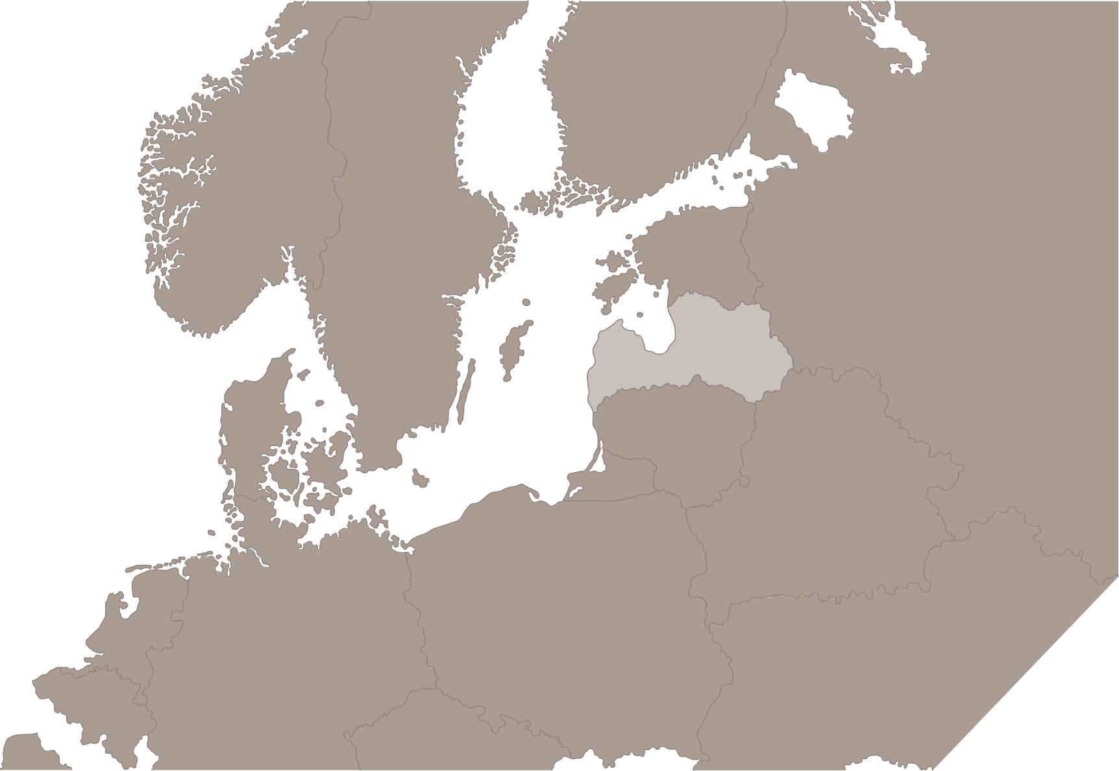




Coaches
Helsinki
St Petersburg
Comfortable coaches operate not only to and from neighbouring countries but also connect Latvia with France, Greece, Ukraine and other further countries
Tallinn
Oslo
Tartu
Stockholm
Parnu
Pskov
Valka
Riga
Rēzekne
Moscow
Daugavpils
Vitebsk
Kaunas
Copenhagen
Vilnius
Minsk
Less than 3 hours away from the majority of European capitals
Hanover
Warsaw
Berlin
Kyiv
Amsterdam
Krakow
Prague

Slide 6
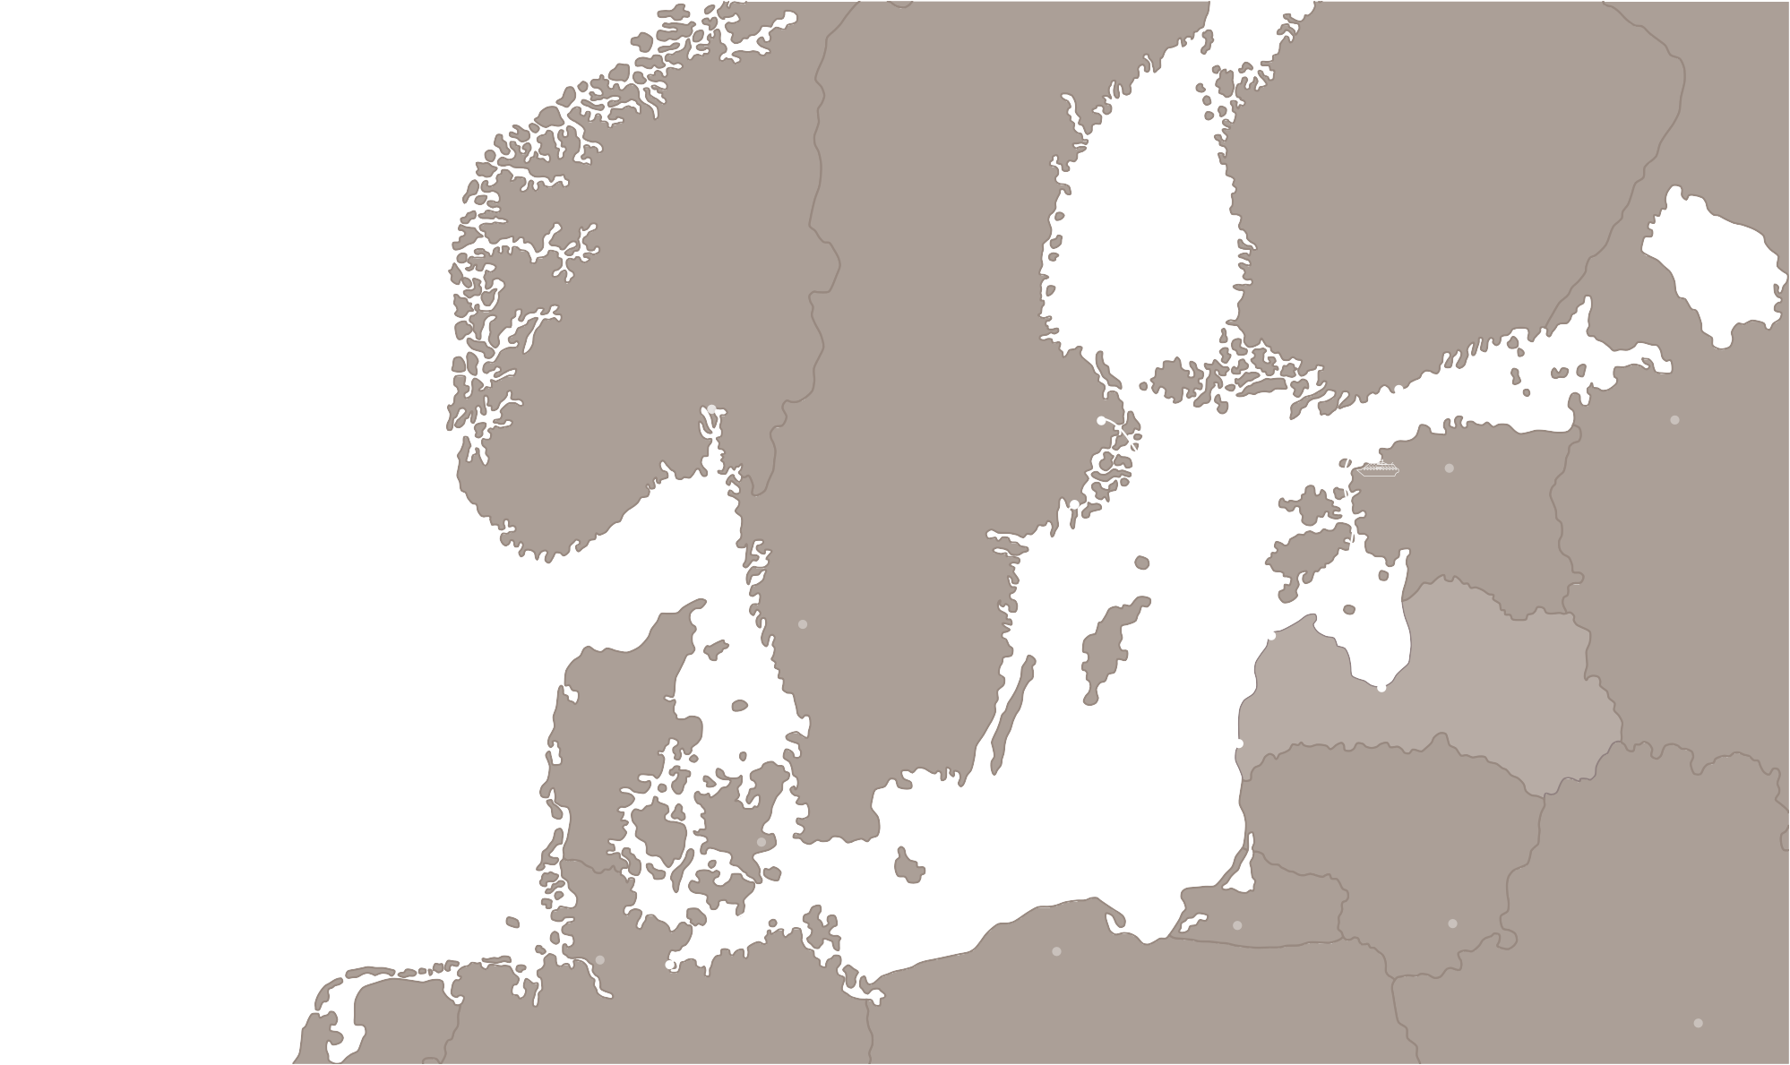

Ferry lines
Ferries operate to and from 3 port cities in Latvia – Riga, Liepaja and Ventspils. A cruise trip connecting Riga and Stockholm is only
18 hours long and is available up to 7 times a week.
Helsinki
Oslo
Stockholm
Saint Petersburg
Tallinn
Nynashamn
19h
The ferry between Liepaja and Travemunde in Germany operates up to 5 times a week with sailing duration from 26 hours.
18h
8.5h
Gothenburg
Seasonal ferry between Riga and Helsinki.
26h
Ventspils
Riga
Baltic Sea
Liepaja
Copenhagen
25.5h
Kaliningrad
Vilnius
Hamburg
Travemunde
Gdansk
Minsk

Slide 7
Some facts about Riga
Riga Central Market is one of the biggest markets in Europe. It is famous for its pavilions housed in giant zeppelin hangars.
Home to almost half of country's population
Riga was founded
in 1201
Its historical center is a UNESCO World Heritage Site
Over 800 Art Nouveau buildings
More than 800 free
WIFI connection points
liveriga.lv

Slide 8
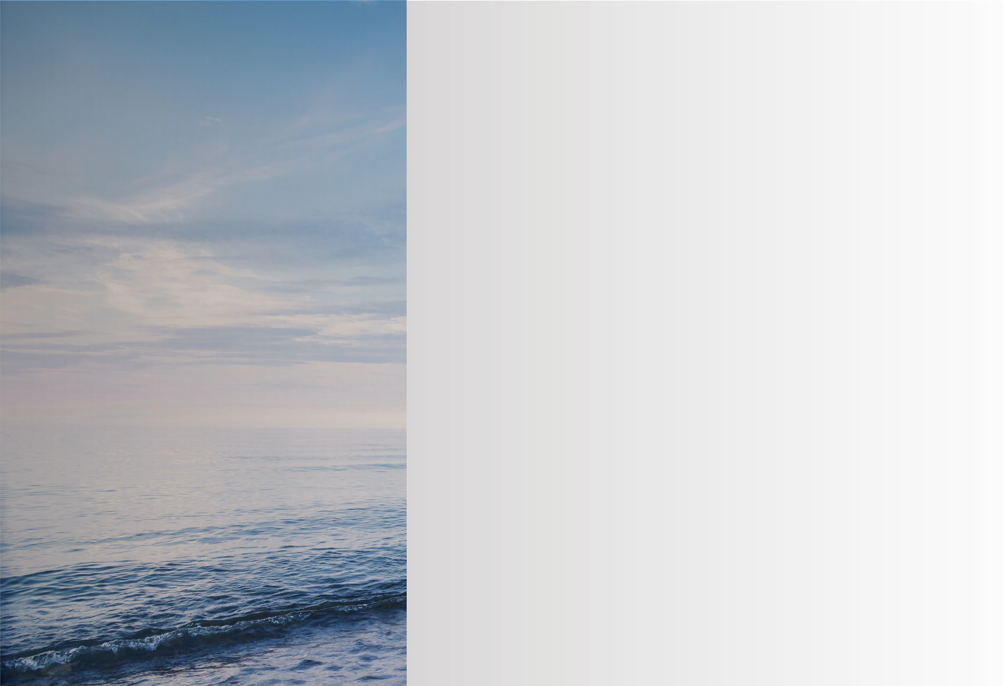
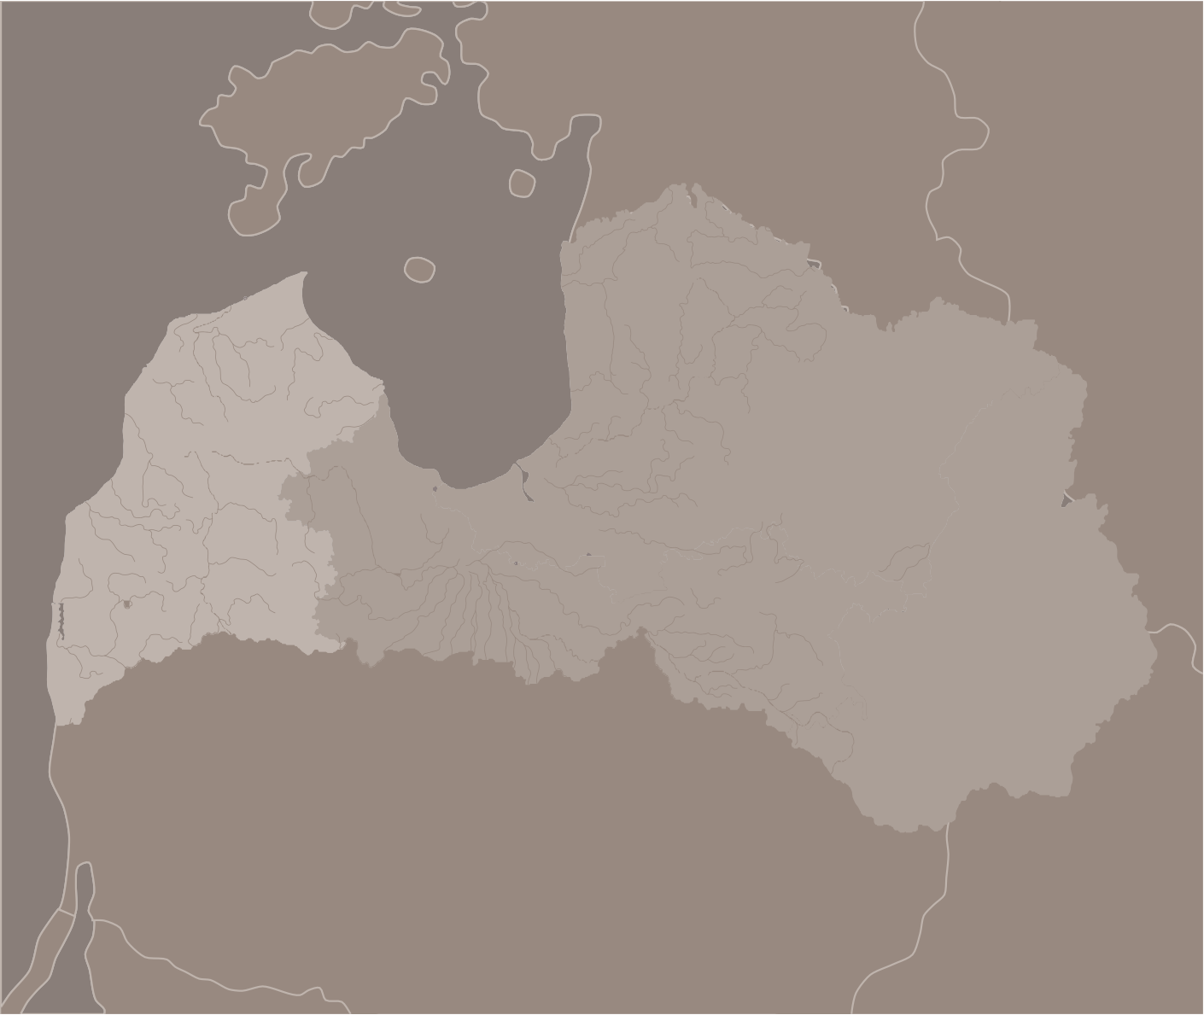
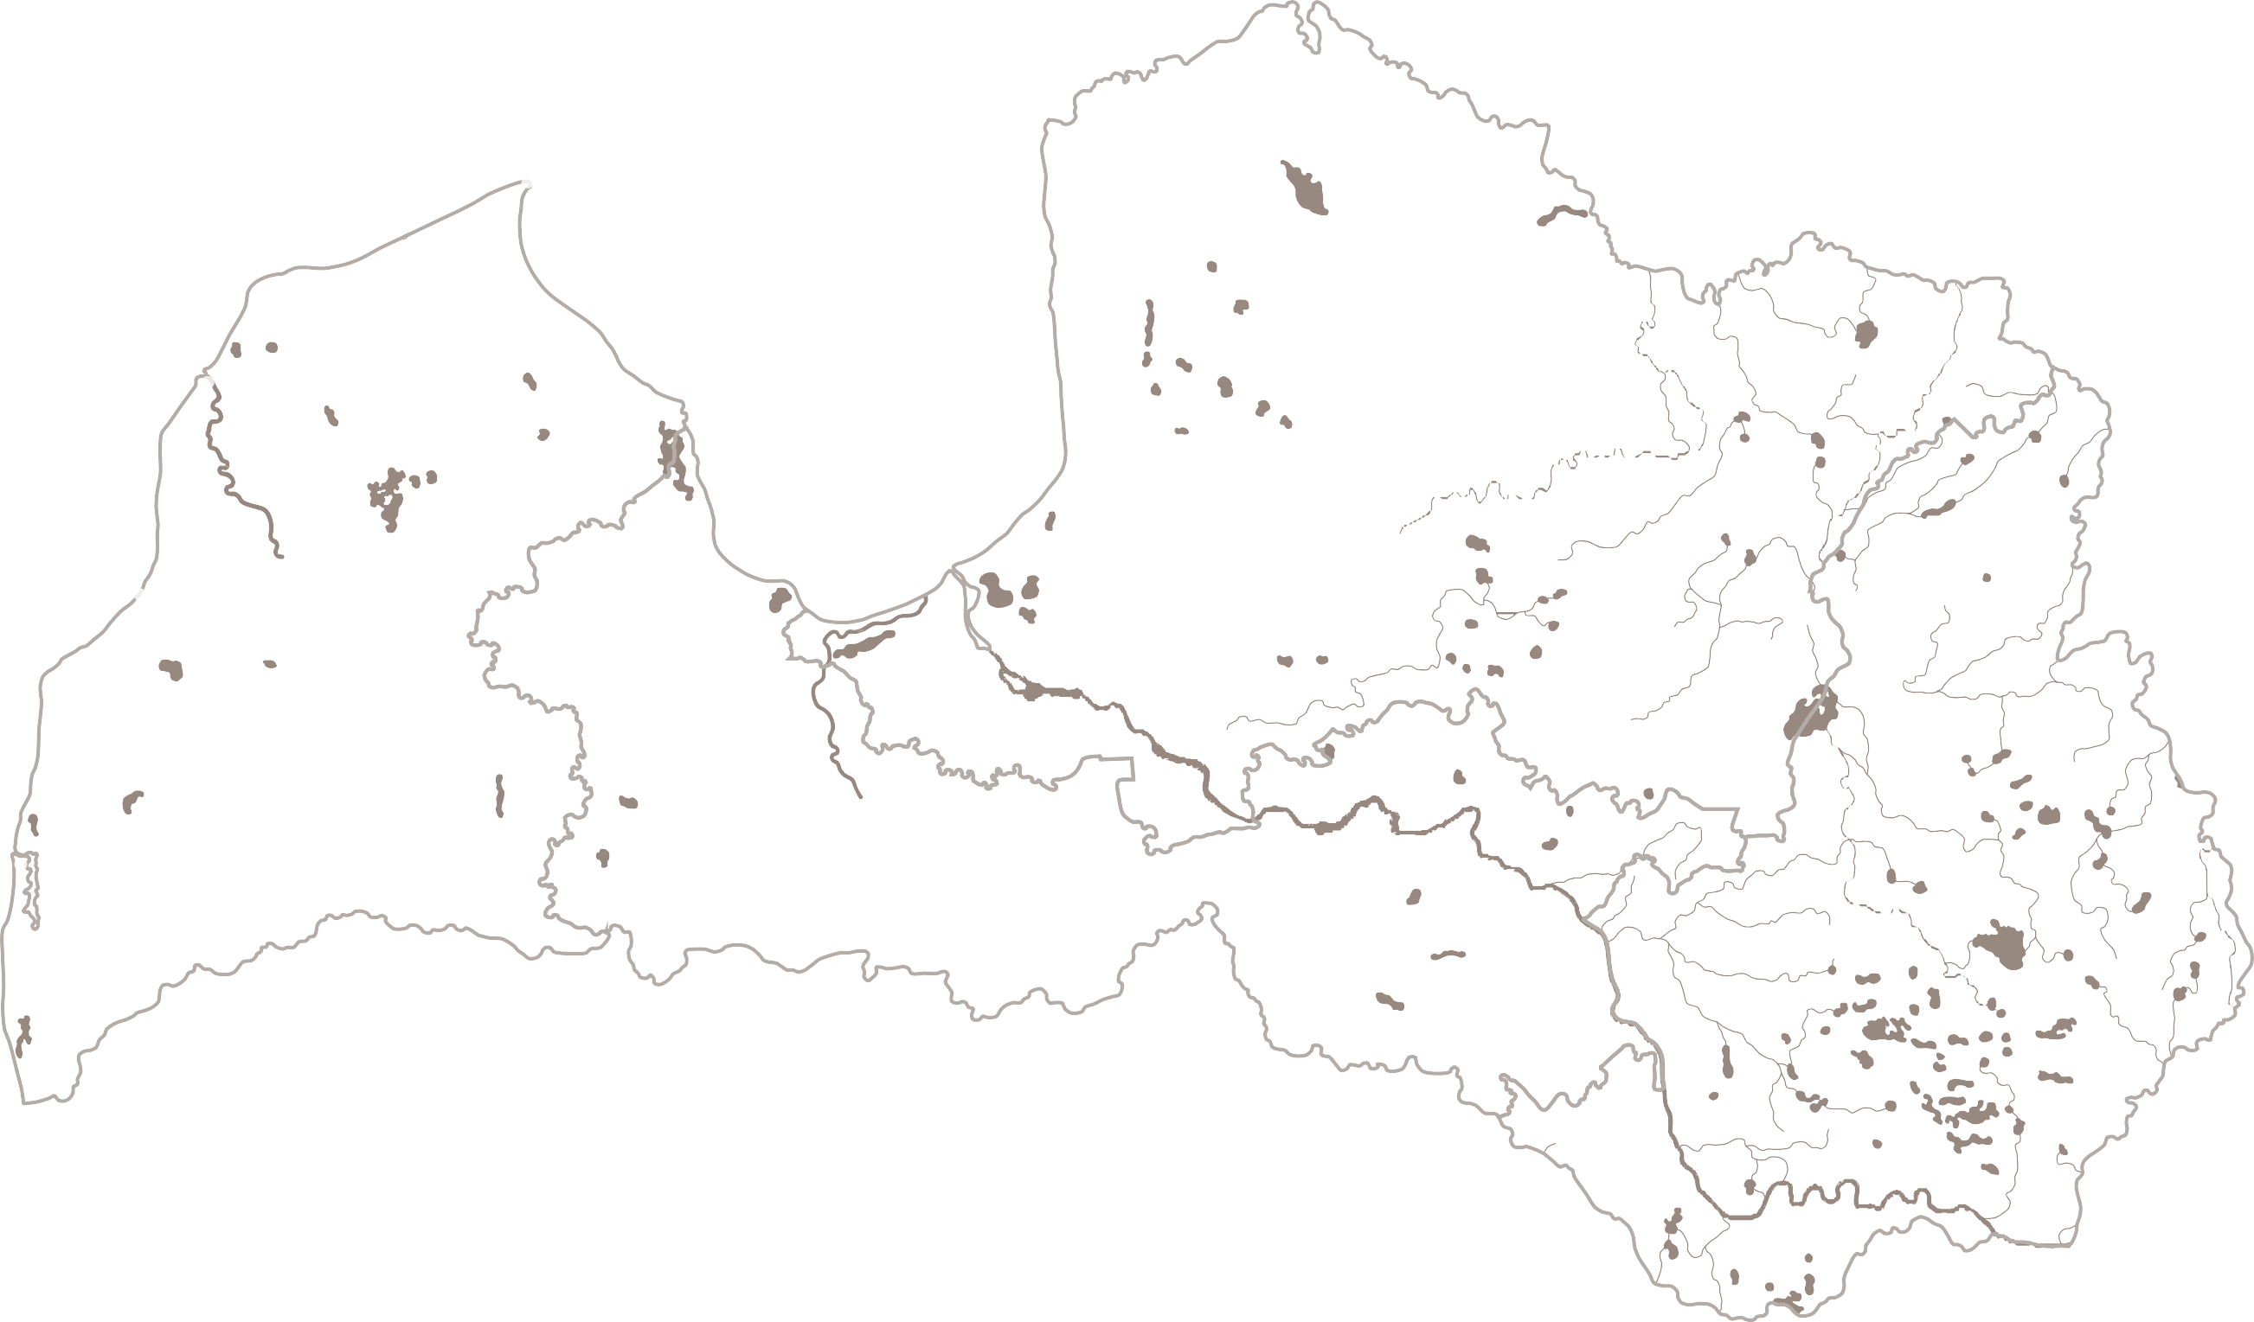
Estonia
_{Kurzeme} (Courland)
region
Russia
Baltic Sea
Cape Kolka
Situated in western Latvia, Kurzeme has a 350 km border with the Baltic Sea. The highlights include the picturesque Jurkalne seashore buffs and the Cape Kolka - a unique place where the Baltic Sea collides with the Gulf of Riga.
Ventspils
Jurkalne
Sabile Kuldiga
Kurzeme
Liepaja
The region can be proud of more than 200 lakes and small rivers. Combined with the Baltic Sea, it's a natural fisherman's paradise, also perfect if you're rather interested only in eating delicious fish.
Need a drink with your meal? Sabile’s Wine Hill is included in Guinness Book of World Records as the northernmost vineyard in the world - suited both for romantic walks and wine tastings.
Lithuania
Belarus
kurzeme.lv

Slide 9
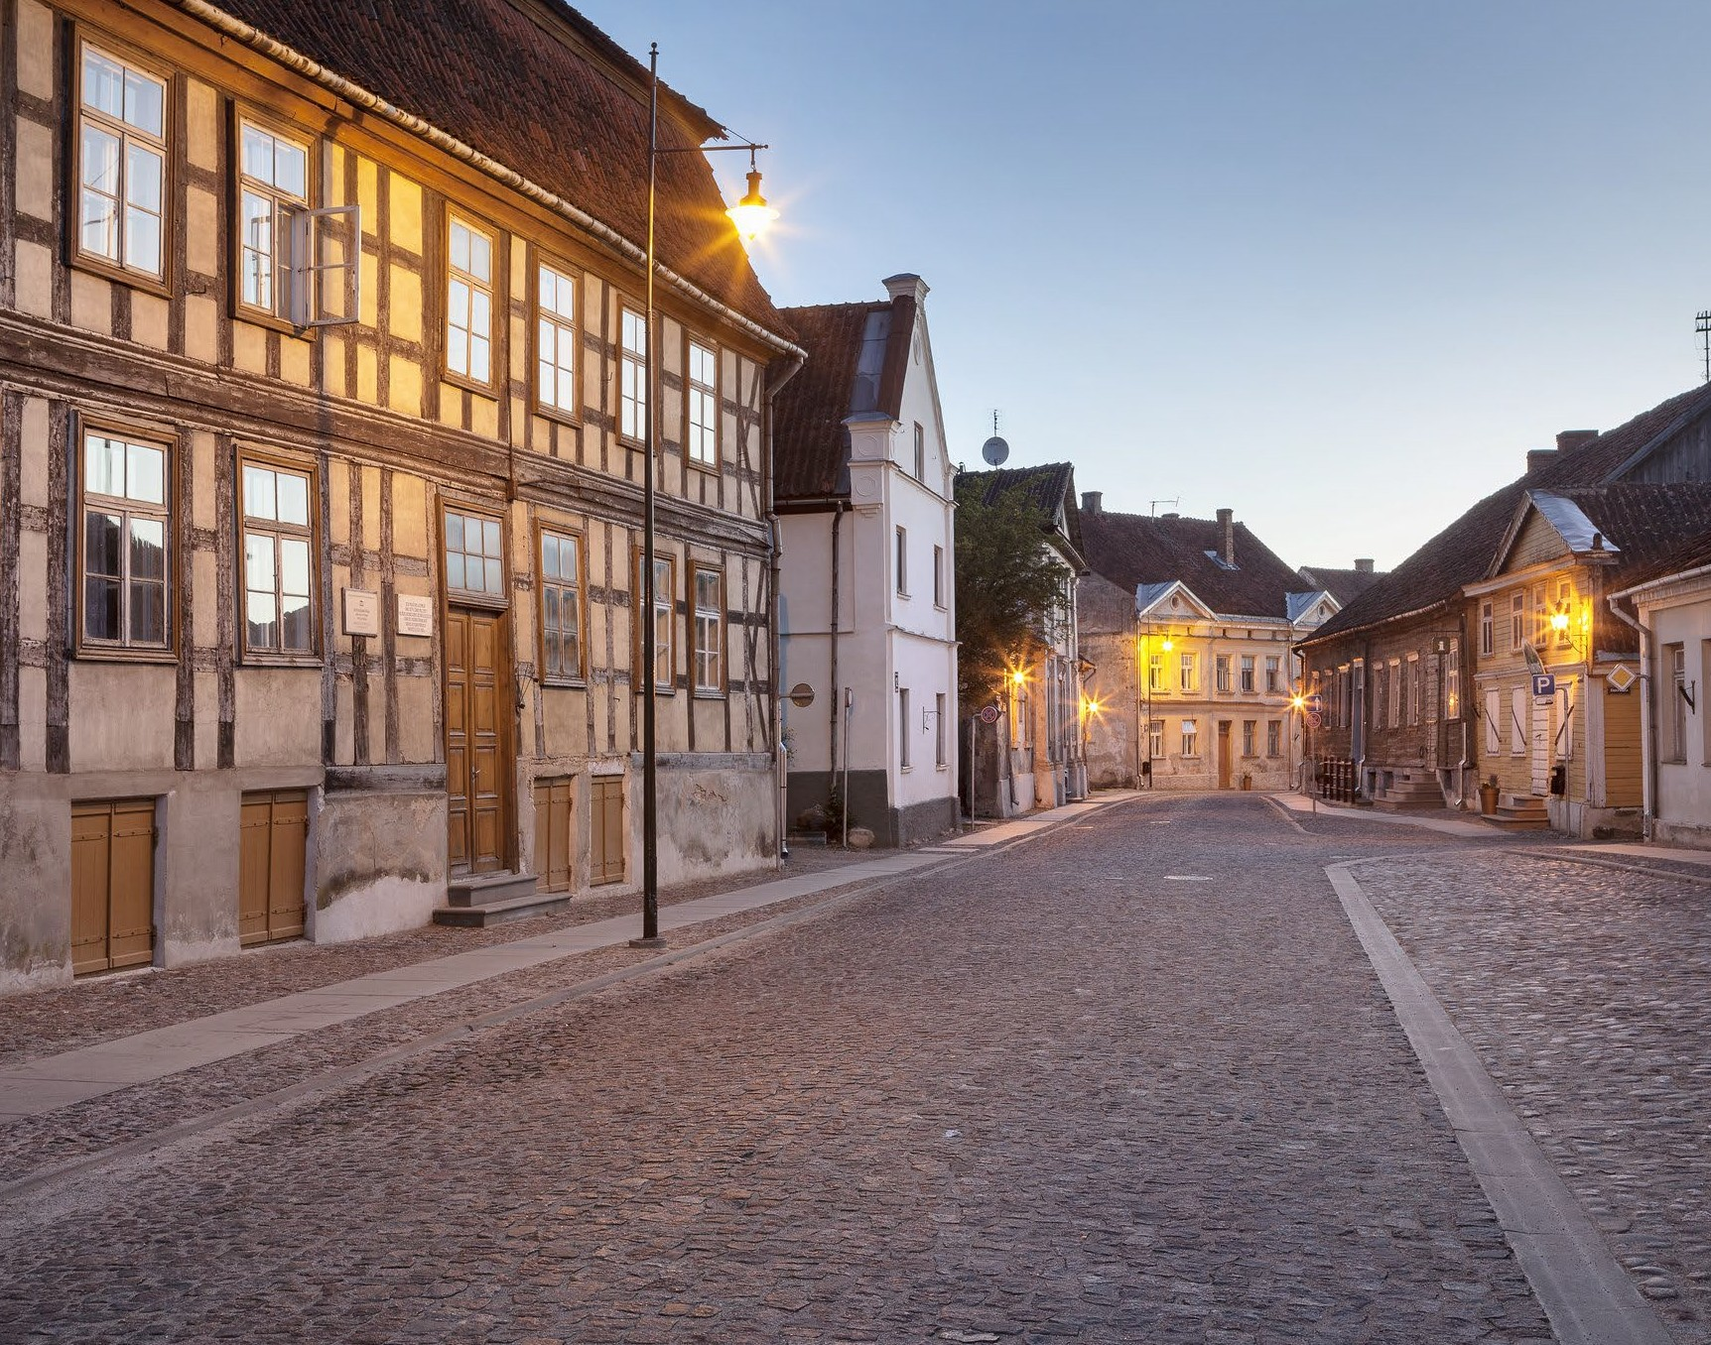
Kuldiga - heritage
of centuries
Situated 150 km from Riga and 100 km from Liepaja, this ancient town was one of the capitals of the Duchy of Courland (1562-1795).
The architecture is still well-preserved and admired by many.
In the Restoration center of Kuldiga everybody is invited to learn more on how to preserve a building's authenticity by performing conservation and restoration works.
The historical centre of Kuldiga has the European Heritage Label and is included in the UNESCO World Heritage Latvian Tentative List. Don't just look with your eyes – take the chance to stay in one of Kuldiga's unique, little hotels.
visitkuldiga.com

Slide 10
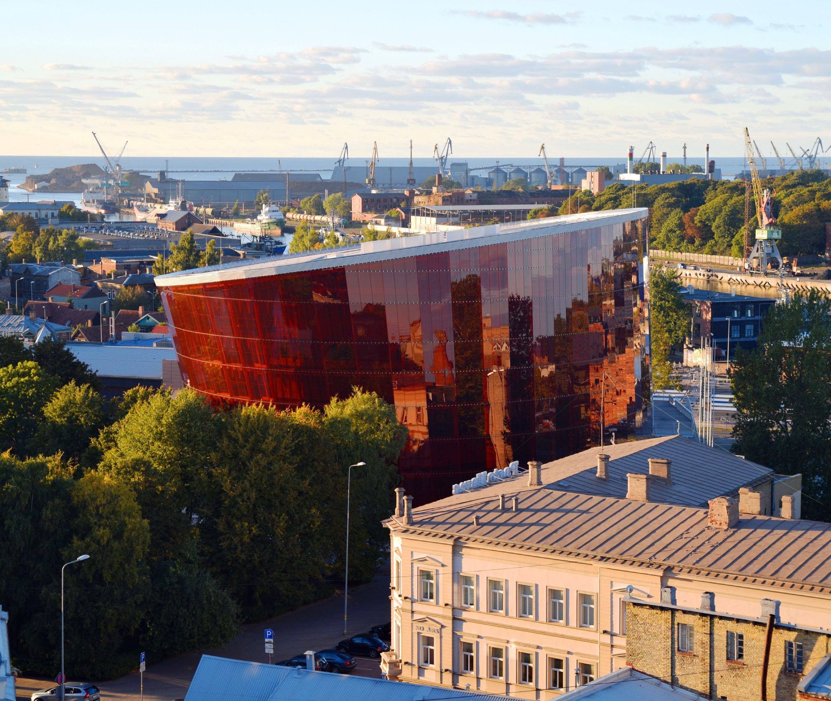
Liepaja never sleeps
The port city Liepaja can be proud of its lively cultural life, enriched by an artistic and independent spirit.
Liepaja Theatre, concert hall “Great Amber” and art gallery “Romas Darzs” are just a few of places in Liepaja to enjoy culture.
During the summer, Liepaja also hosts the annual pop music festival Summer Sound that takes place right on the sandy beach, but if you'd like to enjoy more spiritual sounds – visit the Holy Trinity Cathedral where you can hear the world’s largest mechanical organ.
Fun fact: Liepaja is considered to be the birthplace of the best Latvian rock music singers.
liepaja.travel

Slide 11
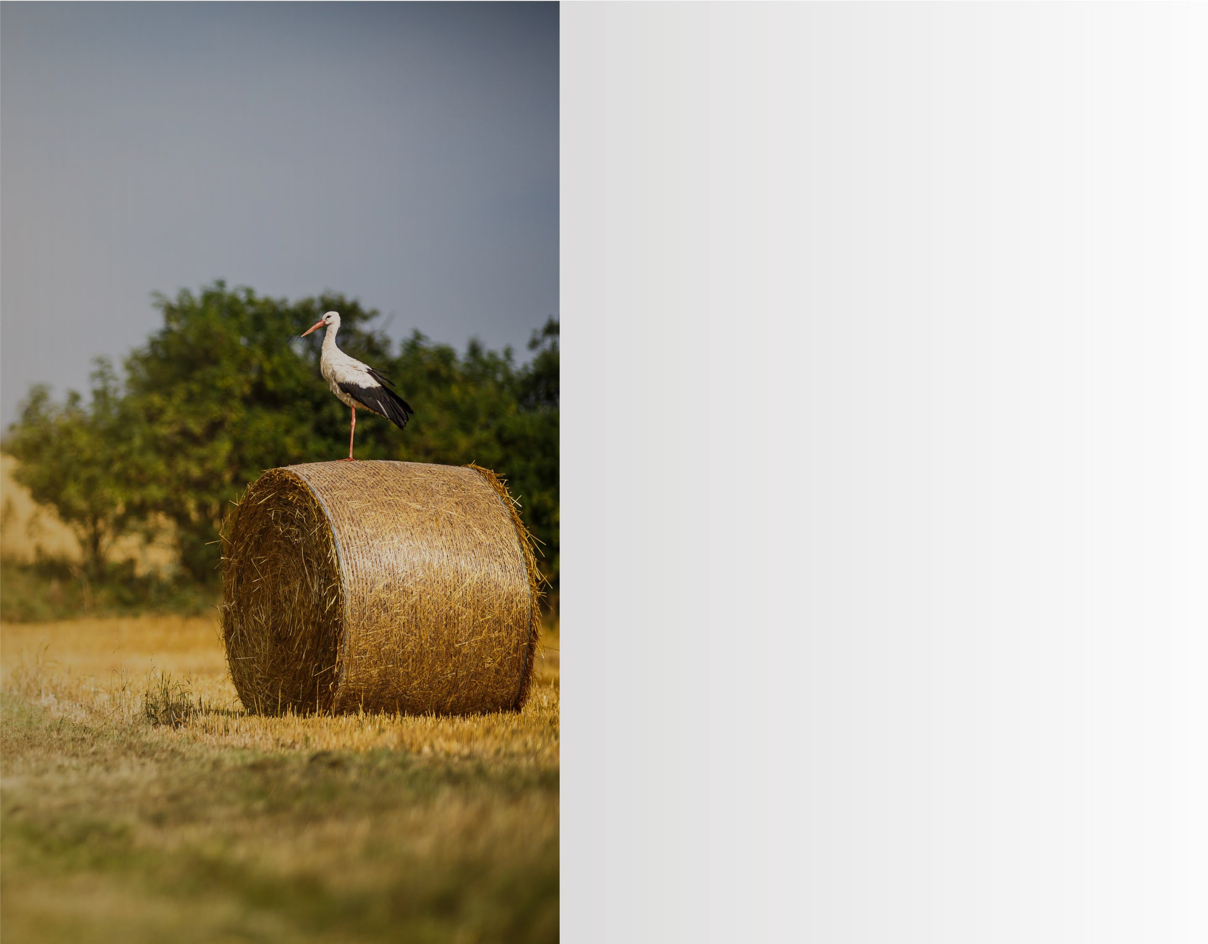
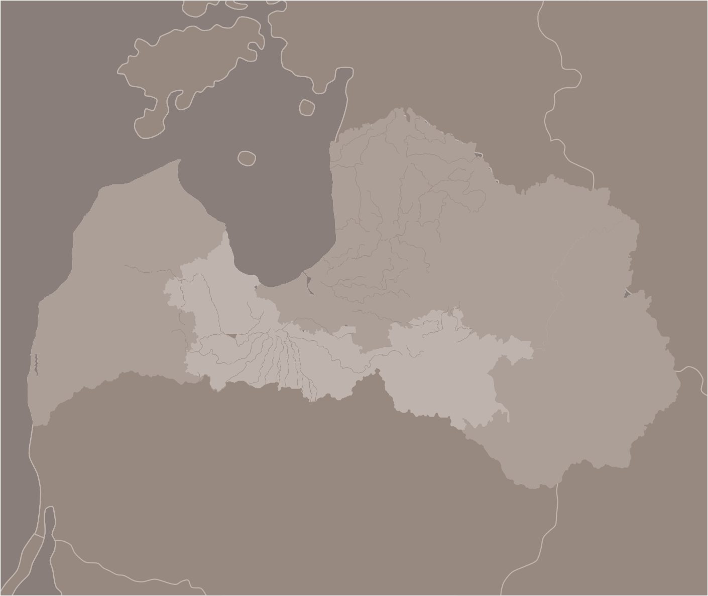

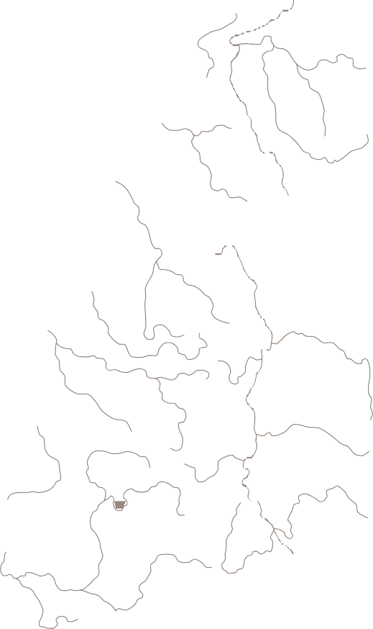
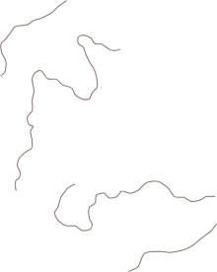
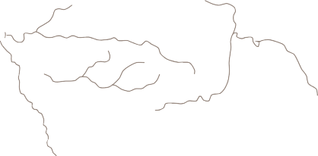

Estonia
_{Zemgale} (Semigalia)
region
Russia
Baltic Sea
Situated in southern Latvia, Zemgale's landscape stands out with extended cultivated fields. Here are the highest chances to spot majestic storks that Latvians hold sacred – a stork’s nest close to a home is considered a blessing.
Jelgava
Zemgale
Bauska
Jekabpils
Zemgale is significant with its large number of remarkable palaces and manors, with Jelgava Palace and Rundale Palace being the most renowned ones.
The Region's central town Jelgava annually holds international ice sculpture and sand sculpture festivals, making it worth paying a visit either in summer or winter.
Lithuania
Belarus
travelzemgale.lv

Slide 12
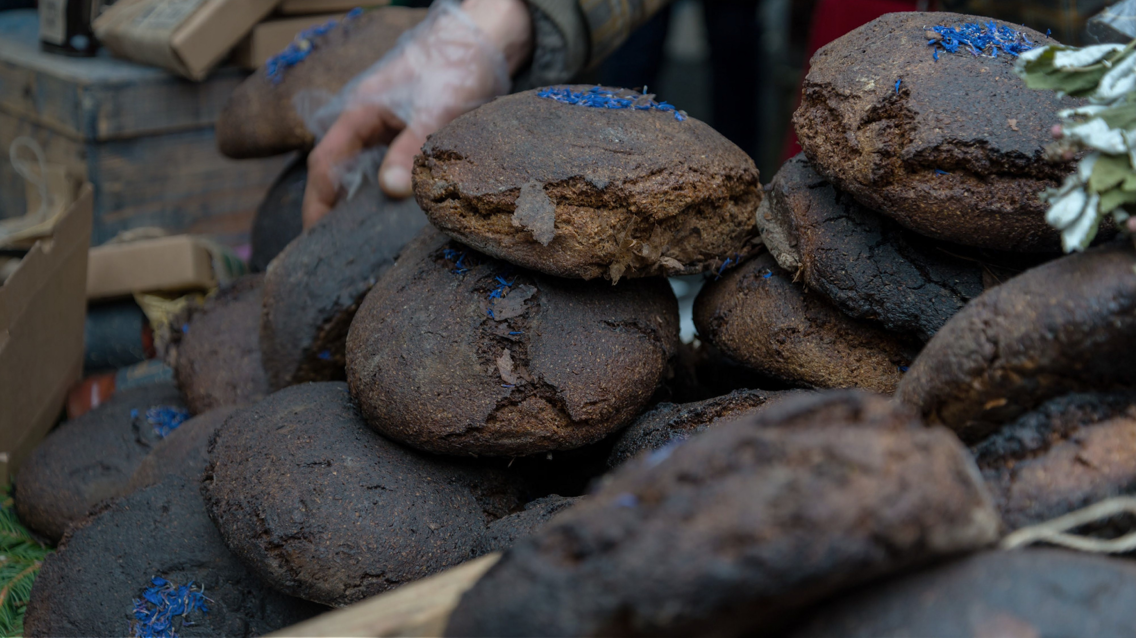
Bread barn of Latvia
Locals pay tribute to Zemgale with this sweet nickname for centuries. Since ancient times, bread making traditions in Latvia have been considered sacred.
When in Latvia, definitely taste locally baked bread or even take a chance to participate in the baking process.
celotajs.lv

Slide 13
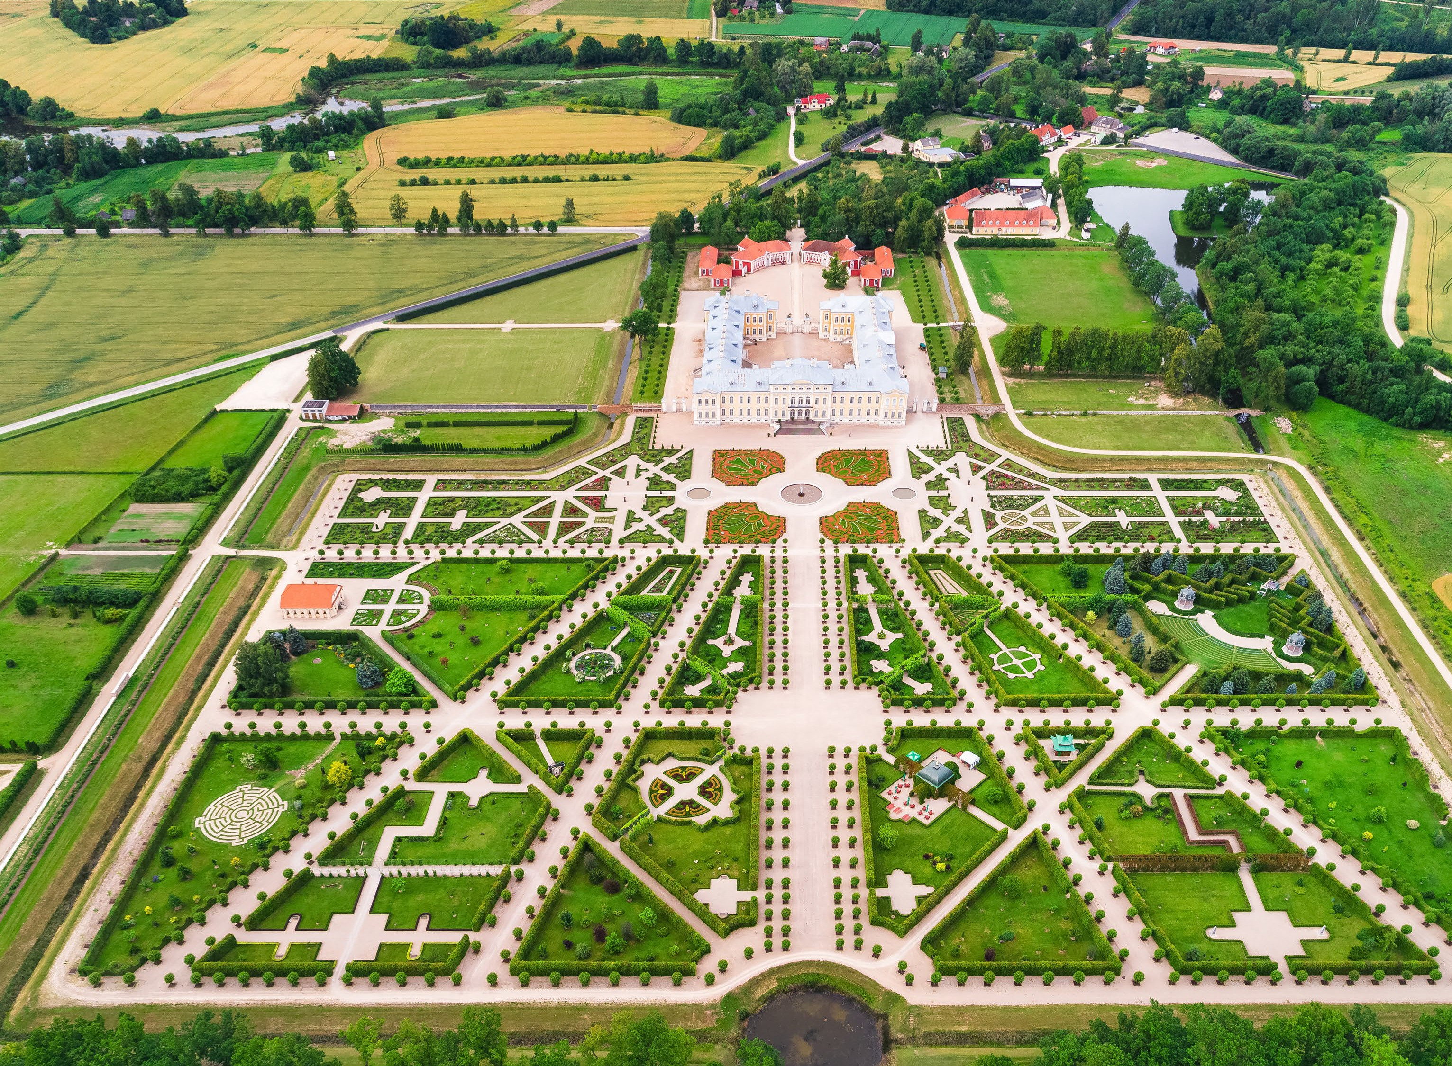
Rundale Palace
Rundale Palace is the most notable 18th-century Baroque and Rococo architectural monument in Latvia.
Designed by Italian architect F. B. Rastrelli, this impressive palace and its gardens are now a museum – one of the major tourist destinations in entire country.
rundale.net

Slide 14
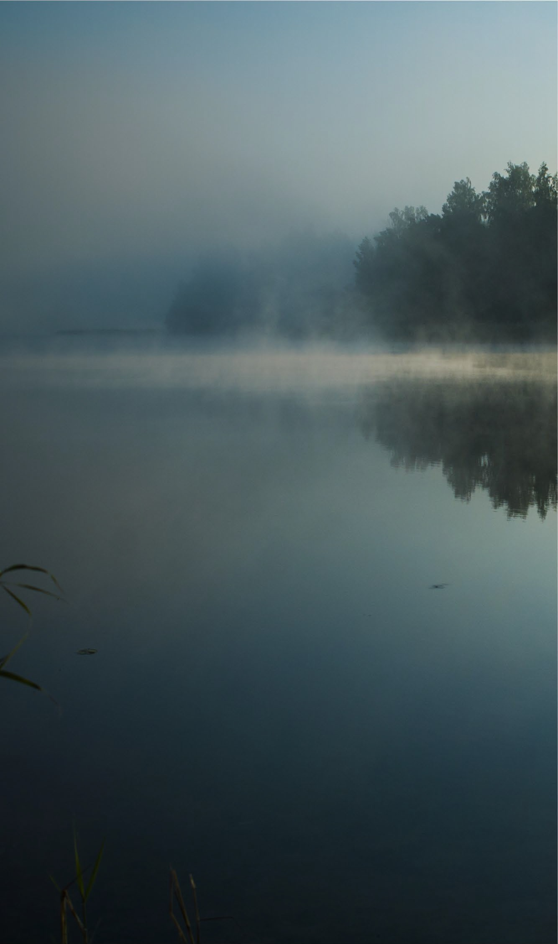
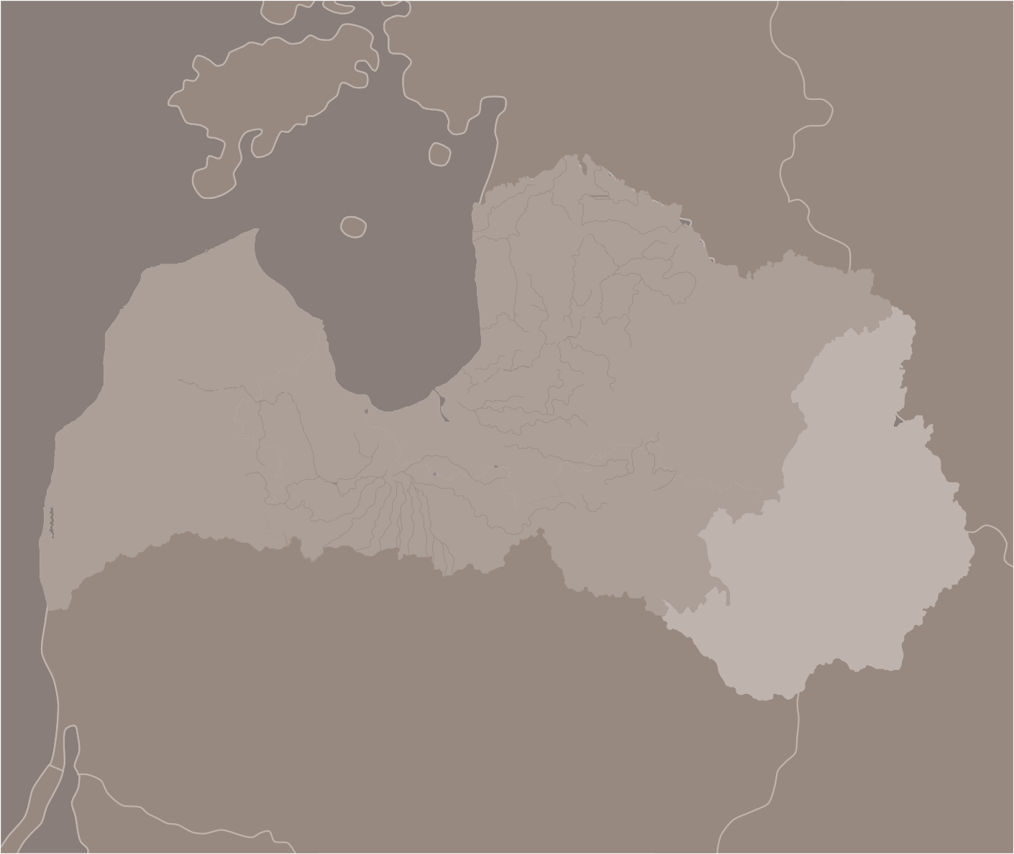
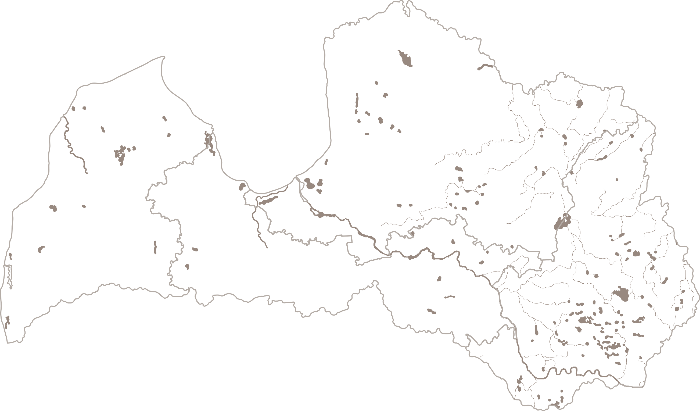
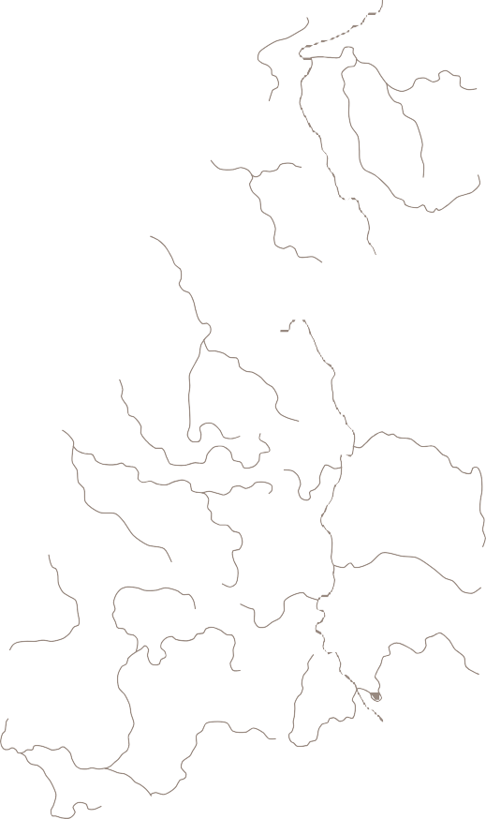



Estonia
Latgale region
Russia
Baltic Sea
Also called the Land of Blue Lakes, this is where the largest number of lakes in Latvia are congregated – of course, full of delicious fish.
Latgalians themselves are famed by their warm hospitality, unique mentality and traditions. Interestingly, language used in Latgale also differs from the rest of the country.
Rezekne
Latgale
Aglona
Ludza
Latgale is also famed for its craftsmen – ceramists, weavers and wickerwork makers. Their work in its widest range is available during the solstice market in Ludza.
Daugavpils
Lithuania
Belarus
latgale.travel

Slide 15
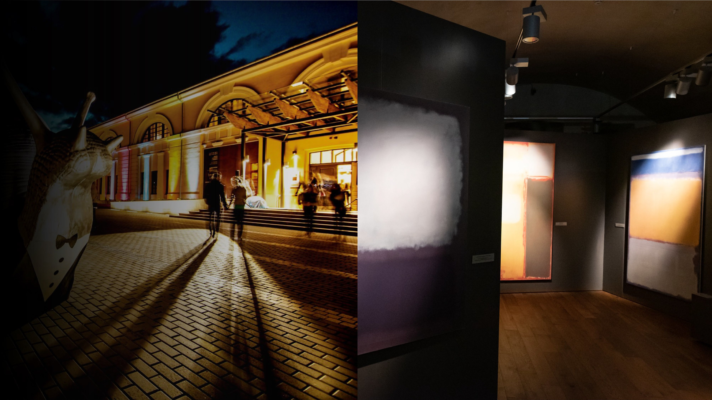
Mark Rothko
Not everybody knows that the acclaimed artist Mark Rothko was born in Daugavpils.
Now Daugavpils Mark Rothko Art Centre is the only place in Northern Europe providing an opportunity to get acquainted with his original works.
rothkocenter.com

Slide 16
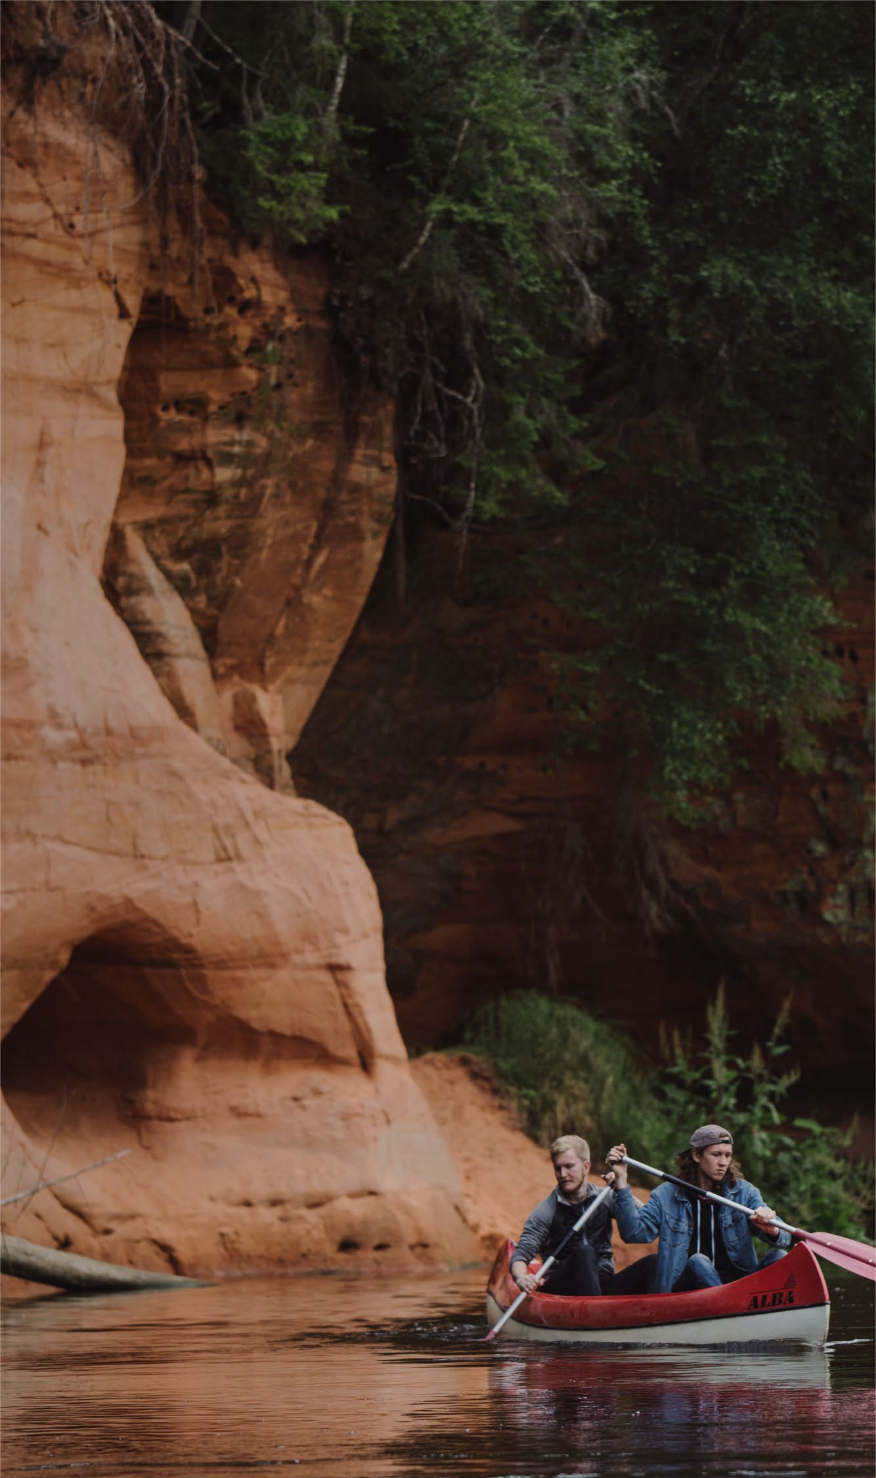
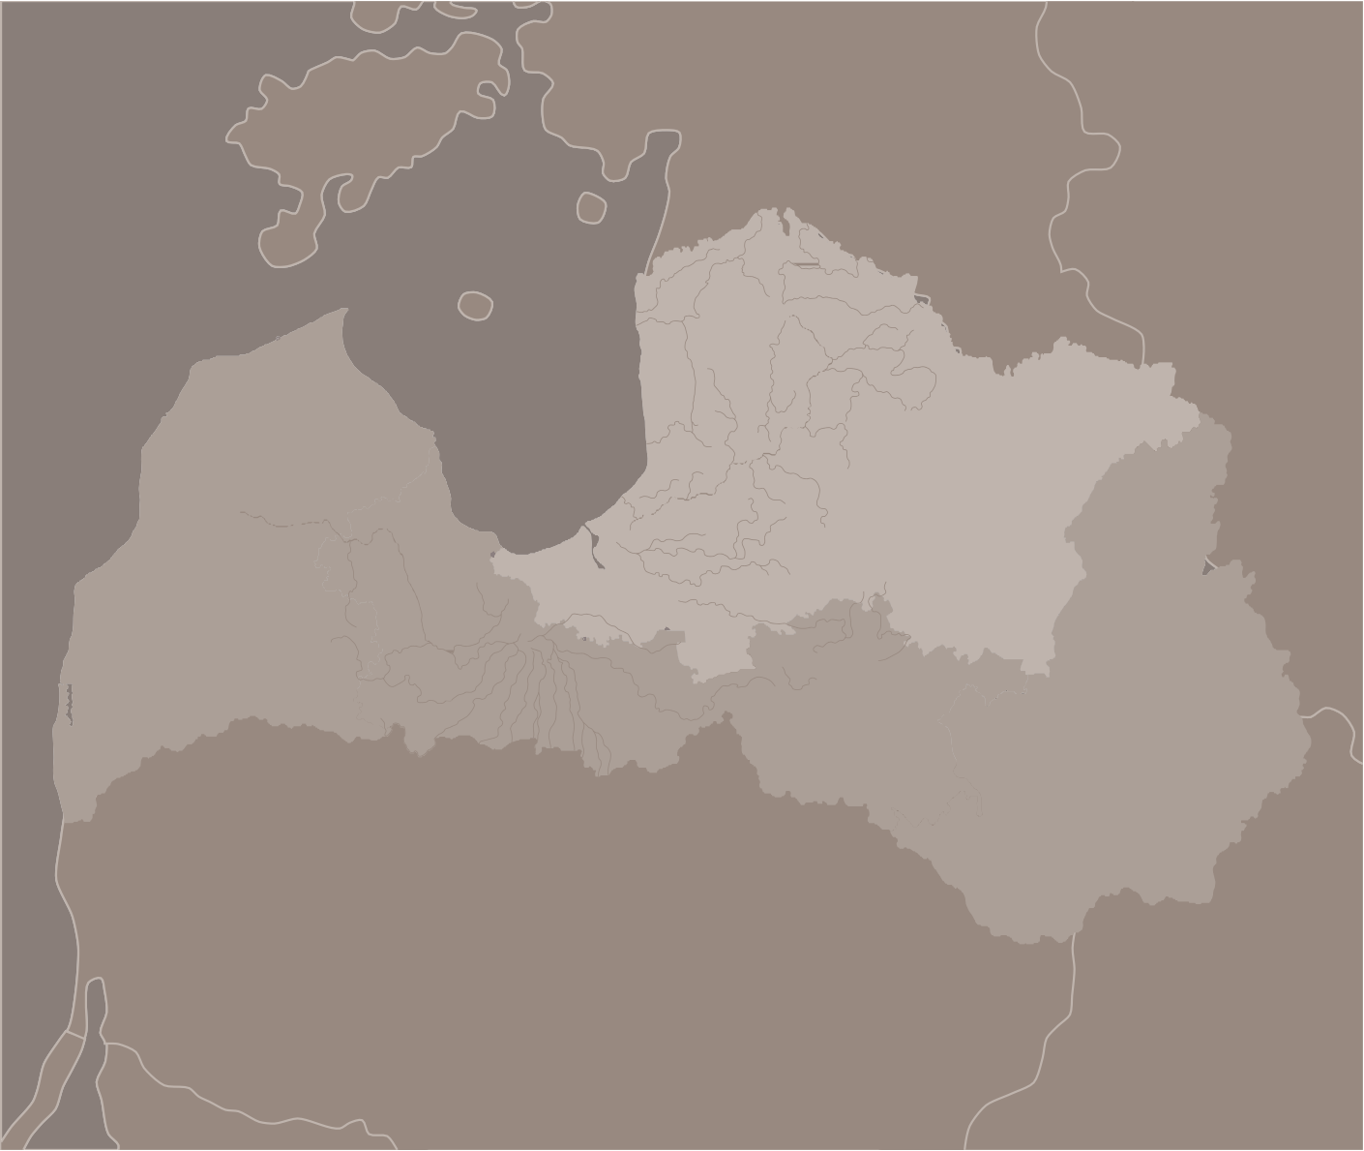

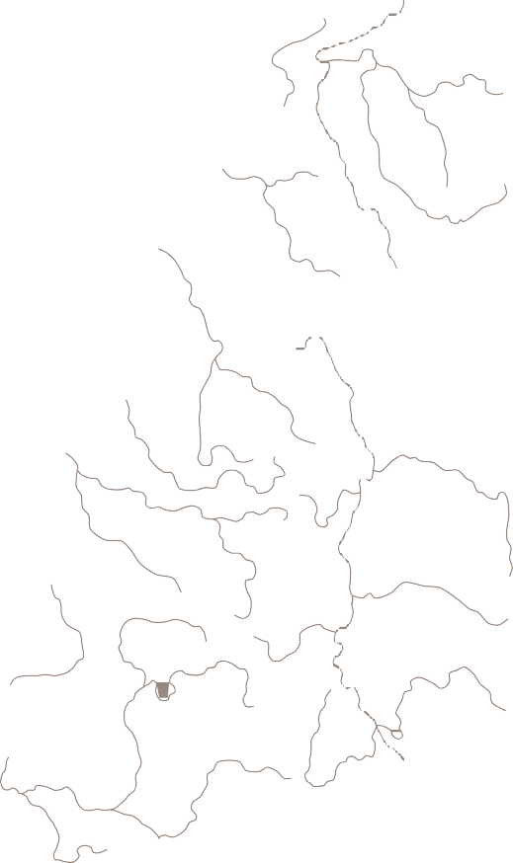



Estonia
Vidzeme region
Russia
Baltic Sea
Valka & Valga
Salacgriva
Valmiera
Literally meaning "the Middle Land", Vidzeme covers the central and northern parts of Latvia. Coastline, hills, rivers and cliffs – Vidzeme is diverse and simply meant for nature lovers.
Even though the region is recognized for the outstanding landscapes and historical sites like medieval castles, this is also where you can visit Riga and Jurmala - cities buzzing with life and different events.
Vidzeme
Gulbeni
Riga
Jurmala
Bordering Estonia, Vidzeme can be proud of a unique town that is split between the two countries - called Valka on our side and Valga across the border. The inhabitants have learned to coexist and take the best from each country.
Lithuania
Belarus
vidzeme.com

Slide 17
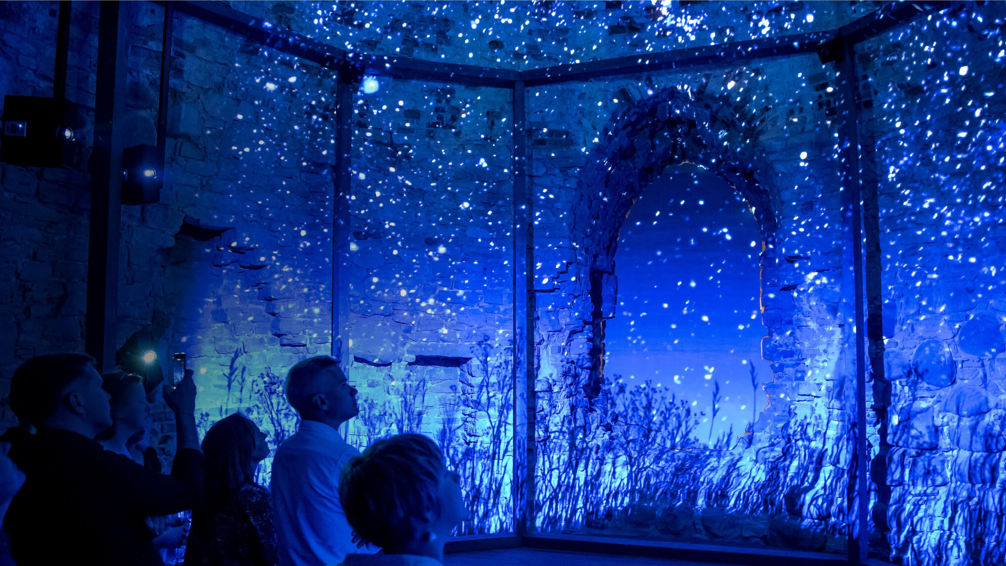
Cesis
Ancient meets trendy, that's the charm of Cesis – one of the
best-preserved medieval towns in the Baltics. Though 800 years of history is no obstacle for the most innovative and creative cultural events to be held exactly here.
This is where architects move to live, leaving the capital behind. This is where cafes are the trendiest and events – most stylish and up to date.
visit.cesis.lv

Slide 18
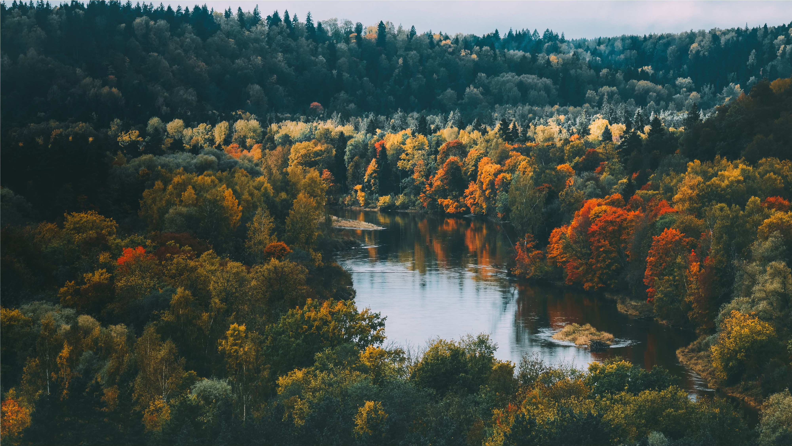
Gauja National Park
Gauja river valley and its vast diversity of plant and animal species are protected by a park that connects ancient times with modern hotels, restaurants and exciting activities.
Things to do include hikes in nature, boating, bike tours, excursions through the impressive number of castles, manors and churches and so much more. This is not the place for only one or two days, be ready for a lengthy adventure!
entergauja.com

Slide 19
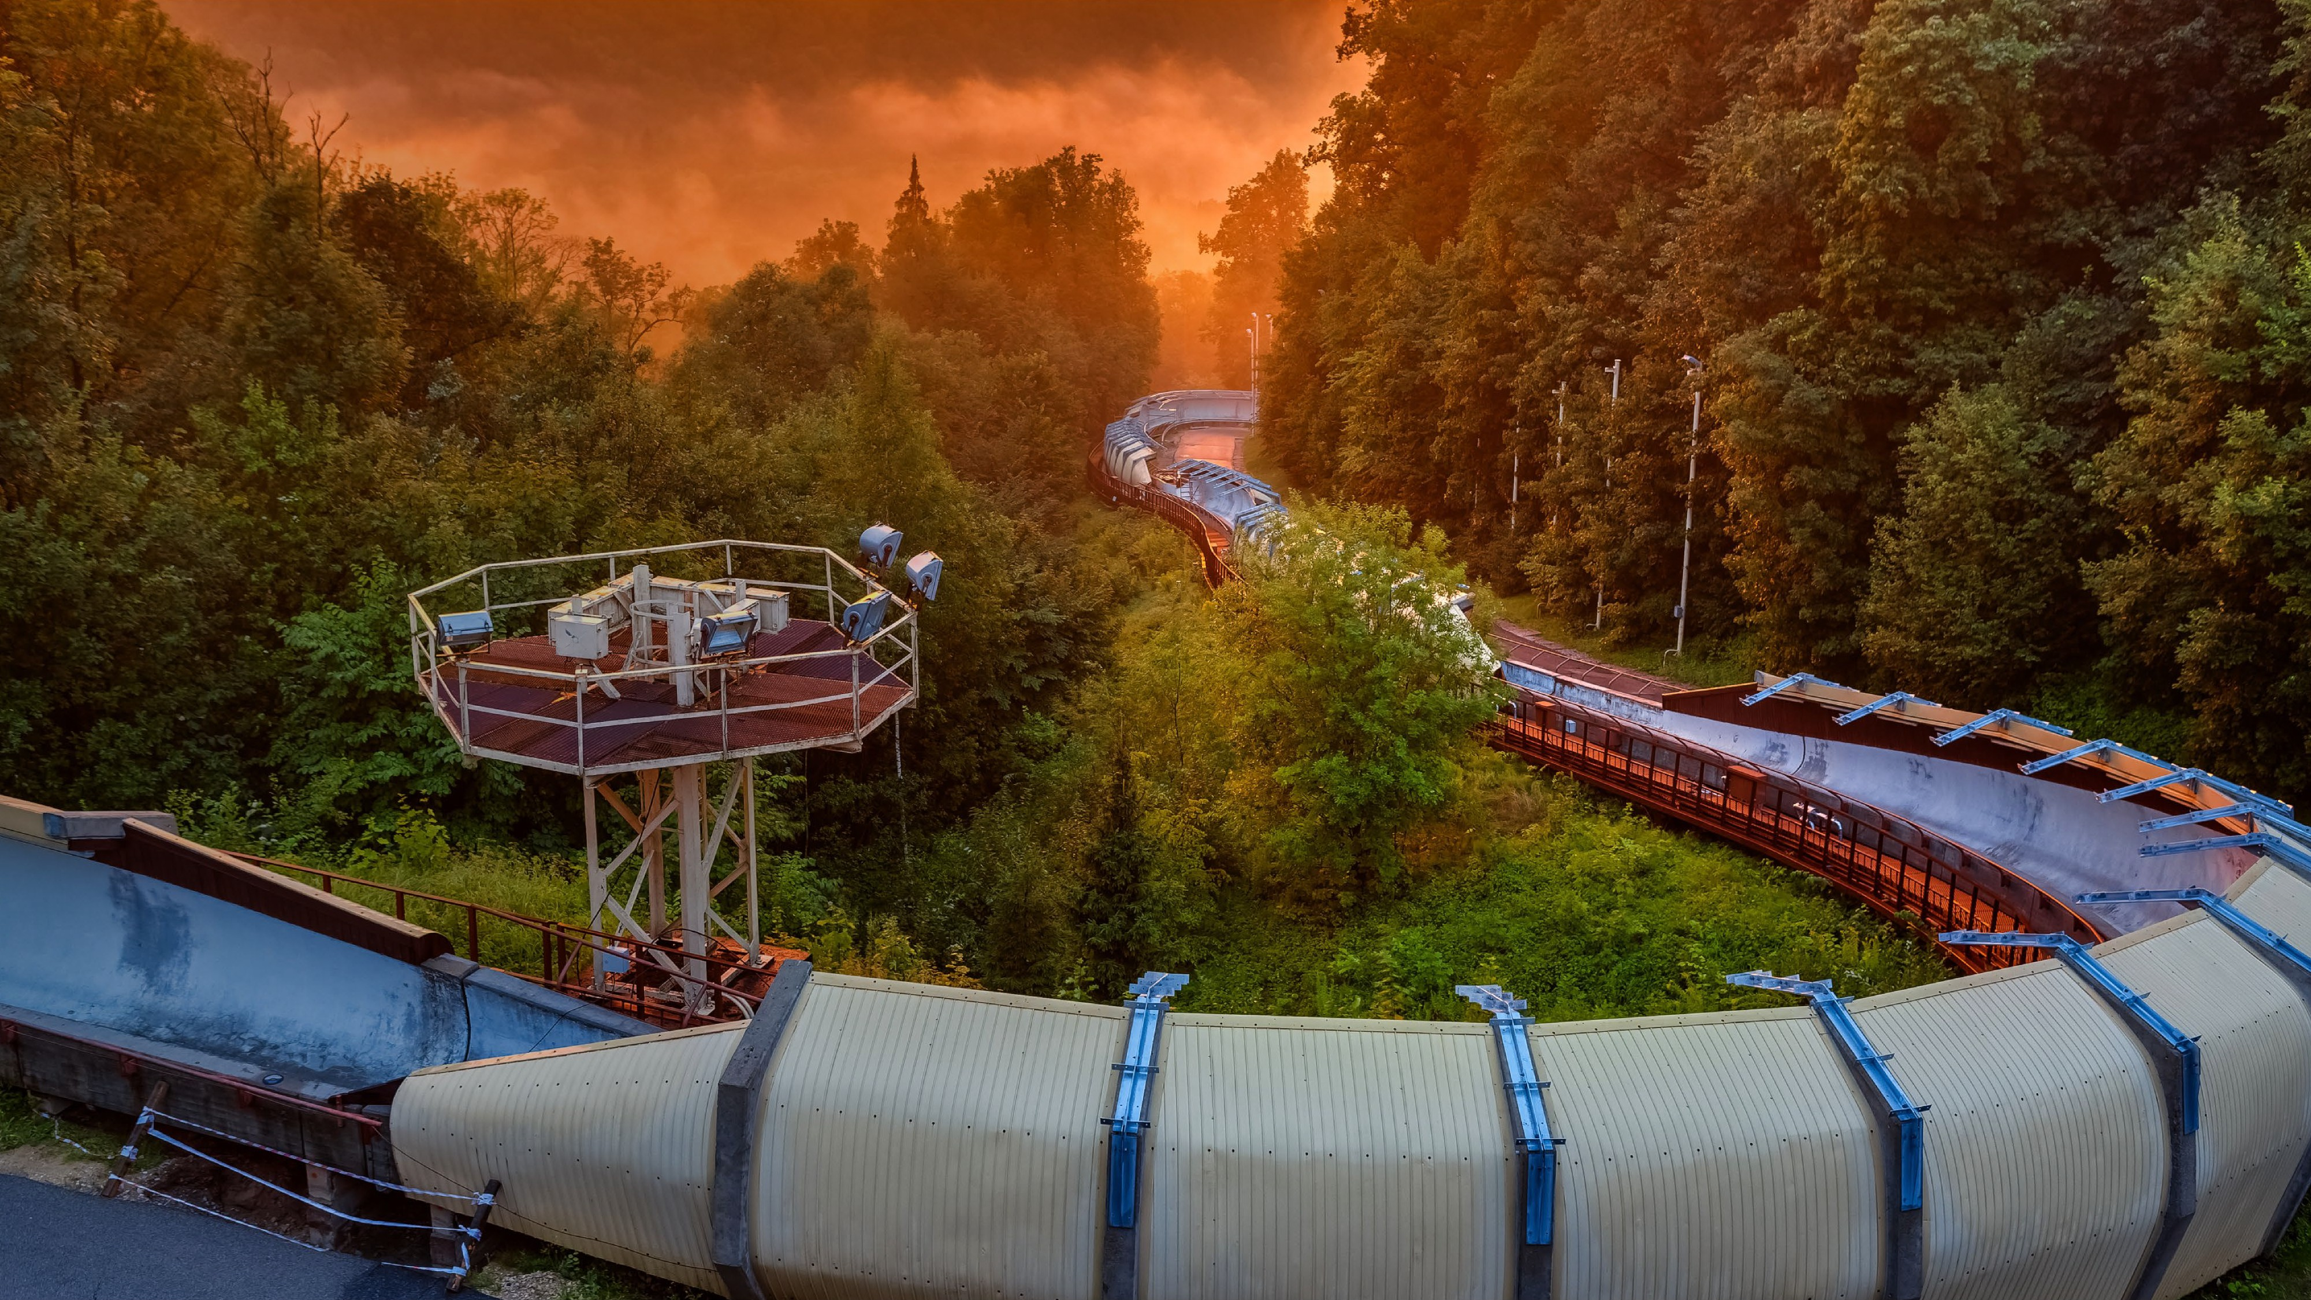
Unique activities in Gauja National park
Sigulda Medieval Castle ruins
AERODIUM vertical wind tunnel
Soviet Secret Bunker in Ligatne
Sigulda bobsleigh track
Turaida Museum Reserve
Cesis Castle complex
Bungee Sigulda
Zipline Zerglis
entergauja.com

Slide 20
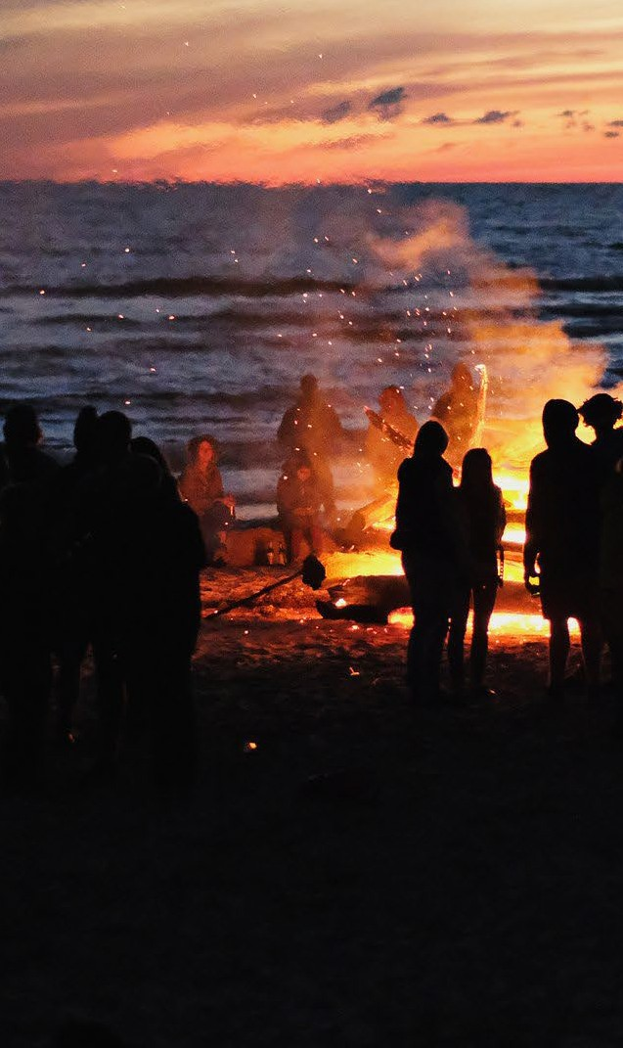
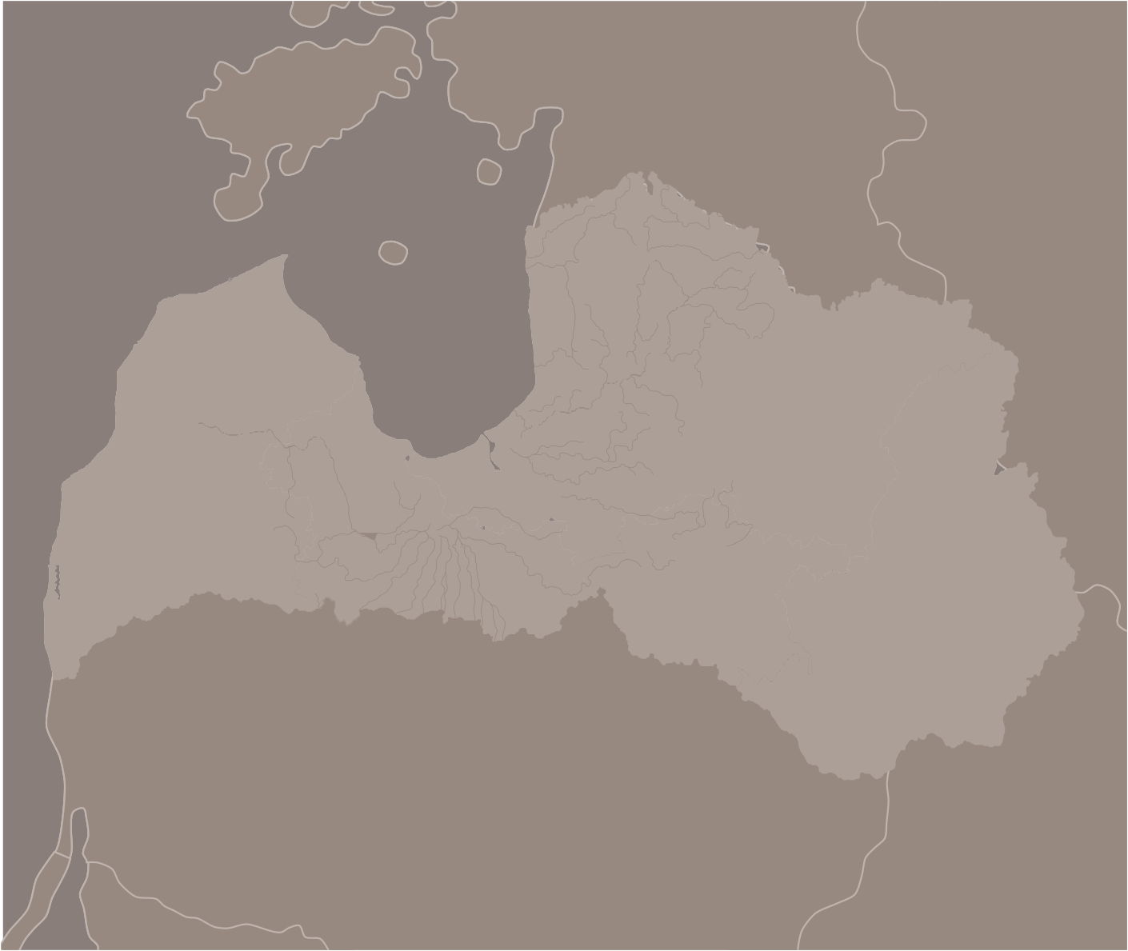





Estonia
In all Latvia
Russia
Baltic Sea
Latvian cuisine, our love for handmade crafts and ancient traditions spread across the country. Special occasions like the summer solstice are celebrated in all Latvia without exceptions.
Valmiera
Ventspils
Aluksne
Cesis
Sigulda
Vidzeme
Kuldiga
Riga
Jurmala
Kurzeme
Liepaja
Jelgava
Ludza
Zemgale
Bauska
Rezekne
Jekabpils
Latgale
Daugavpils
Lithuania
Belarus

Slide 21
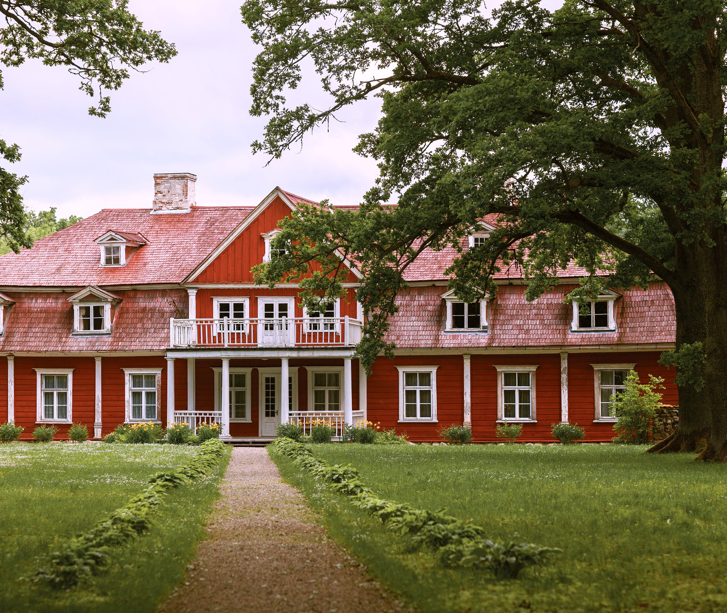
Rebirth
of manors
Latvia has inherited plenty of manors and castles from previous rulers over time.
Now is the time that the once splendid buildings are regaining former glory.
Many today serve as state-of-art boutique hotels, workshop centers or museums.
pilis.lv/en

Slide 22
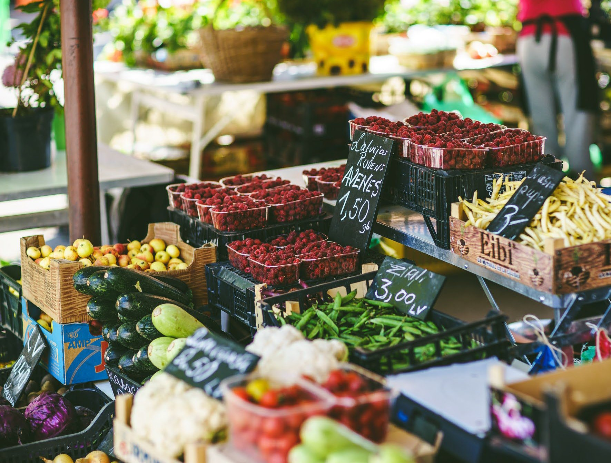
Gastronomy and local cuisine
Fishing in rivers, lakes and the sea, foraging mushrooms and berries, hunting - local people have always embraced everything nature has to offer. It's clearly noticeable in Latvian cuisine - natural ingredients, including ecologically grown vegetables and fruits, are a must-have.
Because of the long winters, Latvians are also the masters of pickle and jam making, preserving food in delicious ways. These goods are typically sold in farmer's markets like the Night Market and Kalnciema Quarter Market.
celotajs.lv/en

Slide 23
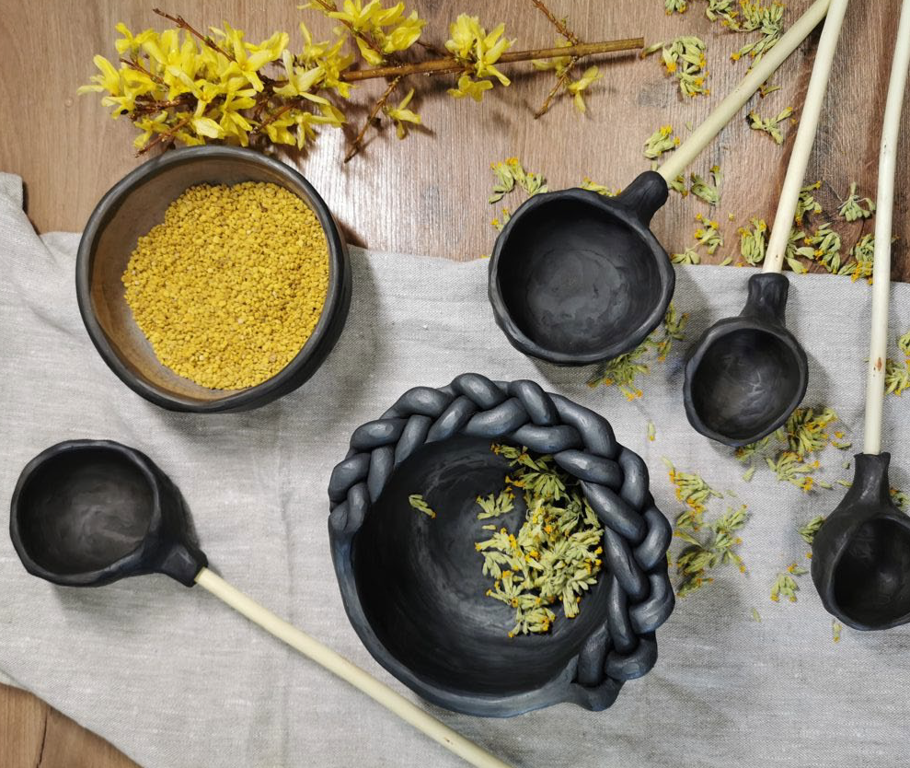
Latvian crafts
Craftsmanship is no stranger to Latvia. Black clay, knits and handmade national costumes are just a small part of what we're masters of.
Regular craft markets are held and goods often can be bought straight from their maker, while hearing their story and perhaps even receiving a discount in exchange for a smile.
celotajs.lv/en

Slide 24
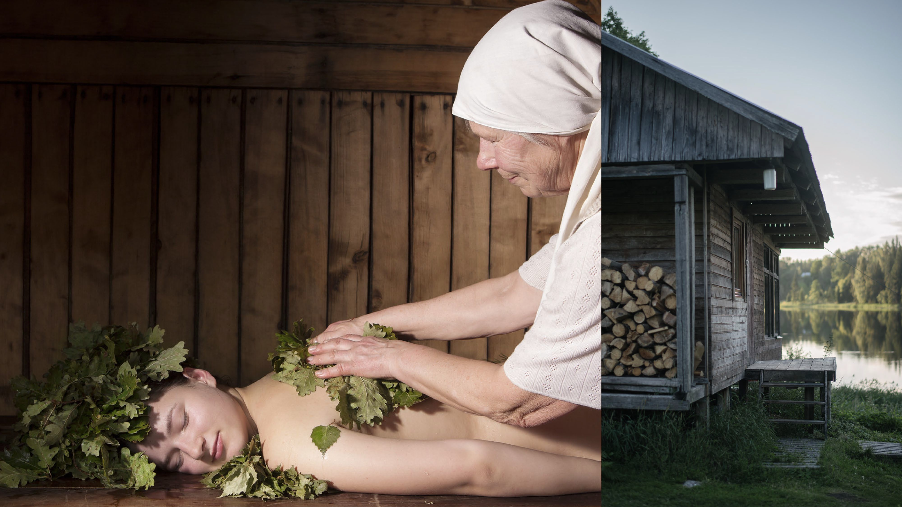
Latvian Bath house
Latvia has deep-rooted sauna traditions that can't be separated from nature - it's not a sauna without bath brooms from birch and other plants. Many countryside saunas offer sauna rituals held by the bather
– master of pagan traditions.
celotajs.lv/en

Slide 25
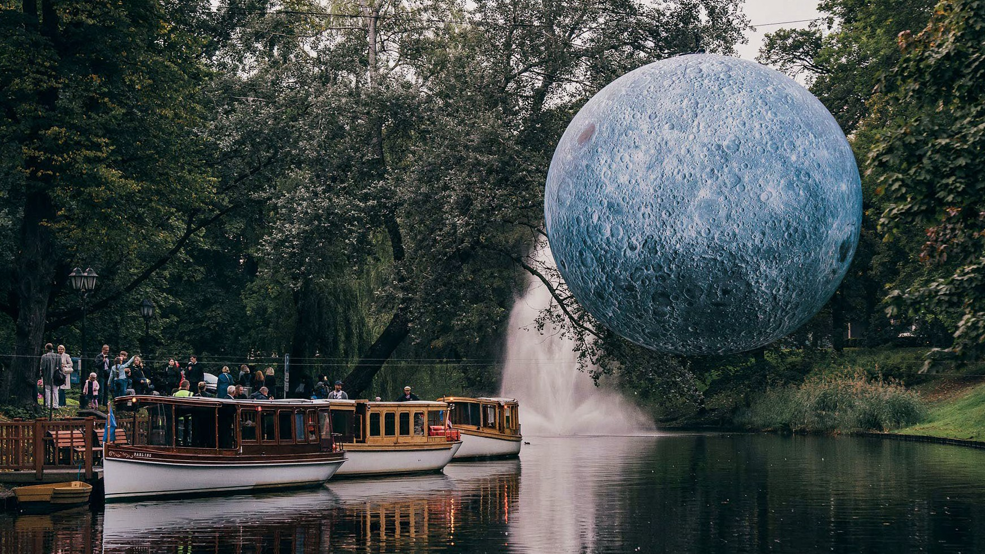
Must-see events
Latvia always offers opportunities to visit open air performances, art shows, exhibitions and festivals dedicated to themes like art, creativity, music, sports and even science. Day or night, all seasons of the year are saturated with things to see and shows to attend.
latvia.travel
liveriga.lv

Slide 26
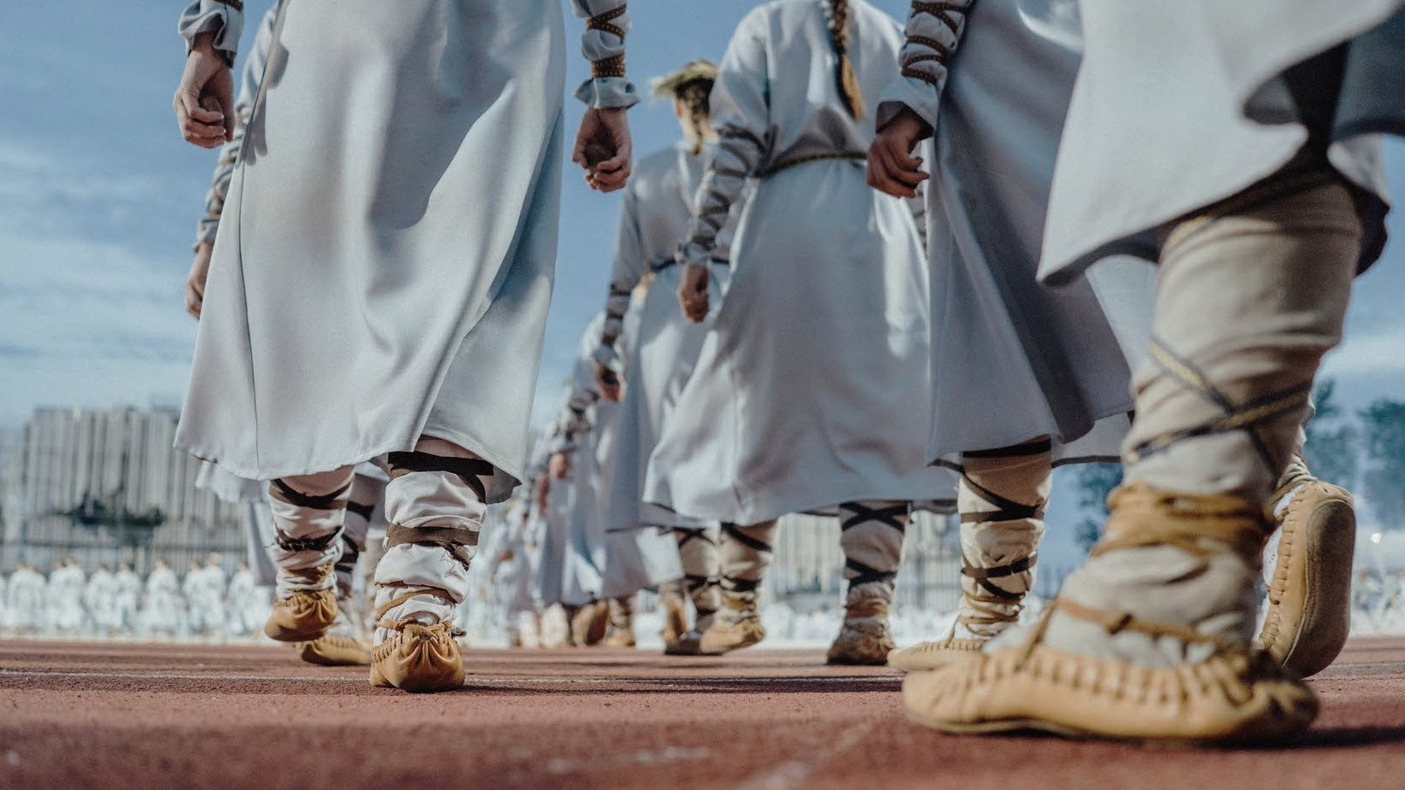
Song
and Dance celebration
Since 1873, once every 5 years
approximately 30,000 performers altogether participate in the song and dance event. Hundreds of choirs and folk dance groups perform in front of thousands of viewers. It's not an exaggeration to call it the main event in Latvian culture.
Song and Dance celebration has been in UNESCO heritage since 2008. The next celebration will be held in 2023 and lasts a week.

Slide 27
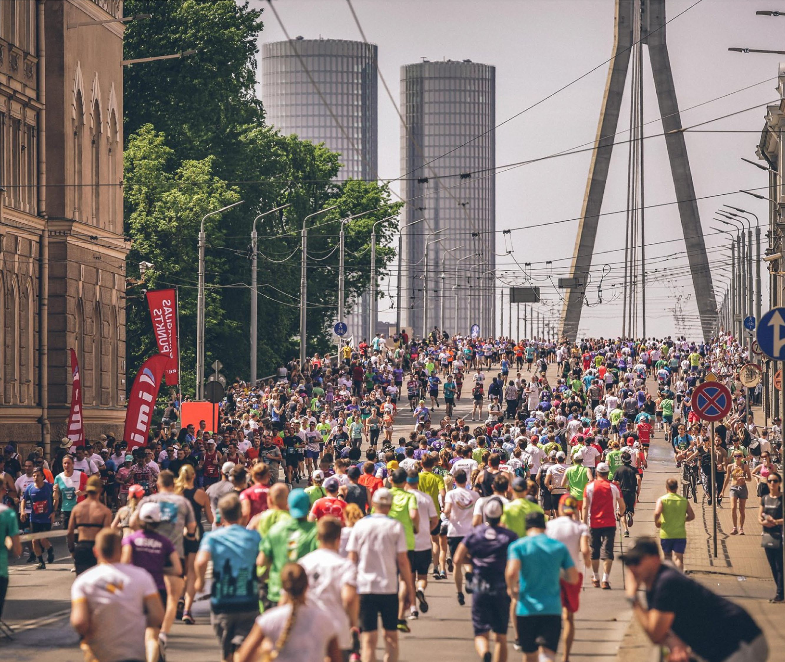
Riga Marathon
Largest running event in Latvia and the most ambitious public sporting event in the Baltics. Marathon's course is set on both sides of river Daugava, goes through Art Nouveau district, medieval Riga old town and even wooden architecture district.
Recently World Athletics has awarded the marathon with Gold Label, once again placing it among the most prestigious marathons in the World.
liveriga.lv

Slide 28
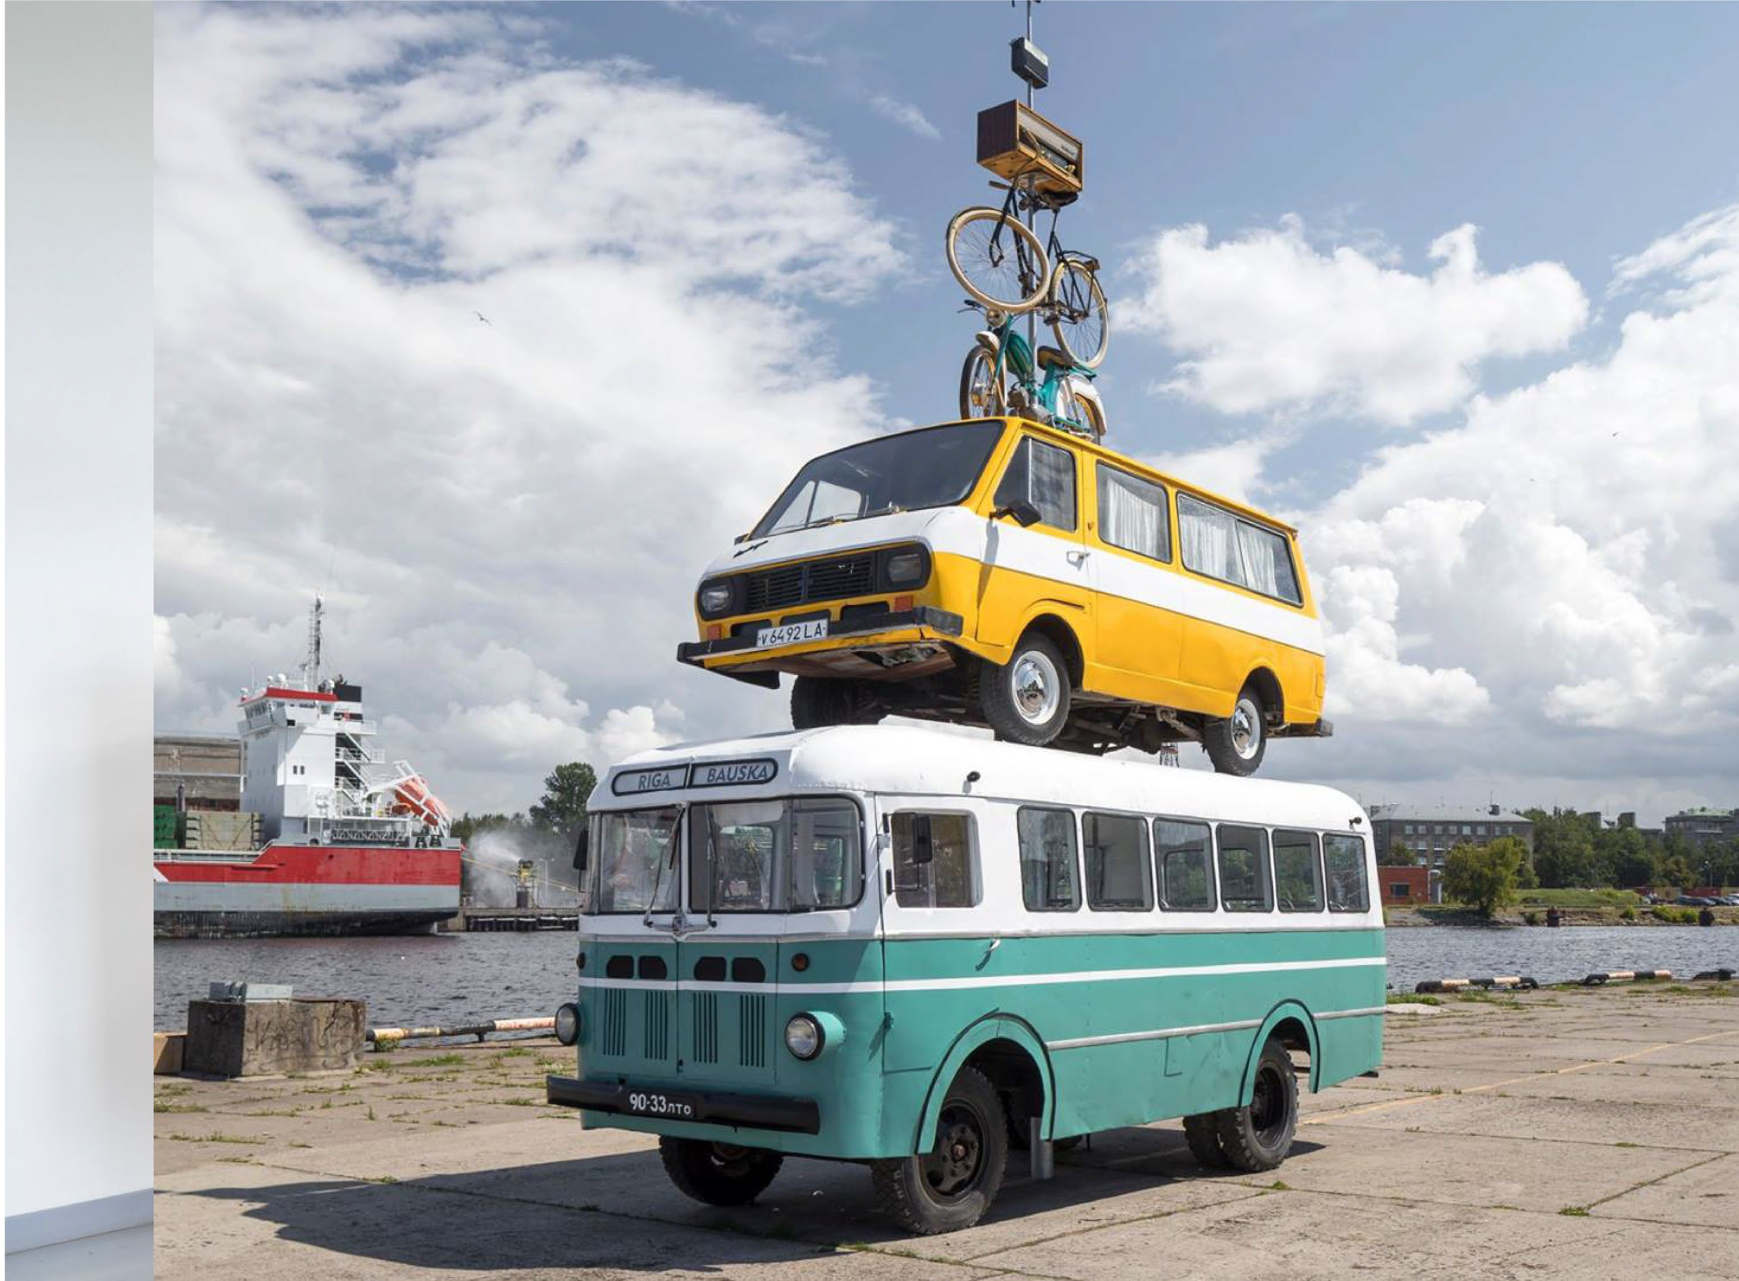
Riga International Biennial of
Contemporary _{Art} (RIBOCA)
Founded in 2016, the annual biennial serves as a platform for local and international artists, promoting contemporary art and acting as an educational tool.
RIBOCA aims to increase artistic engagement between Baltic region and the rest of the world. The underlying framework is the rich history of Riga and Baltic states, while the working process starts from the local, expands to regional and finally to the transnational.
rigabiennial.com

Slide 29
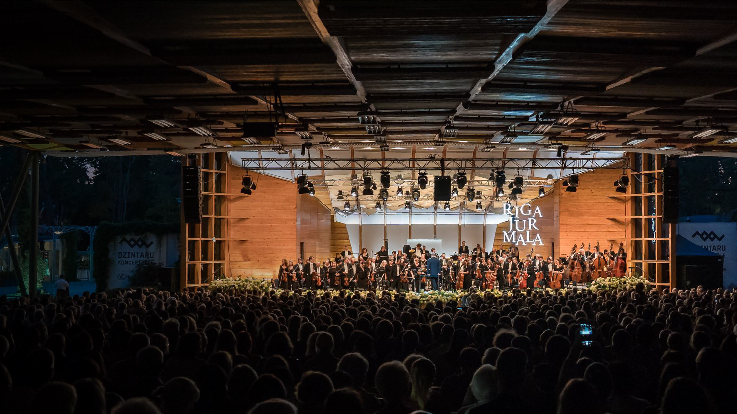
Riga Jurmala music festival
Launched in 2019, the international music festival is dedicated to classical music, gathering together the planet's best orchestras and conductors. Festival's ambitions are high- to become one of the world's greatest classical music events.
Event is also special with it's dual location - Riga and resort city Jurmala, that makes it extra appealing to visitors.
riga-jurmala.com

Slide 30
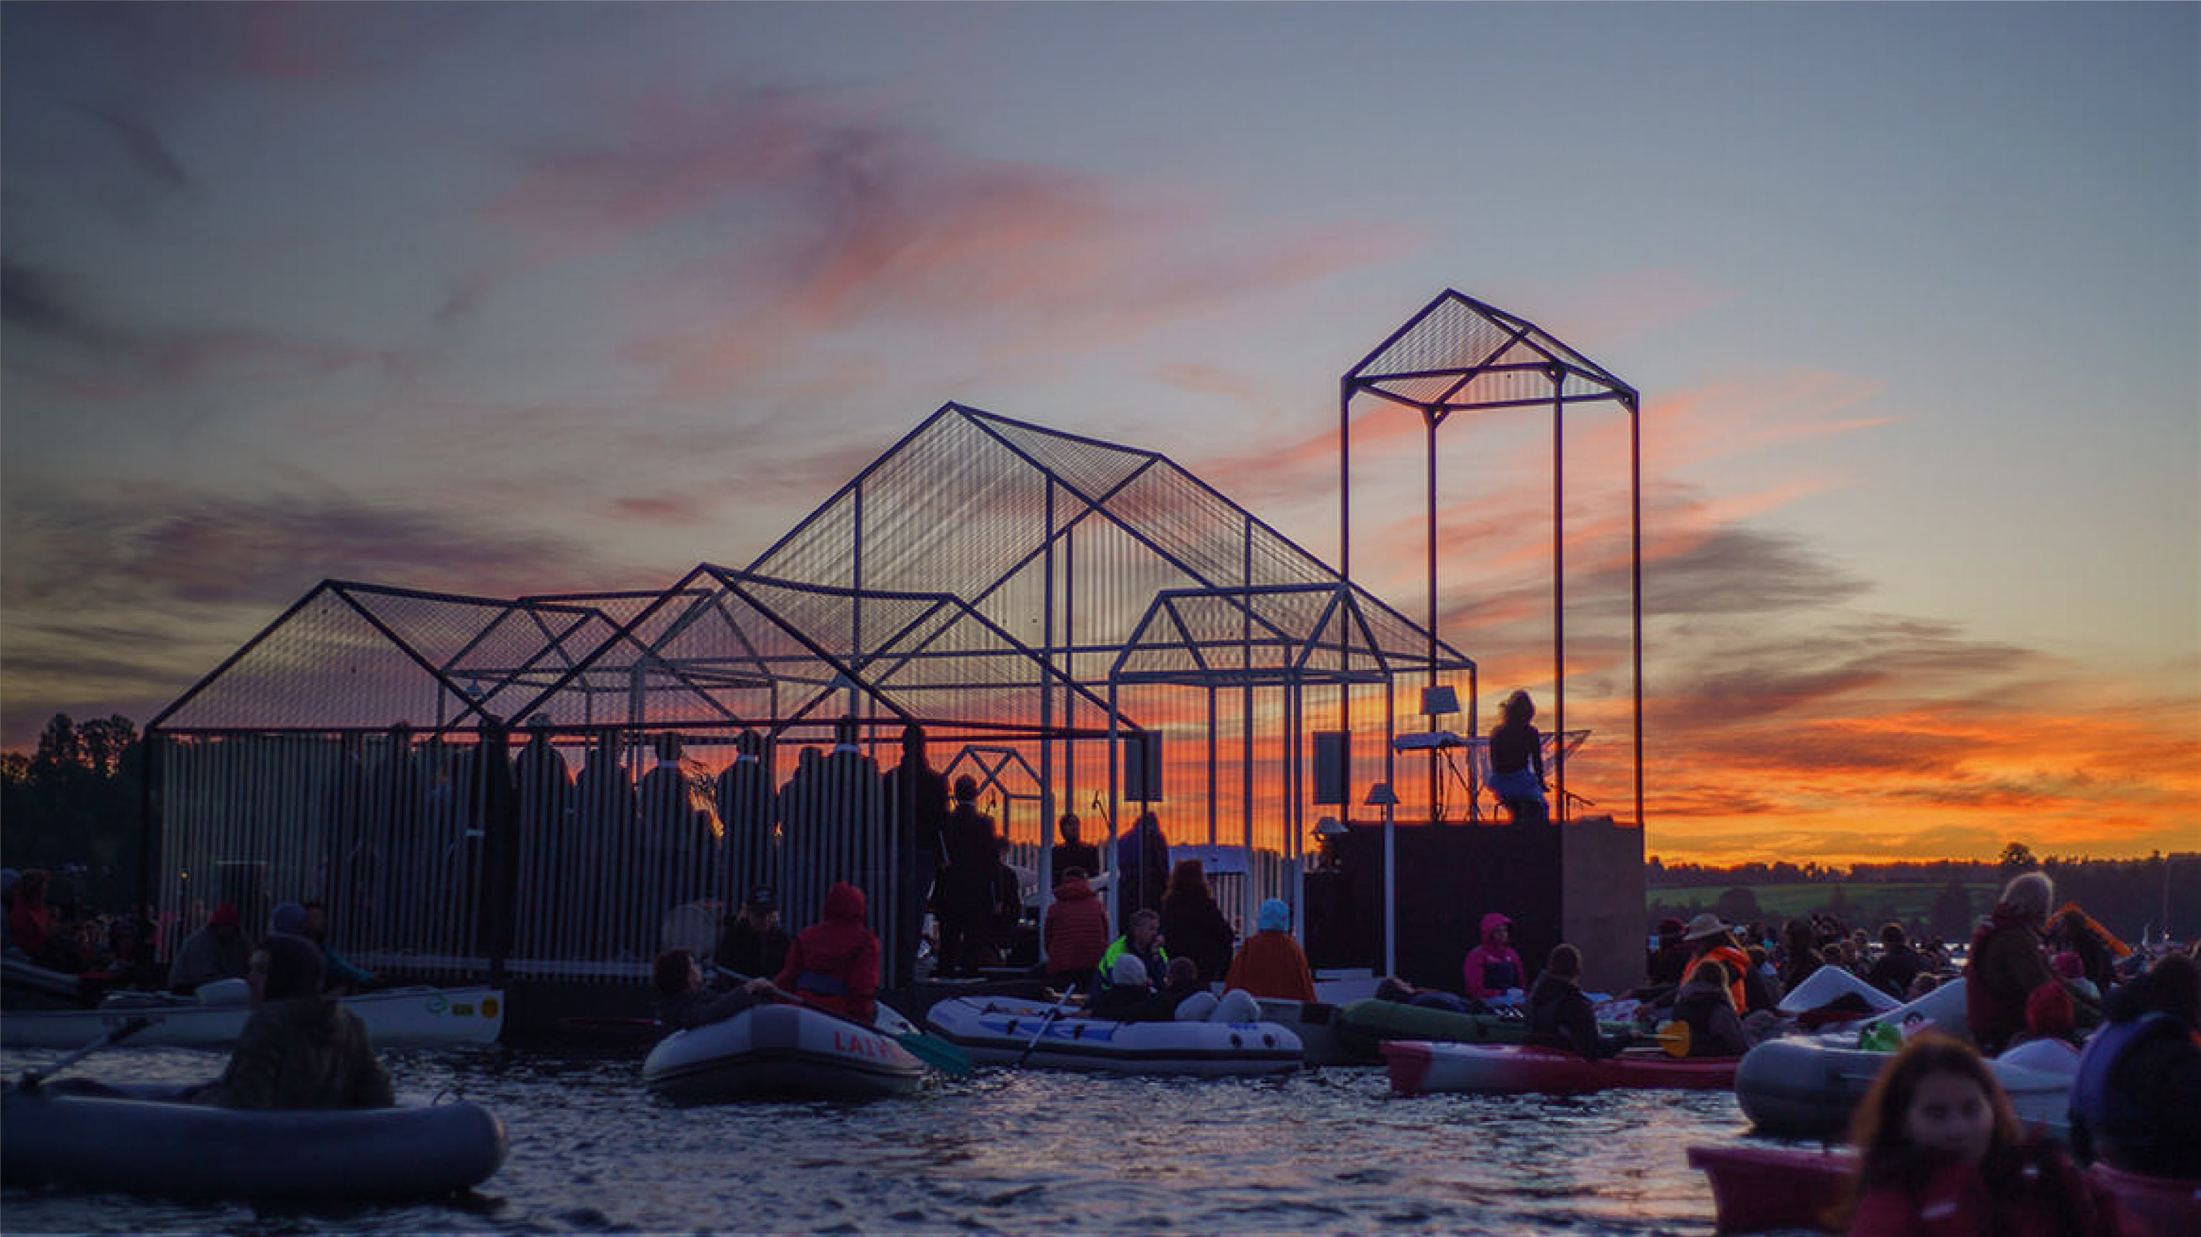
Ezera skanas
(Sounds of lake)
Musical and visual event in Kala ezers before the sunrise at 4 in the morning.
Audience arrive in their boats during the middle of night to be closer to the stage at the center of the lake. The perfor- mance changes together with the amount of light - it grows from delicate sounds and culminates with the sunrise.
Visitors are advised to enjoy the magical event in absolute silence. Those who have been there once, return again and again.
ezeraskanas.lv

Slide 31












TRAVEL
Investment and Development Agency of Latvia
Tourism department
tourism@liaa.gov.lv
Magnetic Latvia Travel
LatviaTravel
LatviaTravel
tourism@liaa.gov.lv
latvia.travel

